Slide 1
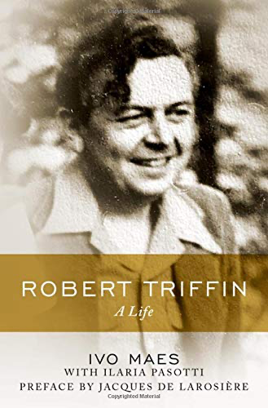
A superb biography…
Search for the man if you want to understand the economist
Comprehensive
Thoroughly researched (24 archives all over the world)
Oral history
Engaging, full of insightful details
Pleasantly written
I shall only highlight some of the issues that interested me most

Slide 2
… of an extraordinary person (and economist)
«I prefer to be wrong nine times out of ten, if I can contribute once in ten times to divert us from catastrophe, and help build a better future»
The son of a butcher, first to go to high school in the family, Harvard PhD.. Baron of the Kingdom of Belgium
Best known as forecaster of the end of Bretton Woods, but..
Builder of South American central banks
Among the early architects of a United Europe
Always a policy-oriented economist

Slide 3
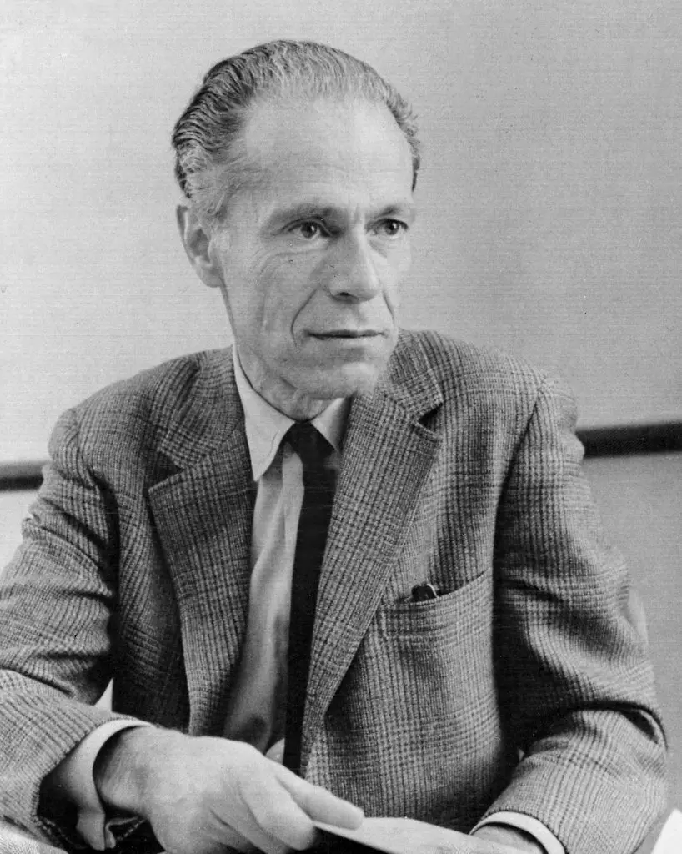
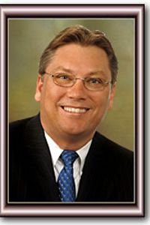
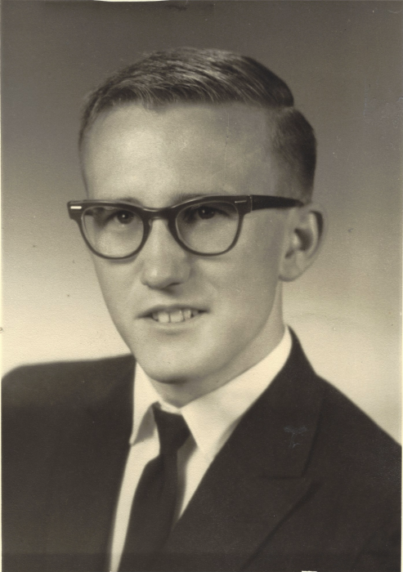
Parterre de rois
Alexander Gerschenkron
Albert Hirshmann
Lloyd Metzler
Randy Hinshaw
Frank Tamagna
Tobin, Viner, Samuelson, Prebish,
Baffi, Carli, Caffè..
I don’t find Kindleberger but he was of the same mould

Slide 4
Young postwar architects: what did they have in common?
Young adults in the 1930s and WWII, “lessons” brought home (for Triffin they included the 1935 devaluation of the Belgian Franc)
Pragmatic (skeptical of gold standard, automatic adjustments, and unconstrained capital movements)
«I do not defend, any more than I reject, all controls in globo» (Triffin)
The (economics profession) as a mission, political and ethical
Citizens of the world with solid roots in their countries of origin

Slide 5
Triffin on central banks
No single blue print: various types of central banks reflect the history, institutions and level of economic development of each individual countries
Bank of England an exception rather than the model
Three types of CBs: a) discount banks, b) all purpose CBs, c) Modern CBs (up to date techniques on money management including open mkt operations, supervision of banking system, control on capital movements and exchange rates)
Skeptical of central bank independence

Slide 6
Architect of Europe
Involved in the creation of the European Payments Union (EPU). Now an almost forgotten institution, crucial for the subsequent drive towards the EEC.
Advocate of a European single currency
Aware of the different traditions and development levels of Western European countries.

Slide 7
Triffin on the International Monetary Architecture (ahead of his time?)
At the core of his preoccupations was the liquidity position of the international monetary system
Displacement of commodity money by fiduciary money will be duplicated in the international field by a similar displacement of gold reserves by fiduciary reserves by money.
“internationalization” of the foreign exchange component of the world's international reserves.

Slide 8
Question for Ivo: Triffin, BW and the ”Consensual hegemony”
Charles Mayer explained the sustainability of the BW system by coining the (oxymoric?) idea of “Consensual hegemony”. The system lasted as long as both Europe (+ Japan) and the US found it advantageous to accept its costs (Exorbitant privilege and domestic policy constrains by the US),
As long as both sides accepted to play by the implicit rules of consensual hegemony, the system could go on indefinitely. Its roots rested on political rather than economic factors.
T. was surprised that BW lasted longer than he had anticipated, he was culturally savvy enough to appreciate the political implications of BW. Did he understand the reasons for the long life of BW and for its demise (including the Vietnam War he was so much against to)?

Slide 10
THANK YOU IVO (& ILARIA)
I learned a lot and enjoyed even more in reading your work

