Slide 1
Learning About Leave:
Peer Influences in Maternal Leave Decisions
Isabelle Sin (Motu)
Steven Stillman (U Bolzano)
Nicholas Watson (Motu)

Slide 2
Disclaimer
These results are not official statistics. They have been created for research purposes from the Integrated Data Infrastructure (IDI) and Longitudinal Business Database (LBD) which are carefully managed by Stats NZ. For more information about the IDI and LBD please visit https://www.stats.govt.nz/integrated-data/.
The results are based in part on tax data supplied by Inland Revenue to Stats NZ under the Tax Administration Act 1994 for statistical purposes. Any discussion of data limitations or weaknesses is in the context of using the IDI for statistical purposes, and is not related to the data’s ability to support Inland Revenue’s core operational requirements.
This presentation represents work in progress and is not a final publication.

Slide 3
Our Contribution
We examine how the parental leave decisions of mothers are influenced by parental leave decisions made by their work colleagues (henceforth, peers) using tax data on the universe of women who gave birth in New Zealand between 2002 and 2018
Maternal leave in New Zealand has a 100% replacement rate up to a fairly low maximum, we use a regression kink design (RKD) to estimate the causal impact of peer leave on a women’s own leave decision

Slide 4
Related Literature
Welteke & Wrohlich, 2019
Investigate the peer effect in parental leave decisions of mothers in Germany.
Use an instrumental variables (IV) approach, where a reform to the parental leave payment scheme serves as the instrument.
a mother is about 30 pp more likely to stay at home during the first 10 months if her peer decides to do so in response to the benefit reform
Dahl et al. 2014
Look at peer effects in paternity leave.
Use a regression discontinuity design where the source of exogenous variation arises from a reform that provides 1 month of leave solely for paternal leave.
Coworkers and brothers are 11 and 15 pp, respectively, more likely to take paternity leave if their peer takes leave because of the reform

Slide 5
Paid Parental leave (PPL) in New Zealand
The PPL payment that mothers receive is calculated as the higher of 100% of employee’s ordinary weekly pay before starting leave and their average weekly earnings in the 26 highest earning weeks of the 52 previous
This is up to a maximum PPL amount which was $325 when first introduced in 2002 and increases each year based on measured average wage increases for all employers.
Average wages among mothers are around $540 per week (in 2002$s).
PPL was available for 12 weeks when introduced in 2002, which has been expanded gradually to 26 weeks in 2020
Women are eligible for leave if they have been employed for the same employer for at least an average of 10 hours a week in either the 26 or 52 weeks preceding the expected birth/adoption date.

Slide 6
Data
New Zealand Integrated Data Infrastructure (IDI) links monthly tax data to other administrative data included birth records
We start with the universe of women who gave birth in New Zealand between 2002 and 2018 (called study mothers).
We drop women who were not eligible for leave (including those not working)
We link study mothers to all other women that have given birth while working at the same firm as the study mother in the two years before the study mother gave birth and were eligible for paid parental leave (PPL)
Each peer-study mother observation is given a weight that is inversely proportional to the number of peers linked to that study mother.

Slide 7
Key Variables (1)
Pre-birth income (running variable)
We calculate for each peer mother (and the study mother) the weekly average from the 6 months of highest earnings (including partial months) in the year prior to childbirth.
We focus on net income as initial checks revealed that mothers exhibited the strongest behavioral response to the maximum PPL threshold relative to their net after-tax income (despite PPL payments being calculated from gross income).
We drop all peers whose gross income is above the PPL threshold, but whose net income is below the same threshold creating a doughnut hole in the distribution

Slide 8
Key Variables (2)
Leave duration (main outcome)
We do not directly observe maternity leave taken for all woman
We instead measure leave by periods of missing income within a window around childbirth.
Average monthly income is calculated for each place of work
Partial month absence is calculated based on the difference between earnings in said month and the average monthly earnings for that workplace.
Leave duration and income are scaled to weekly measures.

Slide 9
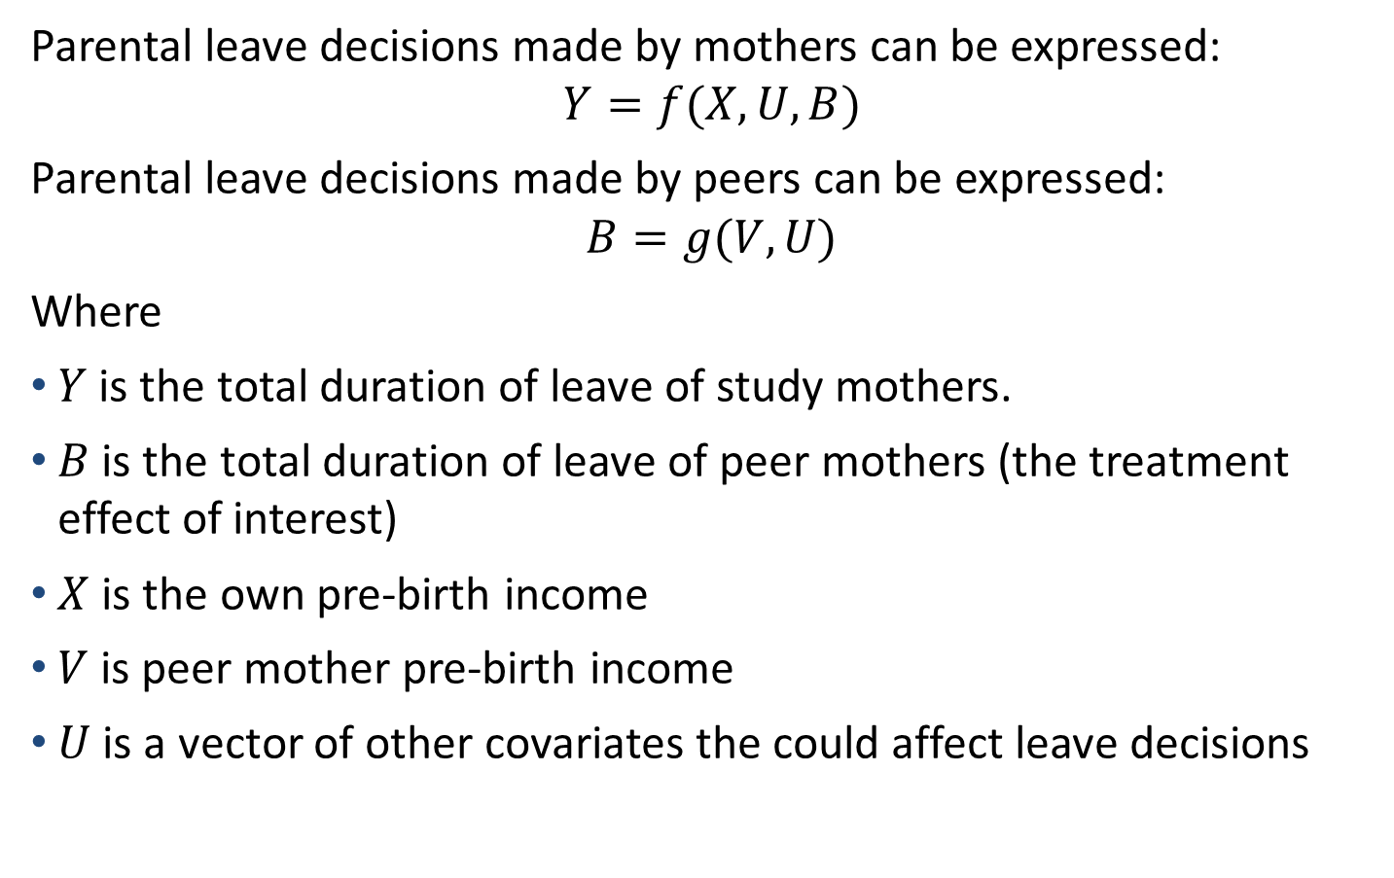
Modeling Parental Leave
Parental leave decisions made by mothers can be expressed:
$$Y=f(X, U, B)$$
Parental leave decisions made by peers can be expressed:
$$B=g(V, U)$$
Where
$Y$ is the total duration of leave of study mothers.
$B$ is the total duration of leave of peer mothers (the treatment effect of interest)
$X$ is the own pre-birth income
$V$ is peer mother pre-birth income
$U$ is a vector of other covariates the could affect leave decisions

Slide 10
Control Covariates
Child
  month and year of birth (also for peers)
  whether a premature birth
Mother (also for peers)
  maximum potential PPL duration
  Age (quadratic), ethnicity
  number of previous children (sometimes we focus on first births)
  previous social benefit usage
Father
  age, employment status, and earnings
Job
  tenure, average wages at the firm
  firm size (sometimes we focus on smaller firms)
  whether the firm is part of central government

Slide 11
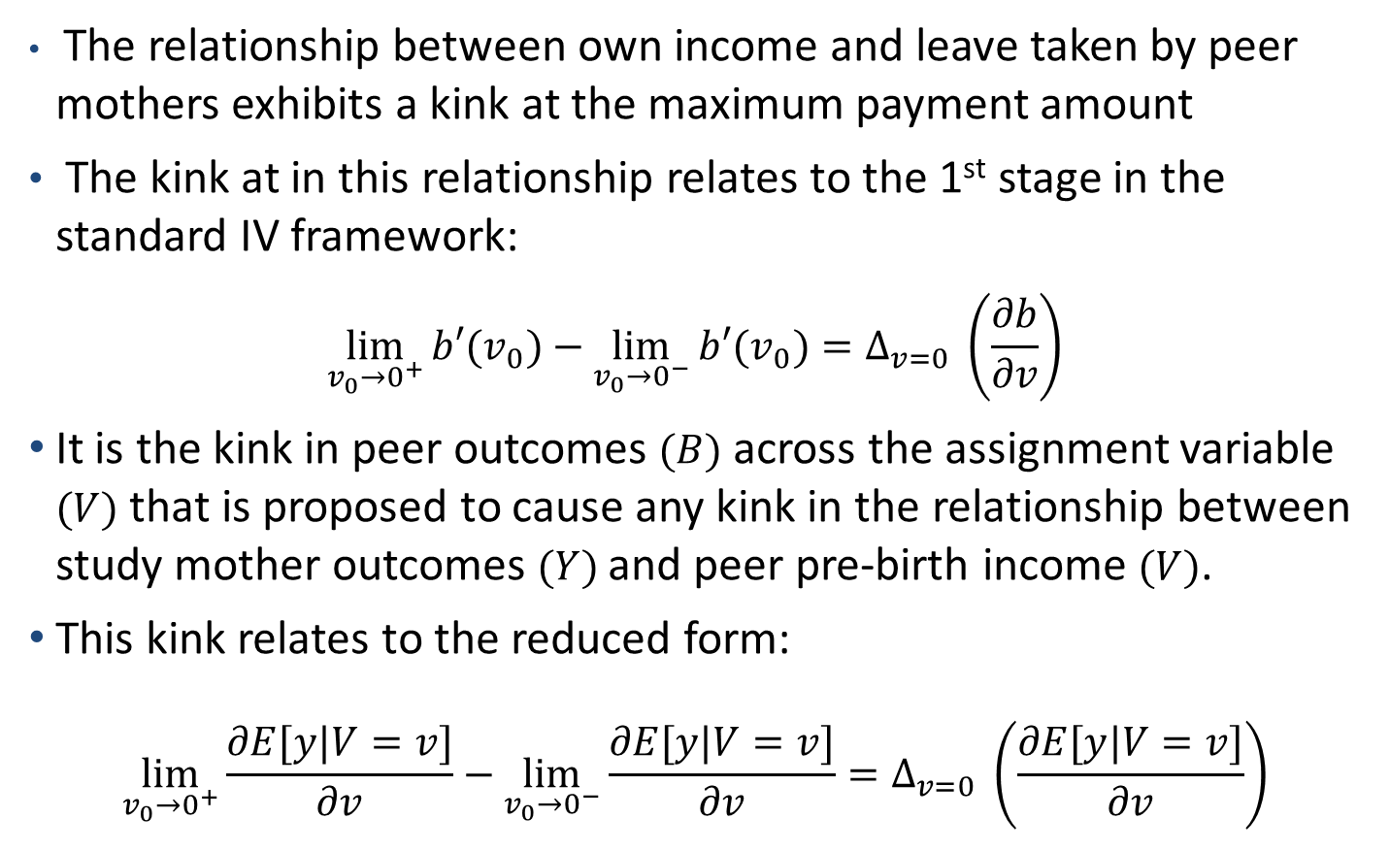
RKD Identification
The relationship between own income and leave taken by peer mothers exhibits a kink at the maximum payment amount
The kink at in this relationship relates to the 1st stage in the standard IV framework:
$$\lim_{v_{0}→0^{+}}{b′(v_{0})}−\lim_{v_{0}→0^{−}}{b′(v_{0})}=Δ_{v=0} \left(\frac{∂b}{∂v}\right)$$
It is the kink in peer outcomes $(B)$ across the assignment variable $(V)$ that is proposed to cause any kink in the relationship between study mother outcomes $(Y)$and peer pre-birth income $(V)$.
This kink relates to the reduced form:
$$\lim_{v_{0}→0^{+}}{\frac{∂E[y|V=v]}{∂v}}−\lim_{v_{0}→0^{−}}{\frac{∂E[y|V=v]}{∂v}}=Δ_{v=0} \left(\frac{∂E[y|V=v]}{∂v}\right)$$

Slide 12
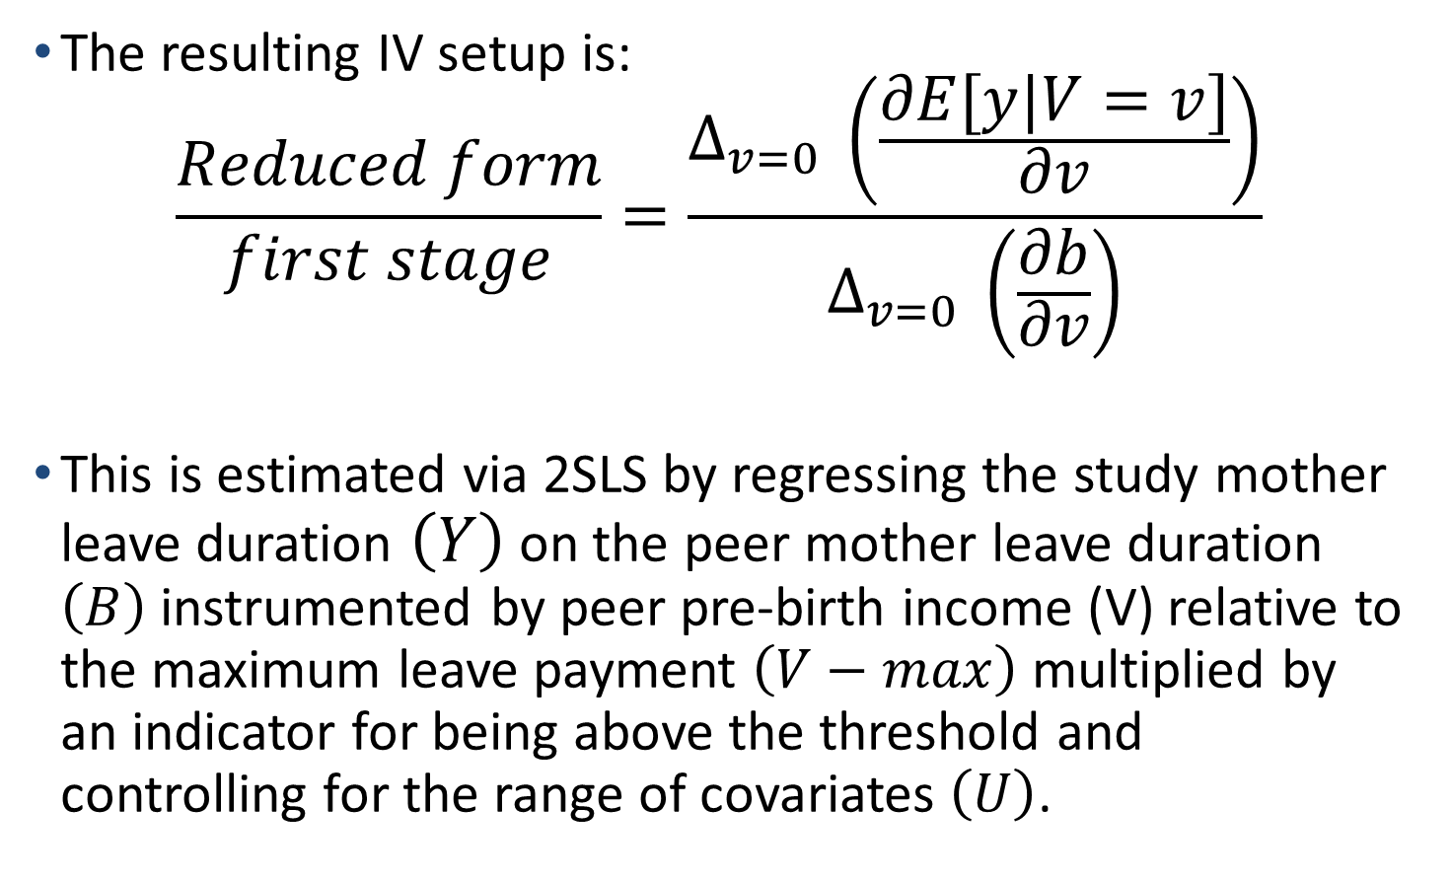
RKD Estimation
The resulting IV setup is:
$$\frac{Reduced form}{first stage}=\frac{Δ_{v=0} \left(\frac{∂E[y|V=v]}{∂v}\right)}{Δ_{v=0} \left(\frac{∂b}{∂v}\right)}$$
This is estimated via 2SLS by regressing the study mother leave duration $\left(Y\right)$ on the peer mother leave duration $\left(B\right)$ instrumented by peer pre-birth income (V) relative to the maximum leave payment $\left(V−max\right)$ multiplied by an indicator for being above the threshold and controlling for the range of covariates $\left(U\right)$.

Slide 13
First Stage
Treatment (Peer Leave)
A
PPL Max
Assignment variable (Peer Income)
Reduced Form
B
Outcome (Study Mother Leave)
PPL Max
Assignment variable (Peer Income)
Notes:
RKD is similar to RDD, except rather than a discontinuity of treatment at a given threshold, we look at a change in the rate of treatment.
Treatment in this case being peer leave duration. Dividing B by A gives us our causal effect of treatment.

Slide 14
2SLS parametrization
Bandwidth selection: We use a $200 bandwidth around the maximum payment threshold, then check alternative selections in a series of robustness checks.
Polynomial specification: Because the theoretical impact of a maximum threshold is a change in slope, only a linear model is estimated
Kernel: Following Card et al. (2015) we use a uniform kernel. This allows us to estimate the causal effect using 2SLS.

Slide 15
Requirements for the validity of RKD
There is no manipulation of the assignment variable at the kink point.
  The conditional density function of the assignment variable and it’s first derivative are inspected for discontinuities.
There should be no discontinuities or change in slope at the kink point for other covariates.
  We inspect the evolution of a ‘covariate index’ (fitted values for the outcome of interest, estimated from the range of covariates) to see if this evolves smoothly across the kink point.
There should be a tangible kink in the 1st stage and reduced form.
  We inspect the kinks in the 1st stage and reduced form graphically and check the statistical significance for the change in slope of the first stage using OLS.

Slide 16
McCrary Test

Slide 17
Covariate Index

Slide 18
First stage

Slide 19
Main results – 2SLS (1)

Slide 20
Main results – 2SLS (1)

Slide 21
OLS

Slide 22
Conclusions
We observe a small positive correlation between the maternity leave duration of co-workers
However, if one’s co-workers reduce their maternity leave duration because they earn more than the maximum possible leave, this has large impacts on one’s own leave decision
This impact is even stronger at smaller firms and for women giving birth to their first child
Peer Matter for important life decisions!!

