Slide 1

An anatomy of US establishments’ trade linkages in Global Value Chains
Discussion
Rome – 14/11/2024
L. Boeckelmann (ECB)

Slide 2
In a nutshell
This paper
Key findings on US GVCs
Measure the source-specific imported input content of US establishments’ output and export using confidential, micro-level datasets.
Study the role of frictions and policy in multi-country linkages.
For every dollar of exports, imported products represent a much higher share than aggregate data suggests.
Strong complementarities in input and output markets.
There is a strong positive association between regional trade agreements and GVC flows.
Aggregation bias and import proportionality assumptions in IO tables mute relationships

Slide 3
Overall assessment
Great paper.
Very promising dataset
A straightforward and very compelling story. Nicely thought and executed.

Slide 4
Data and GVC measure (2/2)
Still, some proportionality assumptions applied, but (very) limited in comparison.
Paper introduces (great!!!) dataset, and authors already provide a range of descriptives of the dataset but would be great to see more.
Perhaps, a heatmap with input cost shares (source country times US sector ~Figure 4) of ‘true’ input shares vs. biased shares from aggregate IOs: first indication where in the data the proportionality assumption is particularly off

Slide 5
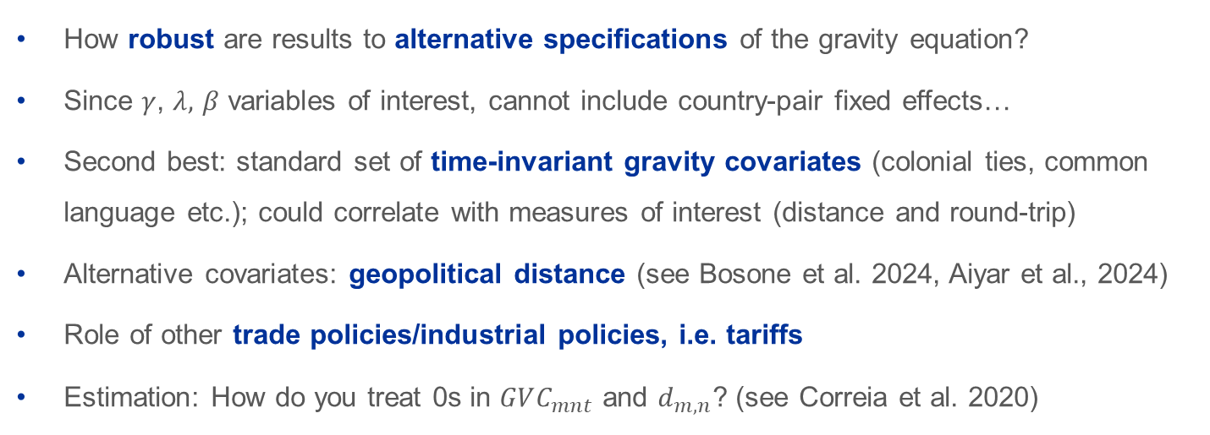
Gravity framework
Round trip trade
Regional trade agreem.
Importer & Exporter FE
$$\log\left(GVC_{mnt}\right)=α+δ_{m,t}+η_{n,t}+γd_{m, US,n}+λd_{m,n}+βI\left(m=n\right)+ζRTA_{m, n, US, t}{+ε}_{mn,t}$$
Distance (cum. and direct)
How robust are results to alternative specifications of the gravity equation?
Since $γ$, $λ,$ $β$ variables of interest, cannot include country-pair fixed effects…
Second best: standard set of time-invariant gravity covariates (colonial ties, common language etc.); could correlate with measures of interest (distance and round-trip)
Alternative covariates: geopolitical distance (see Bosone et al. 2024, Aiyar et al., 2024)
Role of other trade policies/industrial policies, i.e. tariffs
Estimation: How do you treat 0s in $GVC_{mnt}$ and $d_{m,n}$? (see Correia et al. 2020)
Notes:
I = anything that is equal m and n,
Stuff time in-variant
Lack controls that could influence the beta.
Robustness checks.
- tariffs
- geopolitical distance

Slide 6
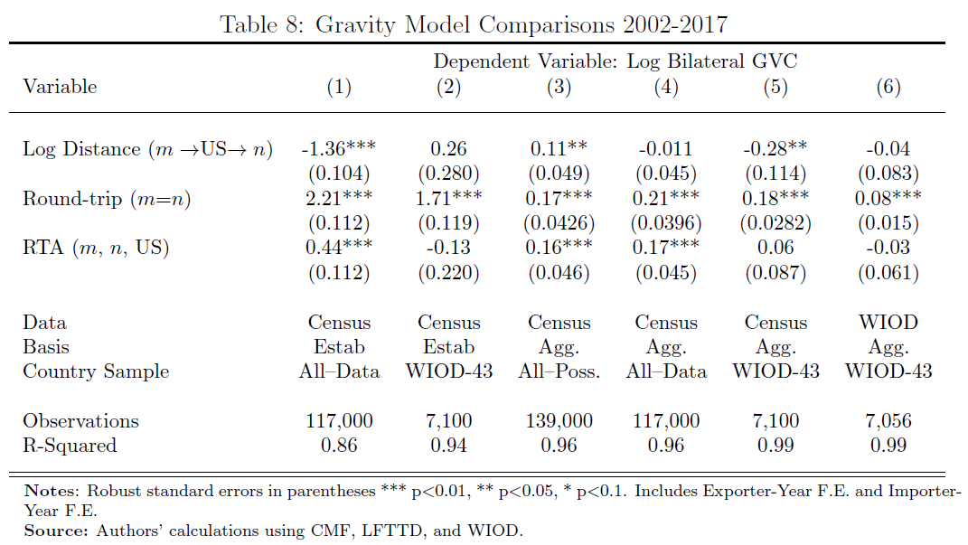
Source of bias when using global IO tables (1/2)
Country coverage
Aggregation bias
Proportionality assumption
3 potential sources of bias, i.e. in determinants of GVS
Notes:
Authors go different route. In fact, three elements
Assume 20%. Unfortunately, no motivation. But thinking about it, very reasonable policy scenario. -> merits more motivation/discussion. Other papers show elasticities, this is actually a Realistic scenario

Slide 7
Source of bias when using global IO tables (1/2)
Country coverage
Aggregation bias
Proportionality assumption
3 potential sources of bias, i.e. in determinants of GVS
Notes:
Authors go different route. In fact, three elements
Assume 20%. Unfortunately, no motivation. But thinking about it, very reasonable policy scenario. -> merits more motivation/discussion. Other papers show elasticities, this is actually a Realistic scenario

Slide 8
Source of bias when using global IO tables (1/2)
Country coverage
Aggregation bias
Proportionality assumption
3 potential sources of bias, i.e. in determinants of GVS

Slide 9
Source of bias when using global IO tables (2/2)
Informative exercise!
Is WIOD a good benchmark global IO table to be compared against?
  Standard IO table in literature
  Main interest: check effect of aggregation bias and proportionality assumptions.
    But small country coverage of WIOD drives alternative gravity results also due to disproportionate representation of EU countries
    Somewhat limits the takeaways from assessment of proportionality assumption.
  WIOD has large RoW bloc with many small countries – aggregating micro data masks many 0 entries in the bilateral GVC indicators
    Could lower the estimated effect of proportionality assumption, as we ignore these extreme cases of 0 bilateral linkages
  Global IO table with more small economies, i.e. OECD ICIO or ADB MRIO

Slide 10
Policy takeaways
Aggregation matters!!!
We often rely on multi-country IO tables to quantify macroeconomic effects from trade decoupling and critical / strategic exposures
Under certain conditions, aggregate data may mask critical exposures. Moreover, when calibrating multi-country multi-sector models with aggregate IO tables, can face additional biases (see Attinasi et al, forthcoming)
Calls for the use of microdata/survey and collaborations among central banks / NSA for access to and production of micro-level data (see ESCB, forthcoming)

Slide 11
Wrap up
Super interesting paper: Aggregation matters!!!
Excellent data work, great dataset with plenty of potential for future research
Careful analysis
More on robustness in gravity models and the bias in multi country IO tables

Slide 12
THANK YOU
This presentation should not be reported as representing the views of the European Central Bank (ECB). The views expressed are those of the authors and do not necessarily reflect those of the ECB and the BdI.

