Slide 1
Infrastructure Investment and Public Sector Balance Sheets: Evidence from the US States
Andrew Haughwout (NY Fed) Robert Inman (Wharton, U of Pennsylvania and NBER)
The views expressed are ours and do not necessarily reflect those of the Federal Reserve Bank
of New York or the Federal Reserve System.
Notes:
https://www.newyorkfed.org/medialibrary/media/research/staff_reports/sr787.pdf?la=en

Slide 2
Overview
Much concern in US about fiscal stress on state and local govts
Prior to Great Recession, but especially since
Changes in public program costs
Medicaid
Public employee pensions and OPEB
A rash of high-profile failures (Detroit, Puerto Rico)
Public infrastructure investment has also been a concern
States play a large role in building and maintaining infrastructure
E.g., highways almost entirely state (and local) –owned
High profile infrastructure failures (eg, Minneapolis bridge collapse 2007 killed 13, injured 145)
Large estimates of “infrastructure gap”
Any connection?
Notes:
Household stress testing quite commonly done in other countries – e.g. UK, Australia, Sweden. Mostly focusing on affordability.

Slide 3
State Fiscal Stress

Slide 4
Sources of pressure on state budgets
Increasing relative health costs
Medicaid
Employees
Narrowing revenue bases
Especially sales tax via e-commerce
Also in income
Low employee pension returns
Low interest rate environment

Slide 5
State fiscal institutions and balance sheets
Balanced budget requirements in 49 states
Vermont is the exception
BBRs refer to operating budget
But state budgets have several other elements
Intra-year funding (STD)
Capital budget
Can (sometimes) use debt finance, typically LTD
Savings accounts
Eg, rainy day funds
Pension funds
Other contractual commitments
Eg, health insurance for retired employees
This makes state balance sheets interesting and worthy of study

Slide 6
State Balance Sheets

Slide 7
State balance sheets
Many ways to combine and examine balance sheets
We propose a general framework, then adjust as needed for projects
General Framework:
Cash account
Liquid assets and ST liabilities
Capital account
Physical Assets and LT liabilities
Pension account
Related to retired employees

Slide 8
1. Cash Account
Short-term Debt(-)
RANs, TANs, BANs intended to smooth cash flows within fiscal years
Terms < 12 months
In principle should frequently reach zero
Sometimes rolled over – eg, NYC in 1960s and 1970s
Cash and securities holdings outside of insurance trust funds(+)
3 Types
Bond funds – hold bond proceeds prior to expenditure
Debt offsets – sinking funds for bond P&I payments
Other – less encumbered including rainy day funds
All measured at par

Slide 9
2. Capital Account
Long term Debt (-)
Par value of outstanding debt owed to bondholders
Often callable, so MV≠Par
Future work to consider adjusting for difference
Prepayment option valuable if interest rates change a lot
Infrastructure stock (+)
Land, Structures and equipment
Perpetual inventory technique
Data from 1915 for states (excl Alaska and Hawaii)
$${\left(1\right) K}_{s,t}^{j}={(1−δ^{j})K}_{s,t−1}^{j}+I_{s,t}^{j}−A_{s,t}^{j}$$
Depreciation assumptions from BEA
Similar to IMF (2018)

Slide 10
3. Pension Account
We measure net pension wealth (+)
MV(assets) – NPV(liabilities)
Data from Munnell (2017) on state-reported values for 2001-15
These data almost certainly overstate wealth/understate unfunded liabilities
Rauh shows that appropriate discounting reduces net wealth substantially in most states
But for now we use Munnell for longer panel
Future work to improve using combination methods
Future work also to include OPEB
May be substantial in many places
May not be as mandatory as other A&L

Slide 11
For this project
Combine physical capital components and net financial wealth
NFW consists of Cash Account, Pension Account and par value of LT Debt

Slide 12
Hypotheses

Slide 13
Infrastructure Stock in Decline?
State infrastructure visibly declining
Highways, bridges in need of repair
ASCE gives US a grade of “D+”
$2 trillion investment needed to raise to “B”
Economists have been more skeptical
US stock is already quite large
Economic returns to additional investments likely variable
May induce more driving and relocation of activity rather than new development
Measured pavement quality actually improving
Better maintenance might be valuable, especially in urban centers

Slide 14
Financial Wealth Declining Due to Pensions?
State pension issues have become well-known
Popular focus on specific places, eg.
Detroit
Puerto Rico
Illinois
New Jersey
Big enough to affect entire balance sheet?
Most other states in OK shape(?)
Effects on taxes, public service delivery?

Slide 15
Some Pictures

Slide 16
Real Per Capita Financial Wealth is Declining

Slide 17
Real Per Capita Financial Wealth is Declining
~$600 prior to 2001 recession

Slide 18
Real Per Capita Financial Wealth is Declining
Large decline during and after 2001 recession

Slide 19
Real Per Capita Financial Wealth is Declining
Large decline during Great Recession

Slide 20
Real Per Capita Financial Wealth is Declining
No meaningful recovery since Great Recession

Slide 21
Infrastructure Stock Continues to Rise

Slide 22
Infrastructure Stock Continues to Rise
$24,000 per capita in 2015

Slide 23
Infrastructure Stock Continues to Rise
+33% real, per capita 1992-2015

Slide 24
Infrastructure Stock Continues to Rise
Possible inflection points?

Slide 25
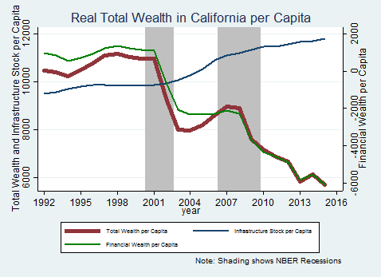
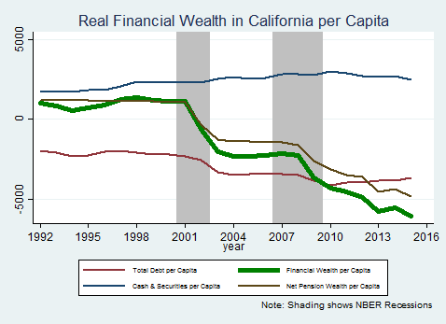
California – Cyclical with downward trend

Slide 26
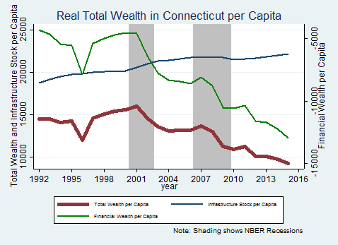
Connecticut – Downward trend

Slide 27
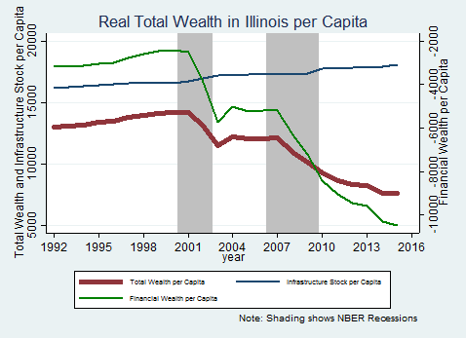
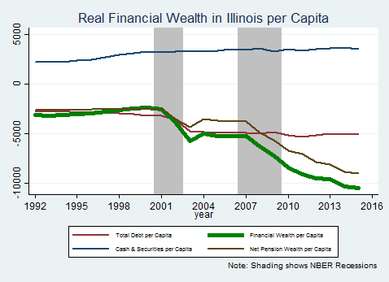
Illinois – Downward trend

Slide 28
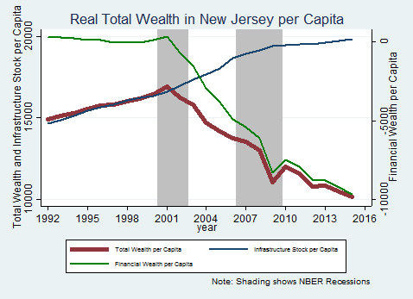
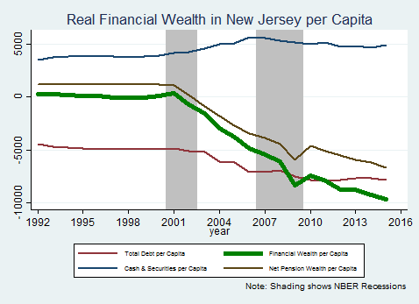
New Jersey – Decline after 2001

Slide 29
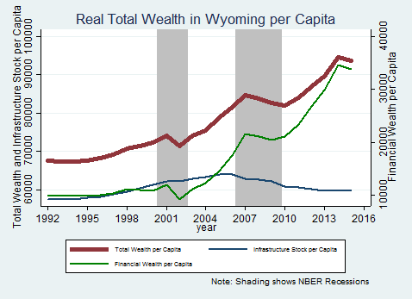
Wyoming – Financial Accumulation

Slide 30
Statistics

Slide 31
Descriptive Statistics
Variable | Mean | Standard Deviation | 10th %ile | 90th %ile
K_{s,t} | $25,858 | $9,405 | $16,576 | $38,486
ΔK_{s,t} | 253.7 | 308.2 | -46.3 | 634.6
Financial Wealth pC | -593.6 | 4,186.4 | -4,600 | 1,948
Change in Financial Wealth pC | -66.4 | 683.7 | -752.8 | 435.8
S&P 500 | 6655.3 | 2446.4 | 2687 | 10380

Slide 32
Regression Results, 2003-2015 - Preliminary
Dependent Variable | DK_{s,t} (1) | DK_{s,t} (2) | DK_{s,t} (3) | DK_{s,t} (4) | DK_{s,t} (5)
Method → Ind. Variable | OLS | OLS | OLS | IV | IV
Constant | 213.1*** (13.58) | 211.1*** (13.53) | 234.4*** (13.89) | 209.8*** (12.58) | 205.0*** (11.91)
Change in Financial Wealth | -- | -0.049*** (-2.87) | -- | -- | -0.047 (-1.12)
Change in Financial Wealth (t-1) | -0.051*** (-3.22) | -0.036** (-2.21) | -0.052*** (-3.32) | -0.066* (-1.68) | -0.057 (-1.44)
Change in S&P 500 | -- | -- | -0.257*** (-3.27) | -- | --
3 lags of population change? | Y | Y | Y | Y | Y
Year FE? | N | N | N | N | N
State FE? | Y | Y | Y | Y | Y
Observations | 624 | 624 | 624 | 624 | 624

Slide 33
Conclusions
New approach to measuring state balance sheets
Evidence of fiscal stress on average state’s finances
But considerable dispersion
Declines in financial wealth not strongly associated with slow infrastructure growth
Average state’s infrastructure stock growing over period
Slightly more in states with declines in financial wealth
Caveats/future directions
Analysis so far totals, but some of that is mechanical
Eg, debt→infrastructure
Analysis so far at means, but action may be in tails
NJ, IL, IA

