Slide 1

21st Workshop on Public Finance
Rome, 20-22 March 2019
Fiscal Stabilisation in the US
Lessons for Monetary Unions
Plamen Nikolov (European Commission*)
Paolo Pasimeni (European Commission* and IES-VUB)
* The views expressed are the authors’ alone and cannot be attributed to the European Commission.

Slide 2
Monetary Unions
US as reference (for EMU)
Monetary - Fiscal interaction: counterpart to monetary authority?
Reverse vertical fiscal imbalance > unstable framework
Room for manoeuvre cannot be credibly removed from national level, if supranational not equipped to take over
Size of Budget (1% vs 22%)
Borrowing capacity
Stabilisation capacity of Budget (30 times smaller)

Slide 3
Macroeconomic Stabilisation
Mitigation of impacts of macroeconomic shocks – 2 dimensions:
A) Inter-temporal stabilisation
B) Inter-regional stabilisation
A) | B)
Across Time | Across Space
Common Shocks | Asymmetric Shocks
Complement to Common Monetary Policy | Complement to Structural Reforms
Time Consistency Problem | Coordination Problem

Slide 4
Channels of Stabilisation
Factor mobility: market mechanisms, several channels:
  Mobility of Capital: capital market, credit market, cross-border labour compensation
  Labour mobility as adjustment mechanism
  Sufficient? To the extent they are stable and efficient in the allocation of resources. Risk: pro-cyclicality.
Monetary Policy first instrument to address common fluctuations,
  but: one-size-fits-none for idiosyncratic shocks + limits (ZLB)
Structural Reforms: help correct structural reasons for asymmetries
  but: coordination problem, cannot replace speed of adjustment of exchange-rate, short-term costs, higher costs when monetary policy is constrained
National Fiscal Policies: relevant size, automatic stabilisers.
  but: in monetary union, can be forced by market pressure to behave pro-cyclically + coordination problem
Common Fiscal Instrument

Slide 5
Why Fiscal Stabilisation
Economic rationale: limits to market mechanisms and other instruments
2 objectives (inter-temporal & inter-regional) to be considered together
Trade-off in the "non-use" of a fiscal instrument for these two functions:
The less the use of fiscal instrument for risk-sharing and insurance against idiosyncratic shocks > the more need for structural reforms and prudent fiscal policies for adjustment capacity at national level > the stronger the deflationary pressure > the stronger the pressure on monetary policy to counteract (limits) > greater need for fiscal instrument for inter-temporal stabilisation.
The less the use of fiscal instrument for inter-temporal stabilisation > the more the of use of monetary policy > closer to its limits > the higher the short-term costs of structural reforms and fiscal consolidation > the lower their effectiveness > the greater need for a fiscal instrument for inter-regional stabilisation.
The least we want to use common fiscal instruments for inter-temporal stabilisation, the more we will have to use them for inter-regional stabilisation.

Slide 6
Examples of Fiscal Stabilisation
The least we want to use common fiscal instruments for inter-temporal stabilisation, the more we will have to use them for inter-regional stabilisation.
A single fiscal instrument could also address both issues and perform both functions, but it should then include two legs:
a basic arrangement for cross-country risk sharing,
a debt-issuing possibility for inter-temporal stabilisation.
The US federal budget operates in this way, addressing both objectives
The US system of unemployment insurance: example of an instrument that operates on both fronts (mixed system of states' responsibility in normal times, and extended and emergency benefits provided by the federal system - financed through borrowing - in times of crisis).

Slide 7
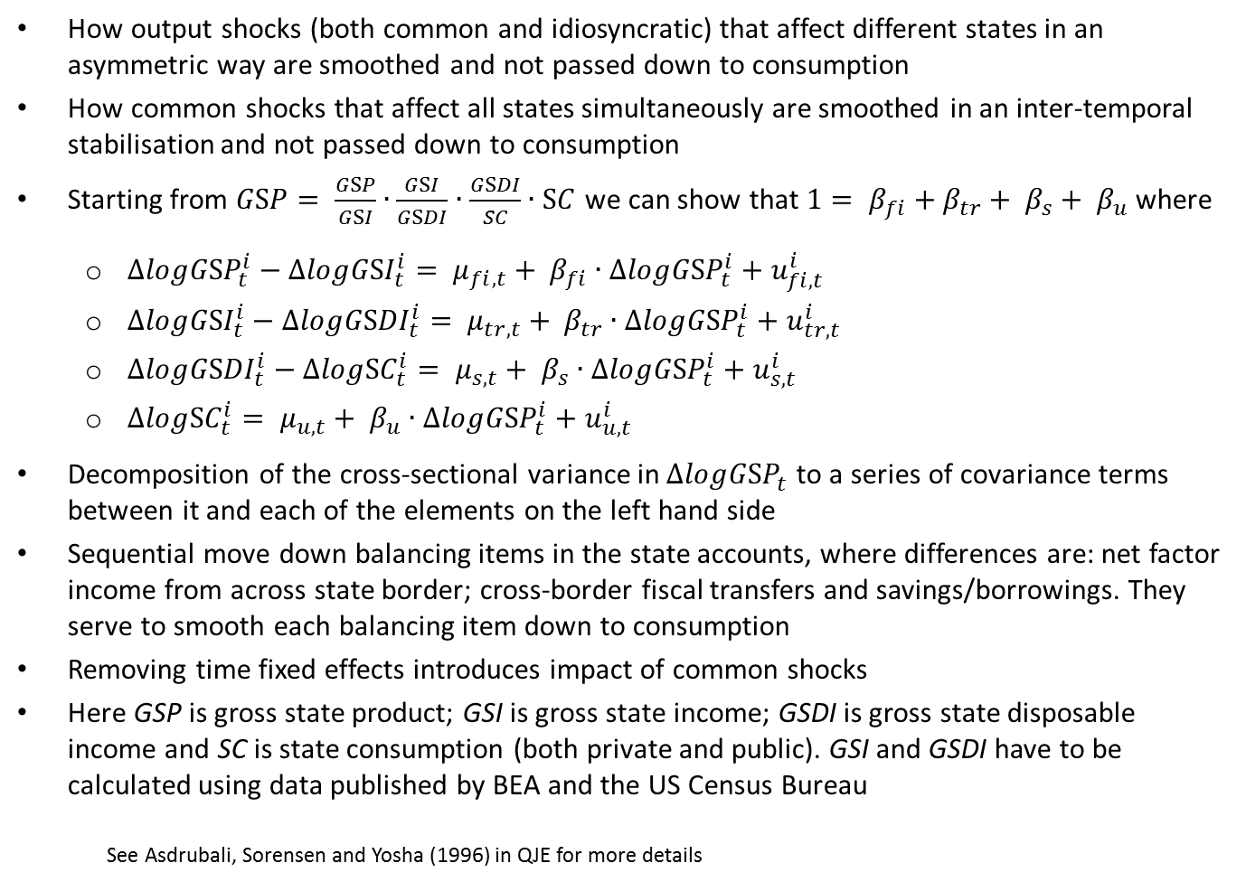
Empirical analysis
How output shocks (both common and idiosyncratic) that affect different states in an asymmetric way are smoothed and not passed down to consumption
How common shocks that affect all states simultaneously are smoothed in an inter-temporal stabilisation and not passed down to consumption
Starting from $GSP= \frac{GSP}{GSI}∙\frac{GSI}{GSDI}∙\frac{GSDI}{SC}∙SC$ we can show that $1= β_{fi}+β_{tr}+ β_{s}+ β_{u}$ where
  $∆log{GSP}_{t}^{i}−∆log{GSI}_{t}^{i}= μ_{fi,t}+ β_{fi}∙∆log{GSP}_{t}^{i}+u_{fi,t}^{i}$
  $∆log{GSI}_{t}^{i}−∆log{GSDI}_{t}^{i}= μ_{tr,t}+ β_{tr}∙∆log{GSP}_{t}^{i}+u_{tr,t}^{i}$
  $∆log{GSDI}_{t}^{i}−∆log{SC}_{t}^{i}= μ_{s,t}+ β_{s}∙∆log{GSP}_{t}^{i}+u_{s,t}^{i}$
  $∆log{SC}_{t}^{i}= μ_{u,t}+ β_{u}∙∆log{GSP}_{t}^{i}+u_{u,t}^{i}$
Decomposition of the cross-sectional variance in $∆log{GSP}_{t}^{}$ to a series of covariance terms between it and each of the elements on the left hand side
Sequential move down balancing items in the state accounts, where differences are: net factor income from across state border; cross-border fiscal transfers and savings/borrowings. They serve to smooth each balancing item down to consumption
Removing time fixed effects introduces impact of common shocks
Here GSP is gross state product; GSI is gross state income; GSDI is gross state disposable income and SC is state consumption (both private and public). GSI and GSDI have to be calculated using data published by BEA and the US Census Bureau
    See Asdrubali, Sorensen and Yosha (1996) in QJE for more details

Slide 8
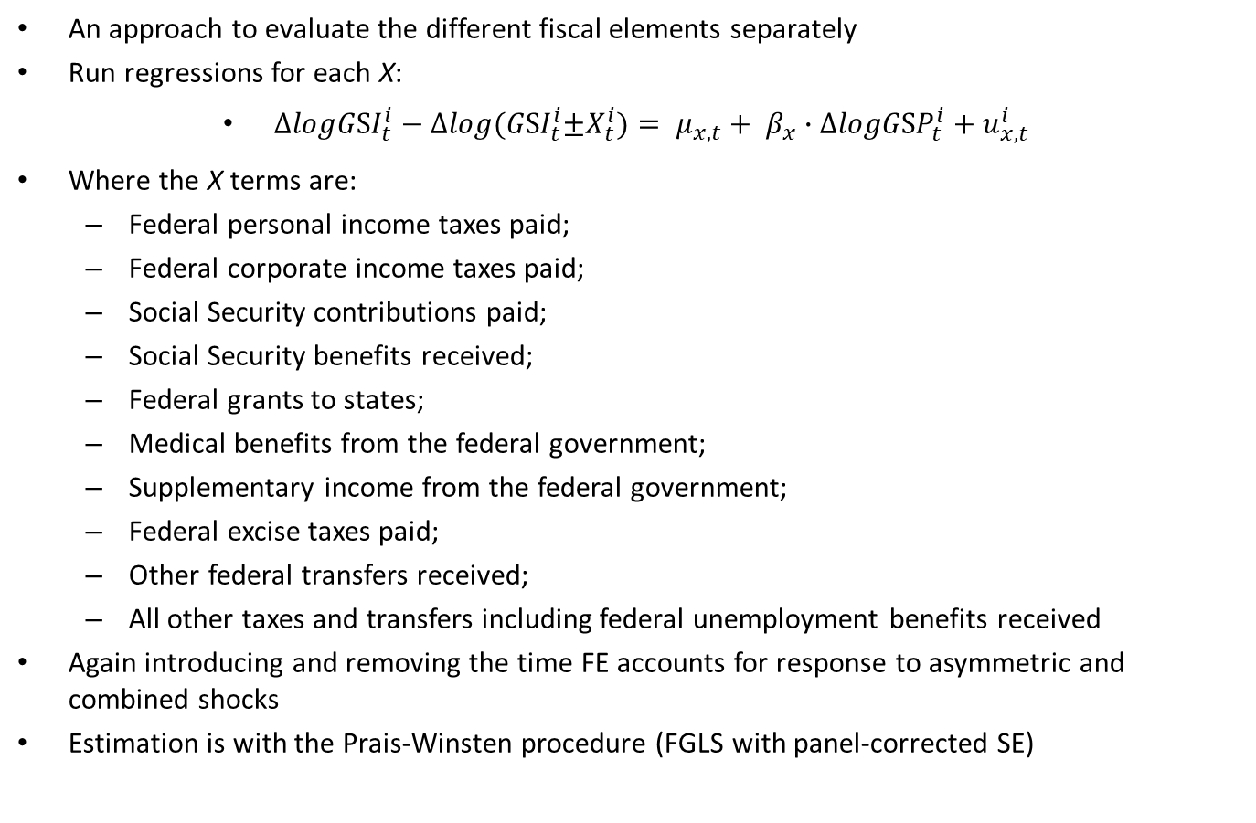
Different Channels of Fiscal Stabilisation
An approach to evaluate the different fiscal elements separately
Run regressions for each X:
$∆log{GSI}_{t}^{i}−∆log{(GSI}_{t}^{i}±X_{t}^{i})= μ_{x,t}+ β_{x}∙∆log{GSP}_{t}^{i}+u_{x,t}^{i}$
Where the X terms are:
  Federal personal income taxes paid;
  Federal corporate income taxes paid;
  Social Security contributions paid;
  Social Security benefits received;
  Federal grants to states;
  Medical benefits from the federal government;
  Supplementary income from the federal government;
  Federal excise taxes paid;
  Other federal transfers received;
  All other taxes and transfers including federal unemployment benefits received
Again introducing and removing the time FE accounts for response to asymmetric and combined shocks
Estimation is with the Prais-Winsten procedure (FGLS with panel-corrected SE)

Slide 9
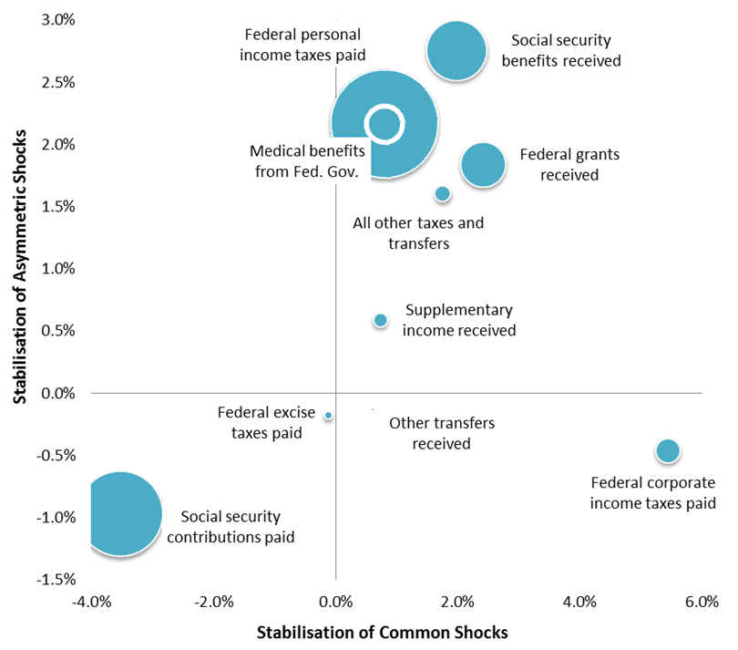
Results
Stabilisation capacity not related to size
Most effective items against idiosyncratic shocks:
social security benefits
medical benefits
personal income tax
Most effective item for intertemporal stabilisation:
corporate income tax
Most efficient item
(common shocks):
corporate income tax

Slide 10
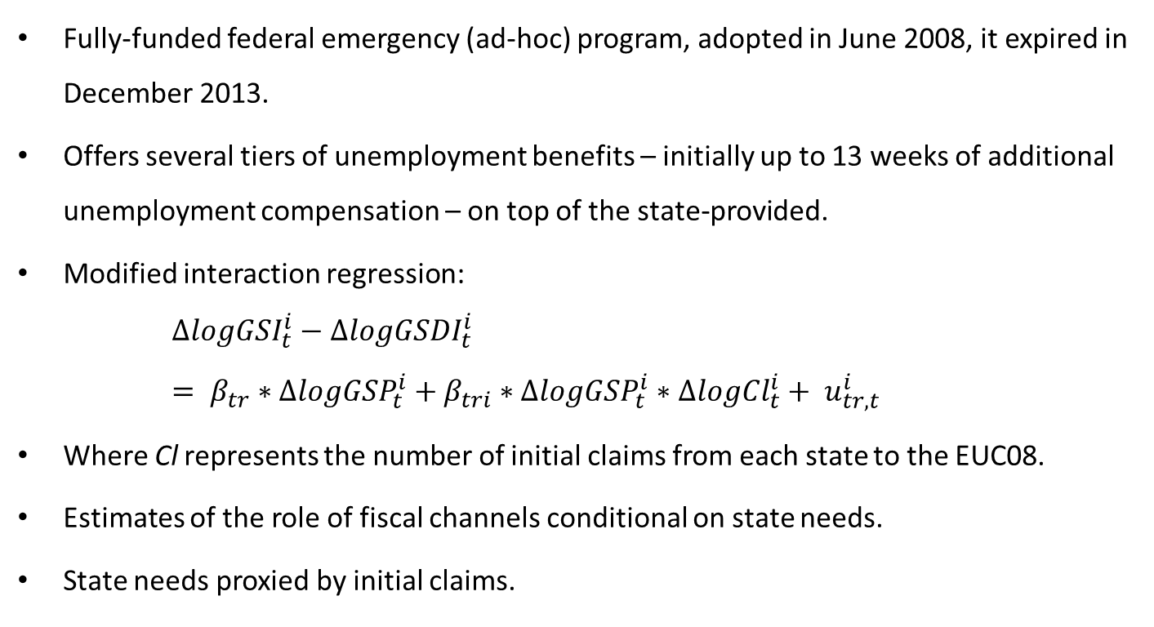
Emergency Unemployment Compensation (EUC08)
Fully-funded federal emergency (ad-hoc) program, adopted in June 2008, it expired in December 2013.
Offers several tiers of unemployment benefits – initially up to 13 weeks of additional unemployment compensation – on top of the state-provided.
Modified interaction regression:
  $$∆log{GSI}_{t}^{i}−∆log{GSDI}_{t}^{i}= β_{tr}∗∆log{GSP}_{t}^{i}+β_{tri}∗∆log{GSP}_{t}^{i}∗∆log{Cl}_{t}^{i}+ u_{tr,t}^{i}$$
Where Cl represents the number of initial claims from each state to the EUC08.
Estimates of the role of fiscal channels conditional on state needs.
State needs proxied by initial claims.

Slide 11
Emergency Unemployment Compensation (EUC08) - results
Introduction of the interactive term in a regression without time fixed effects changes the common and idiosyncratic shocks for the average state – column (7).
When the role of EUC08 claim is explicitly taken into account for their average value across all 50 states during the programme, fiscal smoothing falls by 6 pp.
Can be interpreted as the role of the EUC08 programme.

Slide 12
Lessons for Monetary Unions (I)
Channels of fiscal stabilisation through a common budget are relevant
There is a case to address both common and idiosyncratic shocks
The structure of revenue and expenditure of a common/federal budget greatly determines its stabilisation capacity
On the revenue side, corporate income taxes collected at the federal level are the single most effective and most efficient item (mainly against common shocks)
On the expenditure side, the most effective item is social security benefits (mainly against asymmetric shocks)
Even a small budget can maximise its stabilisation potential by collecting at federal level corporate income taxes to then pay social security benefits to the individuals, in the form of unemployment benefits

Slide 13
Lessons for Monetary Unions (II)
Key criterion: maximising the stabilisation effect by bridging the gap between mobility of capital and mobility of labour
If a specific and contingent stabilisation instrument is considered, the discretionary programme of extended unemployment benefits is a powerful model:
  Even if: US program permanently underfinanced in its state-level component
  Even if: Prone to moral hazard at state-level
  Provided very significant intertemporal stabilisation against common shock (Great Recession)
  Mainly funded by the federal budget
  Supported by the borrowing capacity of the federal government

