Slide 1
Personal Income Tax Progressivity: TRENDS and IMPLICATIONS
&
ARE Elasticities of Taxable Income RISING?
Victor Mylonas
International Monetary Fund (IMF)
Fiscal Affairs Department (FAD)
21st Banca d’Italia Public Finance Workshop
Rome, Italy - March 20, 2019

Slide 2
Introduction
What happened to personal income tax (PIT) progressivity?
  How can it be measured?
  What are the trends?
What is the impact of progressivity on growth?
What could be behind the decline in progressivity?
  Higher tax elasticities?
  Other factors?

Slide 3
What happened to PIT Progressivity?

Slide 4
How to Measure PIT Progressivity (1)
“Progressive system: rising average tax rate
  What about degrees of progressivity?

Slide 5
How to Measure PIT Progressivity (2)
For cross-country comparisons & econometric work on effect of tax system, we need measure that:
  Summarizes system in single statistic
  Reflects tax system, not pre-tax income distribution
    Is exogenous (changes in income distribution caused by tax will not affect it)

Slide 6

Existing Measures
Pigou (1928): $\frac{∆ATR}{∆Y}$
Sabirianova Peter and others (2010): Average of many Pigou measures
Kakwani (1977): 2*Area between Lorenz curve for income and tax

Slide 7
Progressive Capacity Measure
Kakwani with imposed uniform income distribution
Notes:
Advantage: does not depend on pre-tax distribution
Disadvantages: still depends on choice of highest income considered; usual problems of GINI-type measures

Slide 8
PIT Progressivity Has Fallen…

Slide 9
…in line with a decline in top PIT rates

Slide 10
Some Subtle Differences (1)
(SSC + Sub-central PIT)

Slide 11
Some Subtle Differences (2)
(Self-Employed)

Slide 12
Some Subtle Differences (3)
(Family Situation)

Slide 13
IMPACT ON GROWTH

Slide 14
Is tax progressivity harmful for growth?
Tax progressivity
Tax progressivity reduces inequality (Duncan and Sabirianova Peter, 2016)
Redistribution not harmful for growth (e.g., Ostry et al. 2014)
Growth
Direct: our study
Notes:
Theoretical reasons
Some income gains at top may be redistributive, not reflecting greater output (e.g., managers capturing larger share of rents of corporations)
Evasion/avoidance means that high top income tax rates have limited effect on real variables

Slide 15
It doesn’t look like it.
Notes:
Robustness checks: 5-year intervals, GMM regressions.

Slide 16
It doesn’t look like it.
Notes:
Robustness checks: 5-year intervals, GMM regressions.

Slide 17
IMPACT ON PRE-TAX INEQUALITY

Slide 18
Progressivity Reduces Market Inequality

Slide 19
What is behind the Decline in Progressivity?

Slide 20

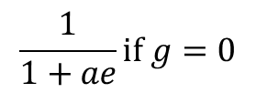
Is it a, g, or e?
If marginal welfare weight of richest is zero
Social welfare weight
Optimal top tax rate
$$t^{∗}=\frac{1−g}{1−g+ae}$$
$$\frac{1}{1+ae}if g=0$$
Then, simply revenue maximizing
Distributional parameter (Pareto index)
Elasticity of income to tax
Notes:
g: the more we weigh the welfare of high-income earners, the lower the tax rate
e: the more elastic income, the lower the tax rate
a: the fewer people earning more, the lower the tax rate
Extensions: migration, rent seeking

Slide 21
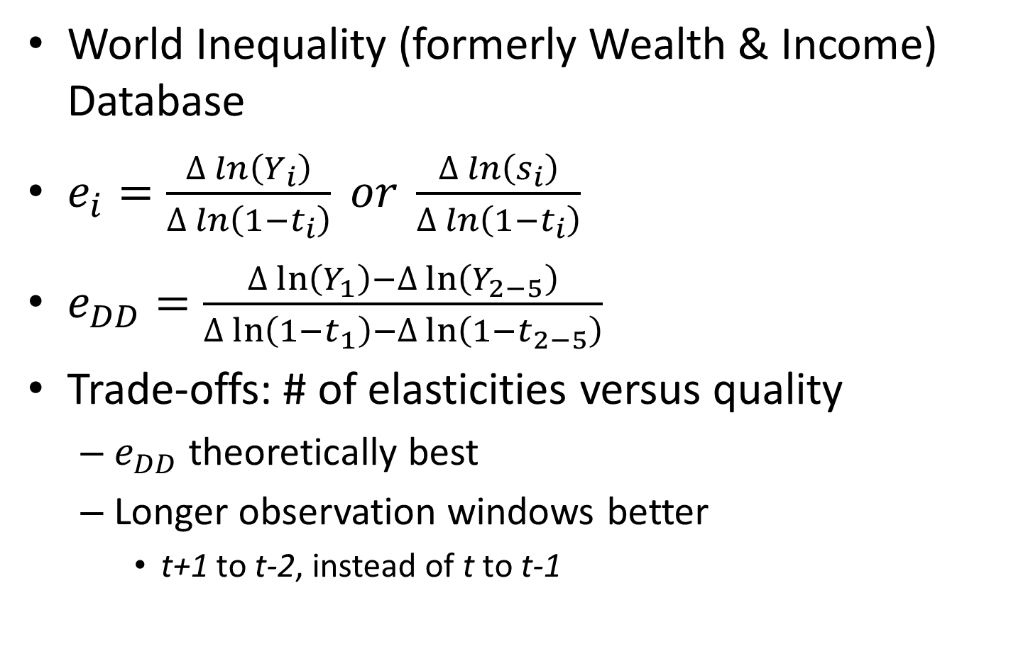
Elasticities of Taxable Income (ETIs)
World Inequality (formerly Wealth & Income) Database
$e_{i}=\frac{∆\ln\left(Y_{i}\right)}{∆\ln\left(1−t_{i}\right)} or \frac{∆\ln\left(s_{i}\right)}{∆\ln\left(1−t_{i}\right)}$
$e_{DD}=\frac{∆\ln\left(Y_{1}\right)−∆\ln\left(Y_{2−5}\right)}{∆\ln\left(1−t_{1}\right)−∆\ln\left(1−t_{2−5}\right)}$
Trade-offs: # of elasticities versus quality
  $e_{DD}$ theoretically best
  Longer observation windows better
    t+1 to t-2, instead of t to t-1

Slide 22
Overview of Estimated Elasticities (1)

Slide 23
Overview of Estimated Elasticities (2)

Slide 24
Overview of Estimated Elasticities (3)

Slide 25
Who can spot a trend?
Short window Long window

Slide 26
Regression coefficients for ETIs on time trend

Slide 27
a or g, then?
Pareto index (a) Support for redistribution (g)

Slide 28
Actual versus revenue-maximizing tax rates

Slide 29
Conclusions
Progressivity has decreased
Empirically not associated with boost to growth
Not driven by rising elasticities
  Nor smaller income share of rich or declining support for redistribution
Something else (political economy) must be at play
Undoing downward progressivity trend may not be as harmful as feared by some

