Slide 1
16th ESCB Emerging Markets Workshop
Managing risks and policy challenges in an increasingly complex environment
2018, November 22-23, Banca d’Italia
Alberto Coco* and Nicola Viegi^
*Financial Attaché from Banca d’Italia to the Embassy of Italy in South Africa
^ SARB Professor of Monetary Economics, University of Pretoria, South Africa

Slide 2
1. Introduction: the SARB monetary policy strategy
2. An assessment of the monetary policy stance
Taylor rule estimation
time-varying neutral interest rate and implicit inflation target
An assessment of the monetary policy communication
Natural Language processing: topic analysis
Natural Language processing: sentiment analysis
4. An assessment of the monetary policy credibility
response of market interest rates
response of inflation expectations
5. Conclusions
The monetary policy of the SARB: stance, communication, and credibility

Slide 3
1. Introduction: the SARB monetary policy strategy
Primary objective of monetary policy in South Africa is to achieve and maintain price stability in the interest of sustainable and balanced economic development and growth. In recent years, complementary mandate of financial stability
Since 2000 flexible inflation targeting (IT) regime: the SARB aims at maintaining the consumer price inflation in an annual range between 3% and 6%.
flexibility allows for interest rate smoothing over the cycle and mitigates output variability
Quarterly Projection Model (QPM) to forecast headline growth and inflation according to the following Taylor -type rule:
i_{t} = 0.79i_{t–1}+ (1 – 0.79){i*_{t} +1.57 [1/3 (Eπ_{t+3} + Eπ_{t+4} +Eπ_{t+5} ) – π*] + 0.54(y_{t} – y*_{t} )} + ε_{t}
The monetary policy of the SARB: stance, communication, and credibility
Notes:
3
Perché crisi e come si è manifestata?
Quale obiettivo hanno raggiunto le misure?
Interazione stabilita monetaria e stabilità finanziaria?

Slide 4
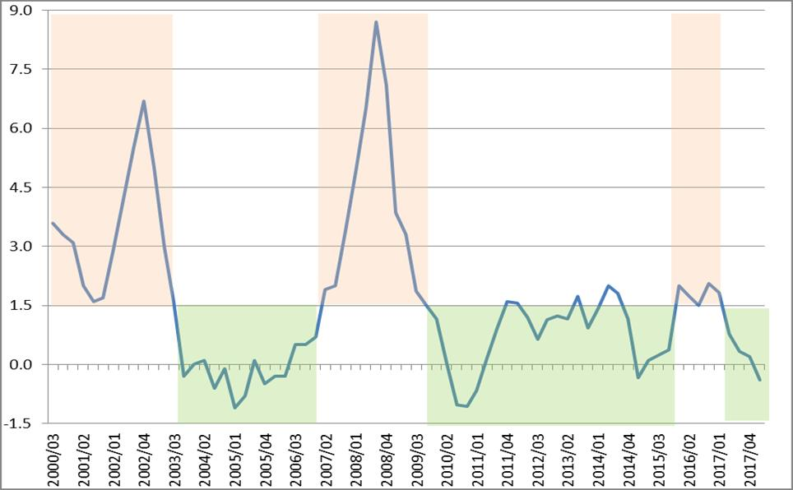
1. Introduction: the SARB monetary policy strategy
Inflation breached the target band only above the upper limit of 6% and never below the lower limit of 3%. After 2009 inflation target was met more than before
The monetary policy of the SARB: stance, communication, and credibility
Notes:
4
Perché crisi e come si è manifestata?
Quale obiettivo hanno raggiunto le misure?
Interazione stabilita monetaria e stabilità finanziaria?

Slide 5
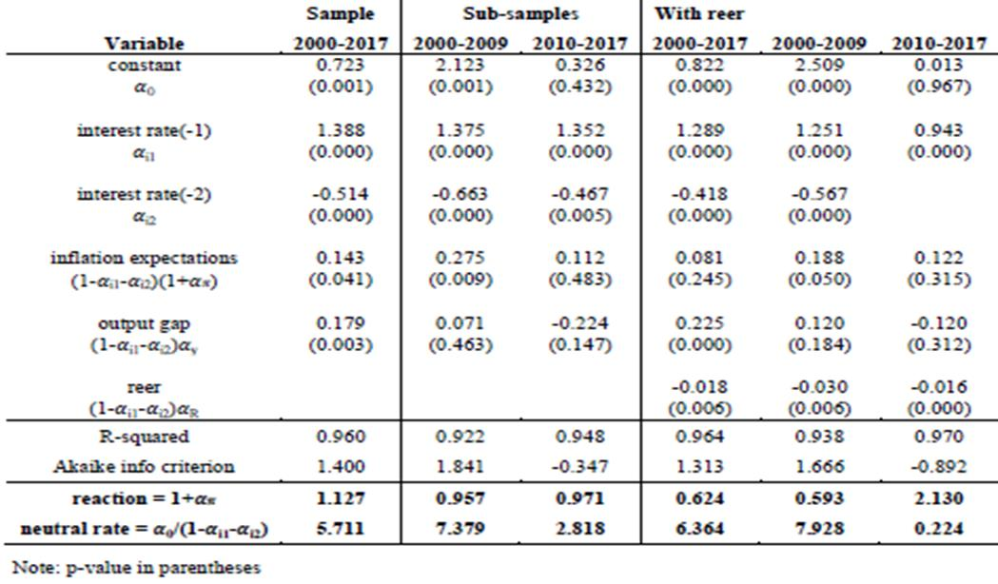
2. Assessment of monetary policy stance
We estimate a reaction function of the SARB under a Taylor rule specification:
𝑖_{𝑡} = 𝛼₀+ 𝛼_{i1}i_{t-1} + 𝛼_{i2}i_{t-2} + (1-𝛼_{i1}-𝛼_{i2})[(1+𝛼_{𝜋}) (𝜋^{e}_{𝑡} – 𝜋*)+𝛼_{𝑦}(y_{t} – y*_{t} ) + 𝛼_{𝑅}(𝑅E𝑅_{𝑡}−𝑅ER*)]+u_{t}
The monetary policy of the SARB: stance, communication, and credibility
Notes:
5
Perché crisi e come si è manifestata?
Quale obiettivo hanno raggiunto le misure?
Interazione stabilita monetaria e stabilità finanziaria?

Slide 6
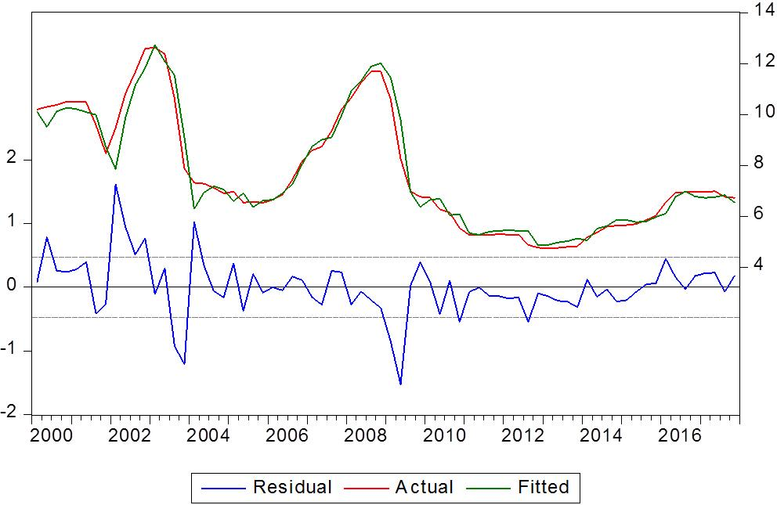
2. Assessment of monetary policy stance
Comparison between estimated and observed rate suggests a looser (effective < fitted) or tighter (effective > fitted) monetary policy stance
The monetary policy of the SARB: stance, communication, and credibility
Notes:
6
Perché crisi e come si è manifestata?
Quale obiettivo hanno raggiunto le misure?
Interazione stabilita monetaria e stabilità finanziaria?

Slide 7
2. Assessment of monetary policy stance
Main results:
For the whole sample 2000-18 (and before GFC) all coefficients are significant and the SARB follows the Taylor principle (reaction to ∆π^{e} > 1)
In the last decade 2010-18 coefficients become mostly insignificant apart from lagged interest rates: monetary policy has become less active with the new mandate of financial stability, especially in most recent years
Real effective exchange rate is significant: rand depreciation induces a small increase of the interest rate and vice versa. In a SOE like South Africa dependant on foreign capital, excessive currency fluctuations are undesired
After recession, from 2009 to 2014 the SARB moved to a dovish/ accommodative stance, under the Governor Marcus. Since 2015, under the Governor Kganyago, it turned hawkish/tighter, motivated by the new mandate of financial stability and by upside risks on inflation caused by growing volatility of the rand, related to policy and political uncertainty
The monetary policy of the SARB: stance, communication, and credibility
Notes:
7
Perché crisi e come si è manifestata?
Quale obiettivo hanno raggiunto le misure?
Interazione stabilita monetaria e stabilità finanziaria?

Slide 8
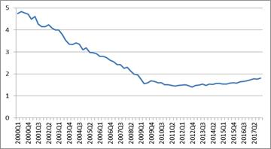
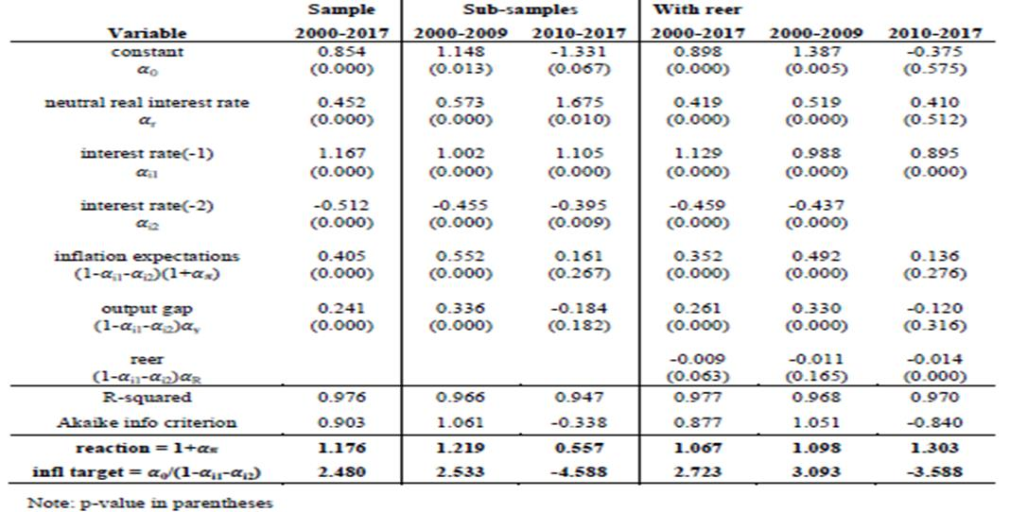
2. Assessment of monetary policy stance
Taylor rule with variable real neutral rate:
𝑖_{𝑡} = 𝛼₀+ 𝛼_{r}r_{t} + 𝛼_{i1}i_{t-1}+𝛼_{i2}i_{t-2}+(1-𝛼_{i1}-𝛼_{i2})[(1+𝛼_{𝜋})(𝜋^{e}_{𝑡} – 𝜋*)+
+𝛼_{𝑦}(y_{t} – y*_{t} )+𝛼_{𝑅}(𝑅E𝑅_{𝑡}−𝑅ER*)]+u_{t}
The monetary policy of the SARB: stance, communication, and credibility
Notes:
8
Perché crisi e come si è manifestata?
Quale obiettivo hanno raggiunto le misure?
Interazione stabilita monetaria e stabilità finanziaria?

Slide 9
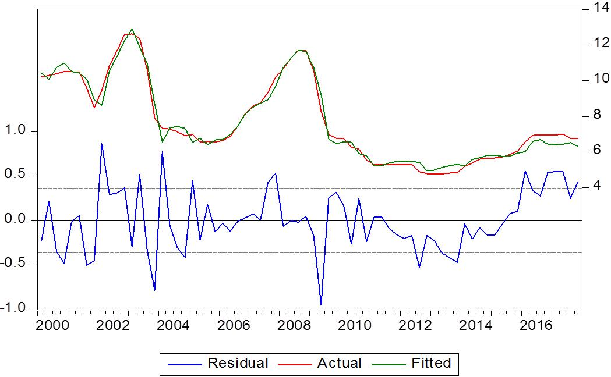
2. Assessment of monetary policy stance
In 2000-03 the fitted series is higher: what we judged as a tight stance is now explained by a higher neutral real interest rate, which raises the policy rate
The monetary policy of the SARB: stance, communication, and credibility
Notes:
9
Perché crisi e come si è manifestata?
Quale obiettivo hanno raggiunto le misure?
Interazione stabilita monetaria e stabilità finanziaria?

Slide 10
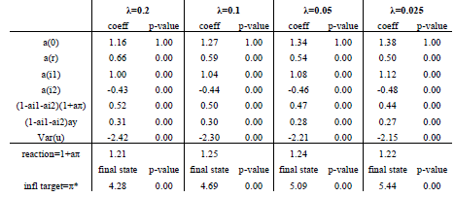
2. Assessment of monetary policy stance
Taylor rule estimation with time-varying inflation target in a state-space form:
𝑖_{𝑡} = 𝛼₀+ 𝛼_{r}r_{t} + 𝛼_{i1}i_{t-1} + 𝛼_{i2}i_{t-2} + (1-𝛼_{i1}-𝛼_{i2})[(1+𝛼_{𝜋}) (𝜋^{e}_{𝑡} – 𝜋*_{𝑡})+𝛼_{𝑦}(y_{t} – y*_{t} ) + u_{t}
implicit inflation target: 𝜋*_{𝑡} = 𝜋*_{𝑡−1} + 𝜐_{𝑡}, Var(𝜐_{𝑡})=𝜆Var(𝑢_{𝑡})
Parameter λ is the “signal-to-noise” ratio, which determines the link between the policy rate’s variance and the inflation target’s variance (Klein 2012)
The monetary policy of the SARB: stance, communication, and credibility
Notes:
10
Perché crisi e come si è manifestata?
Quale obiettivo hanno raggiunto le misure?
Interazione stabilita monetaria e stabilità finanziaria?

Slide 11
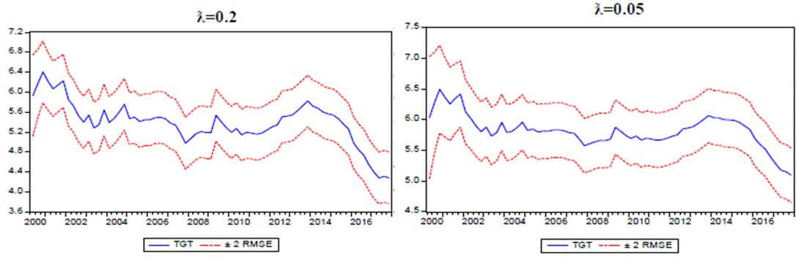
2. Assessment of monetary policy stance
the implicit inflation target is not steady: after an initial hike it shows a declining trend from 2002 to 2007 (Governor Mboweni). In this period the decrease of policy rate is partly explained by the decrease of real neutral rate
from 2008 to 2014 it shows an increasing trend: after the recession the Governor Marcus (2009-14) seemed more tolerant about inflation
after 2014 it shows a clear drop: Governor Kganyago is more oriented to anchor inflation expectations at the middle of the band against a volatile rand
The monetary policy of the SARB: stance, communication, and credibility
Notes:
11
Perché crisi e come si è manifestata?
Quale obiettivo hanno raggiunto le misure?
Interazione stabilita monetaria e stabilità finanziaria?

Slide 12
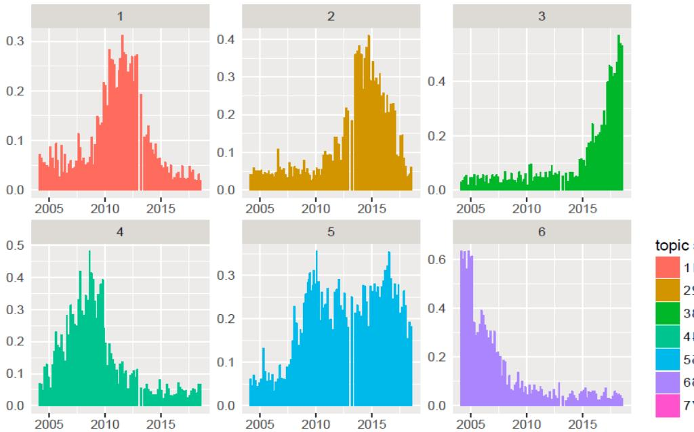
3. Assessment of monetary policy communication
Topic Analysis: six topics are identified by the natural language processing during the IT period according to a certain set of recurring words
The monetary policy of the SARB: stance, communication, and credibility
Notes:
12
Perché crisi e come si è manifestata?
Quale obiettivo hanno raggiunto le misure?
Interazione stabilita monetaria e stabilità finanziaria?

Slide 13
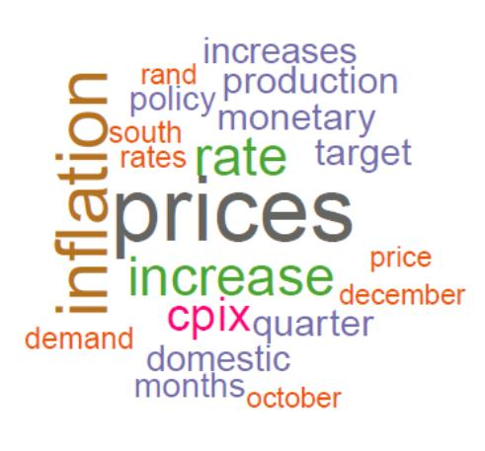
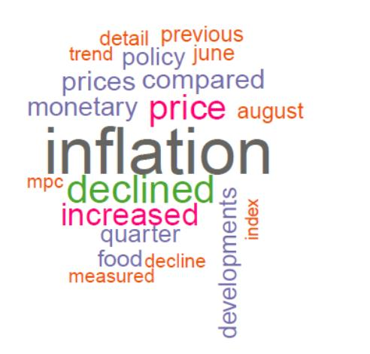
3. Assessment of monetary policy communication
Topic 6 and 4: start of IT
topic 6
topic 4
In the first period (Governor Mboweni) the communication focuses on price and inflation developments in an effort to establish the language and the credibility of the new IT regime
The monetary policy of the SARB: stance, communication, and credibility
Notes:
13
Perché crisi e come si è manifestata?
Quale obiettivo hanno raggiunto le misure?
Interazione stabilita monetaria e stabilità finanziaria?

Slide 14
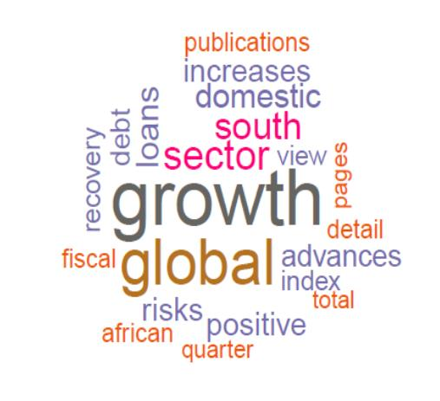
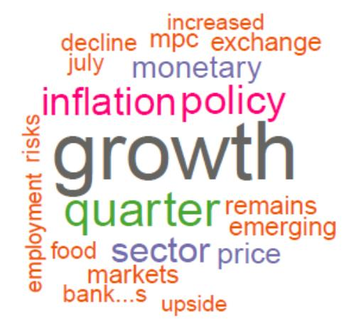
3. Assessment of monetary policy communication
Topics 1 and 2: GFC and its aftermath
topic 1
topic 2
In the second period with the outbreak of the GFC (Governor Marcus) the focus of the communication turns towards global and local growth concerns
The monetary policy of the SARB: stance, communication, and credibility
Notes:
14
Perché crisi e come si è manifestata?
Quale obiettivo hanno raggiunto le misure?
Interazione stabilita monetaria e stabilità finanziaria?

Slide 15
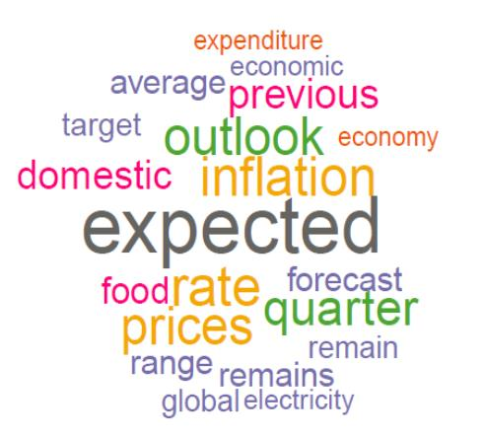
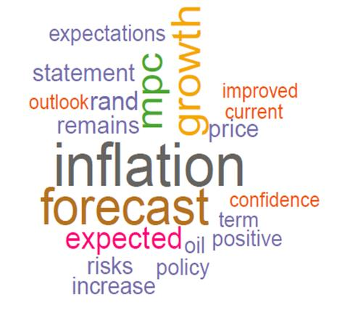
3. Assessment of monetary policy communication
Topics 2 and 3: consolidation of IT
topic 5
topic 3
In the third period (Governor Kganyago) growth concerns are replaced by a communication more focused on expectations and inflation forecast, with a stronger forward-looking nature
The monetary policy of the SARB: stance, communication, and credibility
Notes:
15
Perché crisi e come si è manifestata?
Quale obiettivo hanno raggiunto le misure?
Interazione stabilita monetaria e stabilità finanziaria?

Slide 16
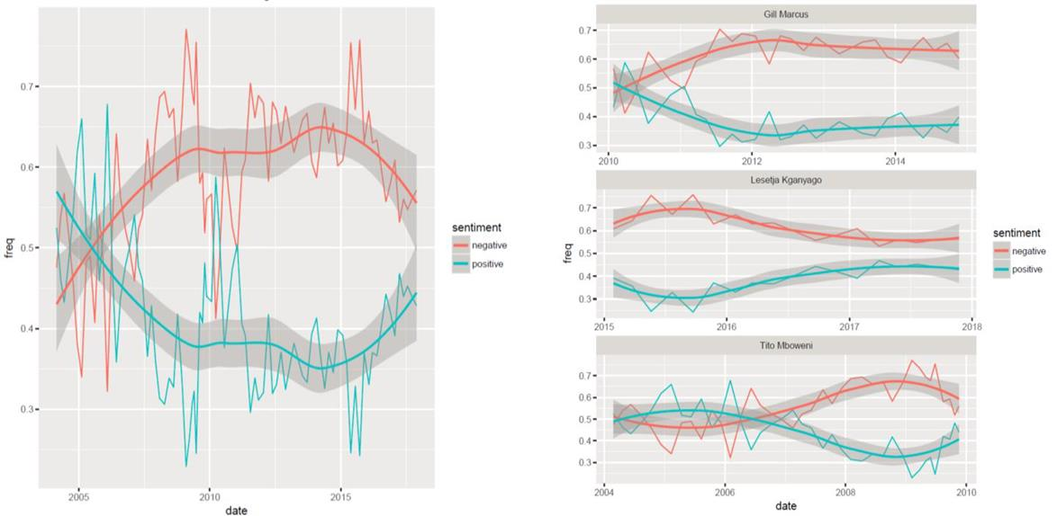
3. Assessment of monetary policy communication
Sentiment analysis by Bing Liu lexicon: sentiment of communication was “negative” during the GFC period, with more focus dedicated to real uncertainty, while it turned “neutral” recently, with more focus on inflation forecasts
The monetary policy of the SARB: stance, communication, and credibility
Notes:
16
Perché crisi e come si è manifestata?
Quale obiettivo hanno raggiunto le misure?
Interazione stabilita monetaria e stabilità finanziaria?

Slide 17
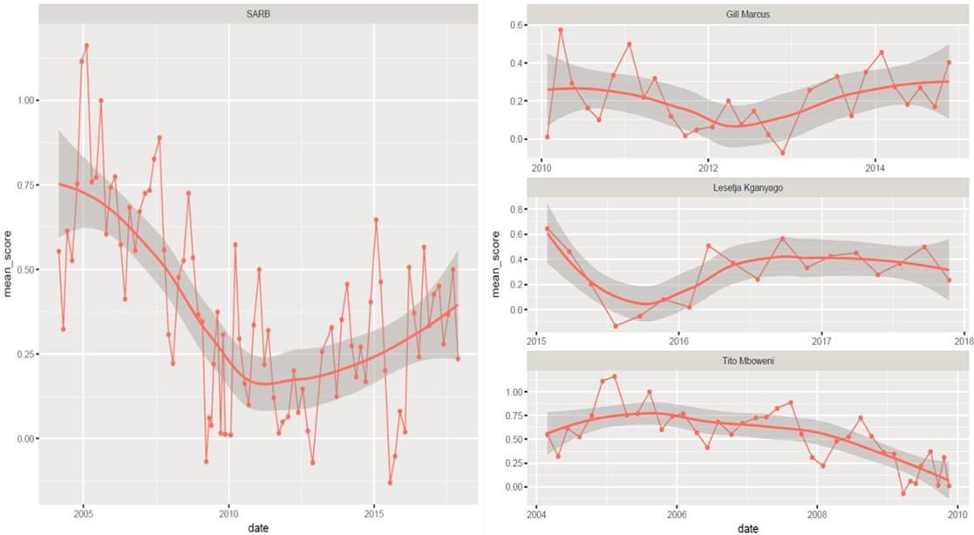
3. Assessment of monetary policy communication
Sentiment analysis by Finn scoring: previous results are confirmed with a clear worsening in sentiment around the GFC and an improvement in the last period
The monetary policy of the SARB: stance, communication, and credibility
Notes:
17
Perché crisi e come si è manifestata?
Quale obiettivo hanno raggiunto le misure?
Interazione stabilita monetaria e stabilità finanziaria?

Slide 18
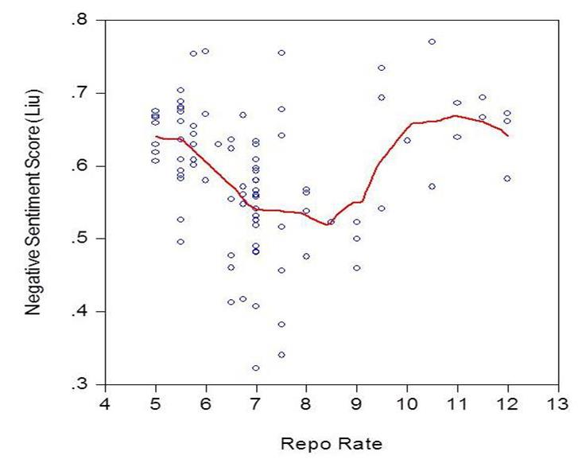
3. Assessment of monetary policy communication
Relation between sentiment and monetary policy stance: negativity is correlated with extreme values of the policy rate: both low and high values indicate periods of economic stress. This justifies the attitude for less active monetary policy and more stable policy rates
The monetary policy of the SARB: stance, communication, and credibility
Notes:
18
Perché crisi e come si è manifestata?
Quale obiettivo hanno raggiunto le misure?
Interazione stabilita monetaria e stabilità finanziaria?

Slide 19
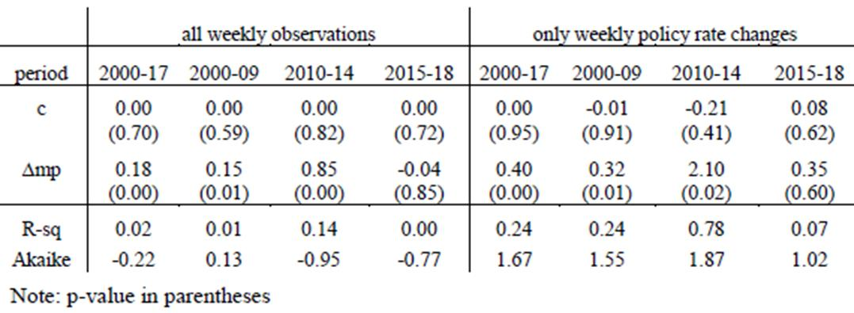
4. Assessment of monetary policy credibility
Response of market interest rates to monetary policy decisions:
Δforward_{t} = 𝛼+𝛽Δi_{t} + u_{t}
Policy rate changes explain variations of forward rates but not in the last period under Kganyago (2015-18), what suggests a higher anchorage of expectations
The monetary policy of the SARB: stance, communication, and credibility
Notes:
19
Perché crisi e come si è manifestata?
Quale obiettivo hanno raggiunto le misure?
Interazione stabilita monetaria e stabilità finanziaria?

Slide 20
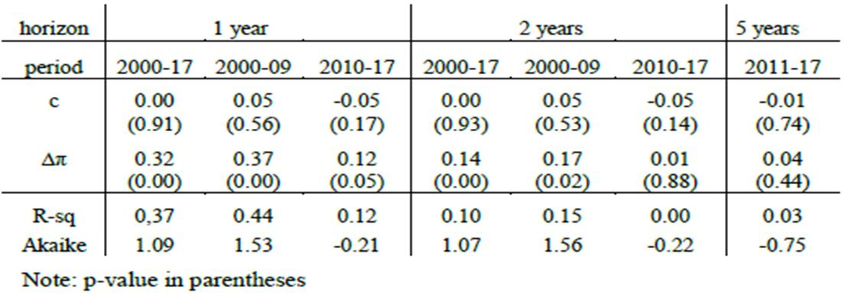
4. Assessment of monetary policy credibility
Response of inflation expectations to changes in inflation:
Δ𝜋^{e} ^{t+h+1}_{𝑡+1} =𝛼+𝛽Δ𝜋_{𝑡+1}+𝑢_{𝑡}
Changes in inflation transmit to expectations over 1 and 2 years at a decreasing rate, while do not transmit at 5 years horizon. The response is stronger in the first sub-sample (2000-09) than in the second (2010-17), where it becomes insignificant at 2 and 5 years horizon. The SARB became more effective in anchoring inflation expectations in the last decade
The monetary policy of the SARB: stance, communication, and credibility
Notes:
20
Perché crisi e come si è manifestata?
Quale obiettivo hanno raggiunto le misure?
Interazione stabilita monetaria e stabilità finanziaria?

Slide 21
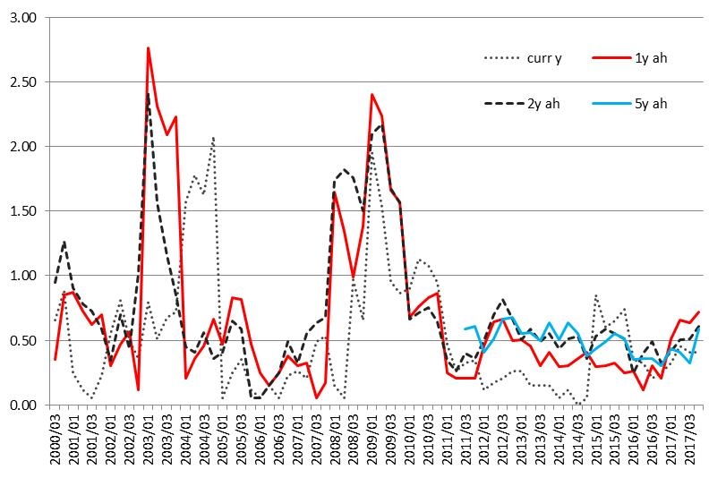
4. Assessment of monetary policy credibility
Dispersion of inflation forecasts: standard deviation of inflation forecasts by 3 different categories (financial analysts, business representatives, trade unions) decreases at all horizons after 2009, confirming the higher ability of the SARB to anchor inflation expectations, especially in the last few years
The monetary policy of the SARB: stance, communication, and credibility
Notes:
21
Perché crisi e come si è manifestata?
Quale obiettivo hanno raggiunto le misure?
Interazione stabilita monetaria e stabilità finanziaria?

Slide 22
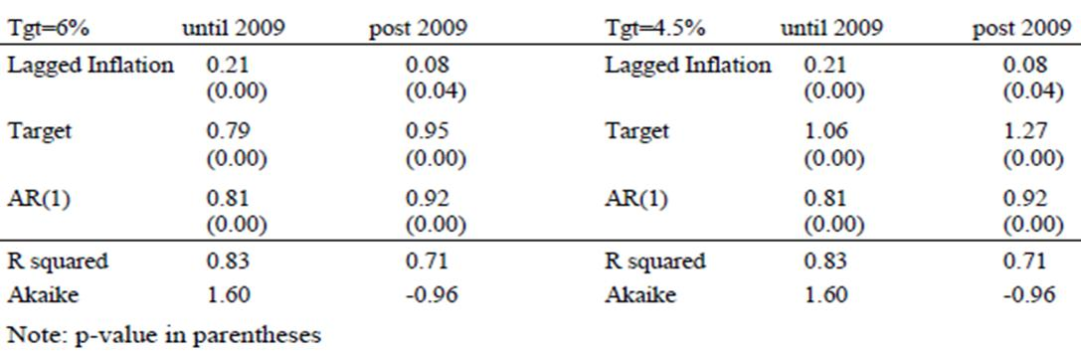
4. Assessment of monetary policy credibility
Inflation expectations as a function of lagged inflation and inflation target:
𝜋^{e}_{𝑡} =𝛼𝜋_{𝑡-1}+(1- 𝛼)𝜋* + 𝑢_{𝑡}
Expectations are stickier to the target (forward-looking component) than to the lagged inflation (backward-looking component), the more after 2009, when the significance of lagged inflation decreases from 99% to 95%. This confirms that monetary policy became more credible in the last decade
The monetary policy of the SARB: stance, communication, and credibility
Notes:
22
Perché crisi e come si è manifestata?
Quale obiettivo hanno raggiunto le misure?
Interazione stabilita monetaria e stabilità finanziaria?

Slide 23
5. Conclusions
Monetary policy stance was mostly neutral after the introduction of the flexible IT regime in 2000, while it turned into dovish after the outbreak of the GFC in 2009, with a tendency of the implicit inflation target to increase
With the new appointment of the Governor Kganyago at end 2014 the stance turned hawkish and the implicit target started declining. Further, monetary policy became less active, in line with the additional mandate for the SARB to be custodian of financial stability
The SARB communication complemented the decreasing activism of monetary policy, by increasing its ‘forward-looking’ nature over years and improving the sentiment after the GFC. More stable interest rates associate to lower economic stress and uncertainty
The response of market interest rates and inflation expectations shows that monetary policy became more credible over years, better anchoring inflation expectations of different categories of forecasters, especially after 2014 under the current Governor Kganyago
The monetary policy of the SARB: stance, communication, and credibility
Notes:
23
Perché crisi e come si è manifestata?
Quale obiettivo hanno raggiunto le misure?
Interazione stabilita monetaria e stabilità finanziaria?

Slide 24
Some references
Carroll D. (2003). Macroeconomic Expectations of Households and Professional Forecasters, Quarterly Journal of Economics, 118, 1, 269-298.
Clarida R., Gali J., Gertler M. (1999). The Science of Monetary Policy: A New Keynesian Perspective, Journal of Economic Literature, 37, 1661-1707.
Kabundi A., Mlachila M. (2017). Monetary Policy Credibility and Exchange Rate Pass-Through in South Africa, IMF Working Paper 173.
Klein N. (2012). Estimating the Implicit Inflation Target of the South African Reserve Bank, IMF Working Papers 77.
Mankiw G., Reis R., Wolfers J. (2003). Disagreement about Inflation Expectations, in NBER Macroeconomics Annual 2003, 18, 209-270.
Stock, J., Watson M. (2007). Why has U.S. Inflation Become Harder to Forecast? Journal of Money Credit and Banking, 39, 3–33.
Zhang L., Wang S., Liu B. (2018). Deep Learning for Sentiment Analysis: A Survey, Wiley Interdisciplinary Reviews-Data Mining and Knowledge Discovery, 8, 4.
The monetary policy of the SARB: stance, communication, and credibility

