Slide 2
Main contribution of the paper
Timely contribution on a topical issue: how monetary policy in advanced economies affects capital flows to emerging markets, and whether this depends on some country-specific characteristics
In other words, the question the authors had in mind is “Will capital flows to emerging markets change destination as the Fed tightens monetary policy further in the coming years?”
The indirect reference is not only to the Taper tantrum episode (2013), but also to recent tensions in financial markets (for the case of Argentina → see Serra et al., 2018, BdE)

Slide 3

What’s in the paper/1
How?
The idea (using Koepke, 2016) is to capture the unexpected component of the future interest rates, proxying it with “Fed funds futures contracts” (p.8). The authors argue that this is a good proxy for “the Fed’s future monetary policy”
(to pin it down: what matter in monetary policy are expectations)
The objective is to explain what is the role of a change in “Fed’s future monetary policy” on the “share of countries in total emerging market portfolio flows” (p.11).
Additionally, to disentangle “pull” and “push” factors, they also include an index for financial/political risk

Slide 4
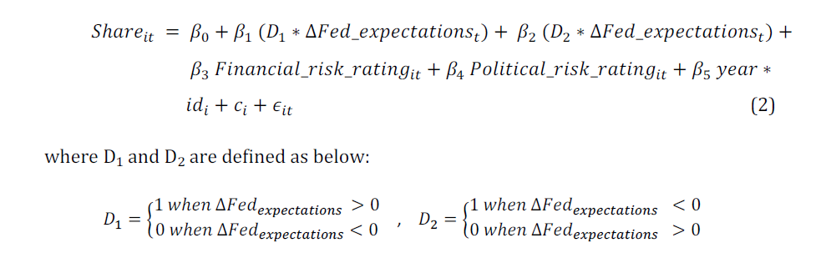
What’s in the paper/2
Then, following Koepke (2016), they separate tightening and easing episodes as follow

Slide 5
Comments/1: Why the share?
MOTIVATION
My first comment relates to the independent variable chosen in the paper
The “share of countries in total emerging market portfolio flows” (p.11)
Why should we devote attention to the share?
This question is not directly addressed in the paper, i.e. it is assumed that the share of capital flows it is important, however:
 | SCENARIO 1 | SCENARIO 2
Country A | Flow 1,000 / Share 10% | Flow 500 / Share 25%
Country B | Flow 5,000/ Share 50% | Flow 1,000 / Share 50%
Country C | Flow 4,000/ Share 40% | Flow 500 / Share 25%
TOTAL EME (A+B+C) | 10,000 | 2,000

Slide 6
Comments/2: METHODOLOGY
METHODOLOGY
If we sum up the share, it should always be 100%.
Main explanatory variable is a variable that only has time variance.
Suppose only two countries, if A’s share goes up, B’s share goes down for the same amount.
Where the variance comes from?
Out of sample variance (as the simple includes 19 countries for a total of 80% of portfolio flows to EMs?) as a determinant? (or maybe related to weights used to calculate shares)

Slide 7
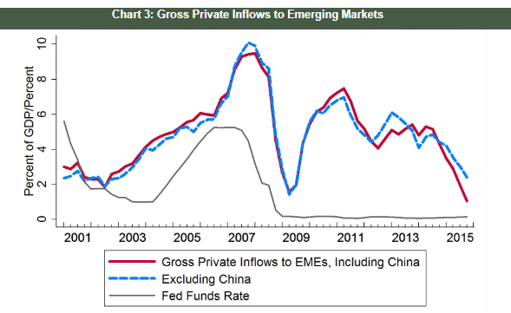
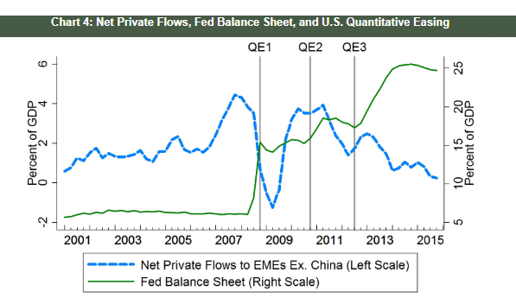
Comments/3: METHODOLOGY
METHODOLOGY
“only three policy rate changes. This makes our forward looking “monetary policy works though expectations channel view more relevant” (p.9)
During the years of analysis (see i.a. Borrallo et al., 2016):
Source: Clark et al.
Source: Clark et al.
FED FUNDS RATE
FED BALANCE SHEET

Slide 8
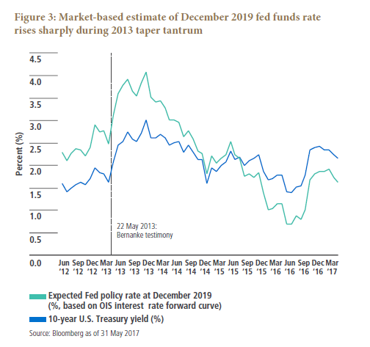
Comments/3: METHODOLOGY
METHODOLOGY
Even if during the “taper tantrum” episode (2013):
This happened because the market was pricing in a “old” neutral interest rate (4%). Right now there is a new normal (2%), and “shrinking the FED balance sheet is not expected to change that”
Clarida (2017)
OIS = overnight index swap → it is an interest rate swap involving the overnight rate being exchanged for a fixed interest rate.

Slide 9
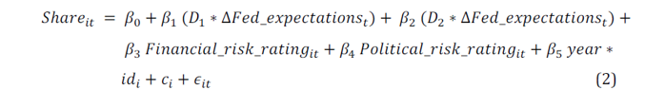
Comments/4: METHODOLOGY
METHODOLOGY
Additionally to that, in some of the specifications there are country-year (year*id(i)) and year FE
Where the variation comes from? (R2 close to 1)

Slide 10
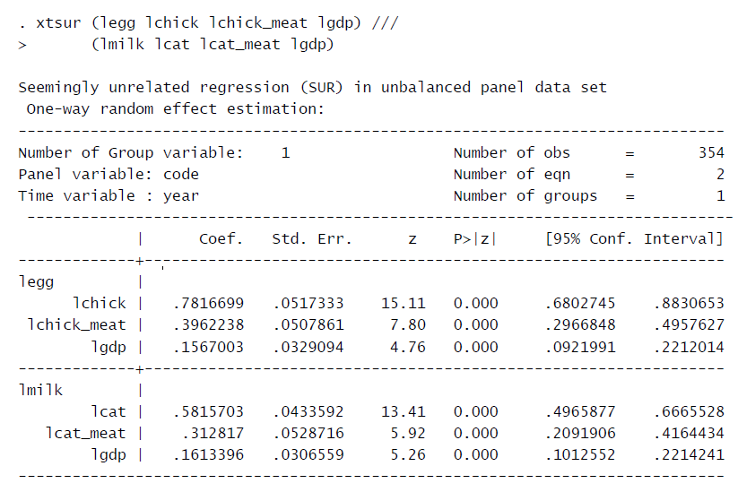
Comments/5: METHODOLOGY
METHODOLOGY
To take into account possible “cross sectional dependence between countries”, the authors implement a SUR (seemingly unrelated regression) model
Why not (spatial) panel data?

Slide 11
SUGGEstions:
Why not to focus on capital flows rather than shares?
Different types of capital flows?
Different countries (time-series analysis)?
A priori, we would expect (and we know that) some countries are more sensible to ECB moves rather than to FED. Why not to focus on those?
Aligning the model and the empirical strategy to mainstream literature (or expanding the explanation for “why not to do so”)
If the share is the focus of the analysis, then the research should dig more on “pull” factors (country-specific determinants) rather than “push” factors (common factors), e.g. Fratzscher (2012)

Slide 12
THANKS FOR YOUR ATTENTION

Slide 13
REFERENCES
Borrallo F., I. Hernando and J. Vallés (2016), “The Effects of US Unconventional Monetary Policies in Latin America, BdE WP n.1606
Clark J., N. Converse, B. Coulibaly and S. Kamin (2016), “Emerging Market Capital Flows and U.S. Monetary Policy”, IFDP Notes, October.
Koepke R. (2018), “Fed policy expectations and portfolio flows to emerging markets”, Journal of International Financial Markets, Institutions, & Money, 55:170-194.
Fratzscher M. (2012), “Capital flows, push versus pull factors and the global financial crisis”, Journal of International Economics, 88:341-356.
Serra X., J. Timini, J. Estefania and E. Martinez-Casillas (2018), “Argentina: economic challenges in an adverse international setting”, Banco de España – Economic Bullettin, 4/2018.

