Slide 1


XVIth ESCB Emerging Market Workshop
Asset price volatility in EU-6 economies:
How large is the role played by the ECB?
Alessio Ciarlone and Andrea Colabella
Bank of Italy, Directorate for Economics and
International Relations
Rome, November 22nd 2018
Notes:
Wilma Rousseff

Slide 2


Slide 3

Notes:
Wave - single dimension

Slide 4
How the wave propagates – the transmission channel
  Many channels studied by the literature;
  Focus on “risk-taking” channel, (Borio and Zhu 2008): how the implementation of highly accommodative (both conventional and unconventional measures) monetary policies (MPs) affect the perception and pricing of risk and the degree of risk tolerance of international investors:
    impact of low interest rates and/or unconventional policies on valuations, incomes, cash flows and the measured risks;
    “search for yields”;
    communication policies of the central bank.
    “Risk-taking” channel more likely in the context of non-standard MPs: ample liquidity into financial markets likely contributed to smoothing out price valuation changes in financial markets and hence to softening volatility movements.
    Hence, there is an inverse relation between (accommodative) MP and financial market volatility.
Notes:
There is a number of ways through which ultra-low interest rates (independent of their underlying cause) can influence economic agents’ risk-taking behaviour, i.e. through which the “risk-taking” channel may operate:
impact of interest rates on valuations, incomes, cash flows and the resulting measured risk: policy rates down leads to boost in asset and collateral values; the boost in corporate equities relative to corporate debts may induce an overall re-evaluation of private investors’ estimates of probabilities of defaults and losses-given-defaults; a reduced risk perception (or an increased risk tolerance) is typically reflected into lower asset price volatilities throughout the different segments of the overall financial system;
“search for yield” behaviour, which stems from the relationship between prevailing market rates and target rates of return: a highly accommodative monetary stance may increase incentives for asset managers to take on more risk for a number of reasons. (classic case: financial institutions regularly enter into long-term contracts requiring them to produce relatively high nominal rates of return);
moral hazard problems: agents’ perception that the central bank will ease monetary policy in the event of bad economic outcome could lower the probability of large downside risks, thereby producing a sort of insurance effect.
As regards the second point, it is helpful to recall the definition of liquidity again suggested by Borio and Zhu (2008) as the ease with which perceptions of value can be turned into purchasing power. Thus, higher liquidity may translate into an increased ability of investors to meet both current and future cash flows and collateral needs (the “funding (cash) liquidity”) and to trade an asset at short notice with little impact on its price in the context of their portfolio rebalancing strategies (the “market liquidity”). Both “funding (cash) liquidity” and “market liquidity” mechanisms contribute to smoothing out price changes in financial markets and hence to softening volatility movements.
Indeed, the two concepts of investors’ risk-taking behaviour and (market or funding cash) liquidity display a high degree of interconnectedness and do reinforce each other: on the one hand, lower perceptions of risk and greater risk tolerance weaken external funding and transferability constraints; on the other hand, weaker constraints can support higher risk-taking.

Slide 5
Outline of the presentation
Transmission channels (already said)
Motivation
Innovations
Main takeaways of the analysis
Asset price volatility and asset purchase programmes (APPs): the DCC-MGARCH model
Asset price volatility and APPs: robustness tests
Conclusions and policy implications
Notes:
5. background;
independent variables (and proxies for APPs);
estimation outcomes:
Base representation;
Refinements

Slide 6
Motivation
Since the onset of the 2008-2009 global financial crisis, the ECB has been implementing a series of non-standard monetary measures to address a range of unusual risks related to:
impairments in the functioning of certain financial markets;
fear of a euro-area break-up and ‘re-denomination’ risk;
consequences of a prolonged period of excessively low inflation/deflation.
The different programmes of outright purchases of financial assets (APPs) gained importance in the balance sheet of the Eurosystem, accounting for more than 55% of total asset in Oct. 2018.
While international spillovers stemming from unconventional monetary policies from advanced to emerging economies have been in-depth studied, the issue of “volatility spillovers” of such policies is a relatively unchartered territory.
Notes:
Only very recently, in fact, the focus has begun to shift to analysing the consequences of such monetary policy measures on the volatility of both real and financial variables at home as well as abroad, hence focusing on volatility spillovers.
Research question
We intend to gauge whether and to what extent the implementation of the APPs by the ECB might have played a role in shielding financial markets in EU-6 economies from adverse external shocks to international investors’ degree of risk aversion/may have contributed to protecting EU-6 financial markets from the adverse shocks that have been hitting international investors’ degree of risk aversion in recent years.

Slide 7
Innovations
The econometric technique Dynamic Conditional Correlation Multivariate GARCH (DCC-MGARCH) models (Engle, 2002)
  volatility clustering;
  cross-market spillover effects.
Wide set of proxies (adequately “treated”) to describe, as far as possible, the actual impact of the ECB’s non-standard monetary policies.
Weekly data on a long time span, ranging from January 2007 to December 2016.
Financial markets only and on a narrow set of countries.
Notes:
In this work, we improve upon the existing literature along several dimensions. First of all, we provide new insights to the nascent debate about the spillovers triggered by unconventional monetary measures implemented by AEs central banks onto volatility developments in EMEs financial markets which, to the best of our knowledge, has appeared only in a limited number of studies up to date. Second, we use an econometric technique (the DCC-MGARCH) which, while remaining in the mainstream of the GARCH models, can adequately take on board not only several variables in the specification of the conditional variance for the different financial markets, but also volatility clustering and important cross-market correlations. At the same time, it allows for a sufficient degree of flexibility in the estimation procedure and a relatively light computational burden. Third, we analyse volatility spillovers by resorting to a wide set of proxies which are adequately “treated” to describe, as far as possible, the actual impact of the ECB’s non-standard monetary policies. The approach suggested by Apostolou and Beirne (2017), in fact, raises some relevant questions about the reasons underlying the changes in ECB’s balance sheet – which may depend on factors not necessarily connected to the implementation of non-standard policies – and the relatively low frequency of the financial data series – which could be strongly affected by missing macroeconomic fundamentals, therefore hinting to an issue of a (potentially relevant) omitted variable bias. Fourth, the estimation exercise is also performed on a rather long time span, ranging from January 2007 to December 2016, which enables us not only to obtain more reliable and accurate estimates of the different linkages underlying the chosen variables, but also to study the whole period throughout which the ECB implemented different waves of APPs comprising the “expanded” one enacted by end-2014. Finally, we focus on financial markets only – which are supposed to bear the brunt of volatility changes – and on a narrow set of countries – the EU-6 economies, in light of their strong financial linkages with the euro area – which we retain would help us to better figure out the existence, and the extent, of the volatility spillovers stemming from the implementation of the ECB’s non-standard monetary policies.

Slide 8
Main takeaways of the analysis
  Implementation of the different waves of APPs shielded EU-6 financial markets from negative external shocks to international investors’ attitude towards risk.
  Conclusion valid against a large series of robustness tests, based on alternative econometric procedures and model specifications.
  From a monetary policy perspective the forthcoming process of gradual re-calibration of the monetary stance by the ECB could be accompanied by an increase in volatility in EU-6 financial markets.
  In general measures to limit adverse volatility spillovers might be needed and include altering monetary and fiscal policies where policy space is available, as well as exchange rate and foreign exchange reserves management.

Slide 9
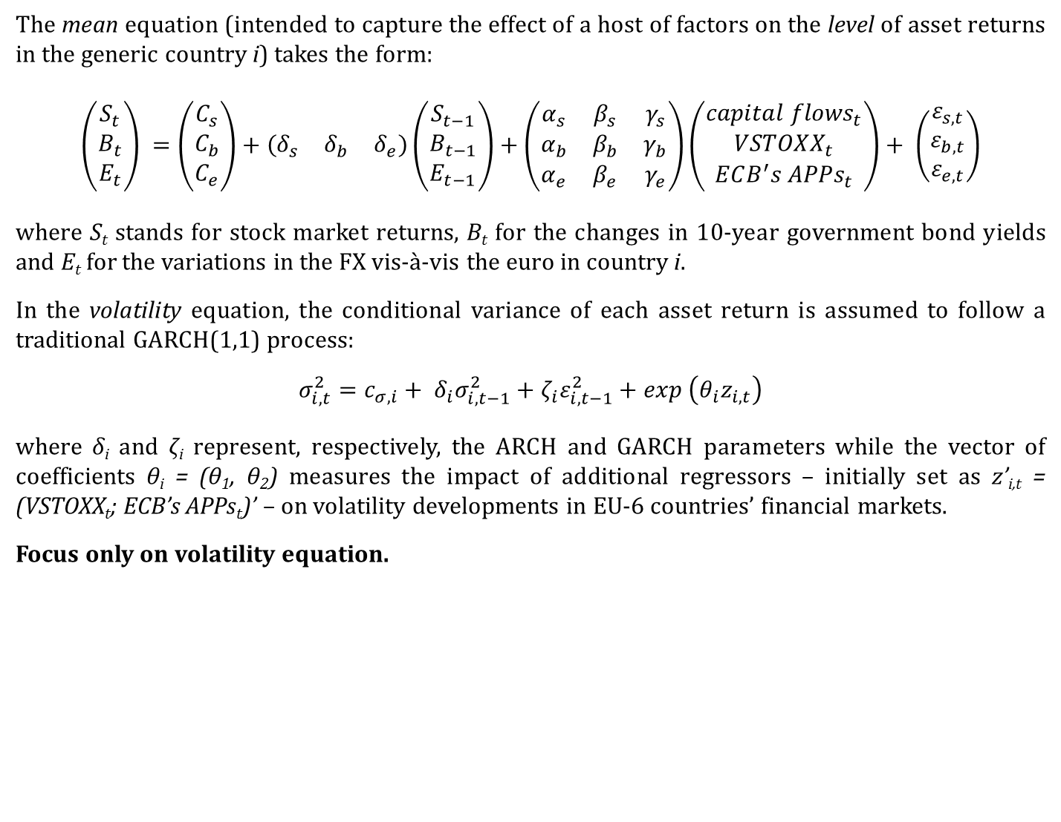
The DCC-MGARCH model: background
The mean equation (intended to capture the effect of a host of factors on the level of asset returns in the generic country i) takes the form:
$$\left(\begin{matrix}S_{t} \\ B_{t} \\ E_{t}\end{matrix}\right) =\left(\begin{matrix}C_{s} \\ C_{b} \\ C_{e}\end{matrix}\right)+\left(\begin{matrix}δ_{s} & δ_{b} & δ_{e}\end{matrix}\right)\left(\begin{matrix}S_{t−1} \\ B_{t−1} \\ E_{t−1}\end{matrix}\right)+\left(\begin{matrix}α_{s} & β_{s} & γ_{s} \\ α_{b} & β_{b} & γ_{b} \\ α_{e} & β_{e} & γ_{e}\end{matrix}\right)\left(\begin{matrix}{capital flows}_{t} \\ {VSTOXX}_{t} \\ {ECB^{′}s APPs}_{t}\end{matrix}\right)+ \left(\begin{matrix}ε_{s,t} \\ ε_{b,t} \\ ε_{e,t}\end{matrix}\right)$$
where S_{t} stands for stock market returns, B_{t} for the changes in 10-year government bond yields and E_{t} for the variations in the FX vis-à-vis the euro in country i.
In the volatility equation, the conditional variance of each asset return is assumed to follow a traditional GARCH(1,1) process:
$$σ_{i,t}^{2}=c_{σ,i}+ δ_{i}σ_{i, t−1}^{2}+ζ_{i}ε_{i,t−1}^{2}+exp \left(θ_{i}z_{i,t}\right)$$
where δ_{i} and ζ_{i} represent, respectively, the ARCH and GARCH parameters while the vector of coefficients θ_{i} = (θ₁, θ₂) measures the impact of additional regressors – initially set as z’_{i,t} = (VSTOXX_{t}; ECB’s APPs_{t})’ – on volatility developments in EU-6 countries’ financial markets.
Focus only on volatility equation.
Notes:
The advantage of using a DCC-MGARCH framework is two-fold: on the one hand, it is known in the literature that asset returns exhibit significant volatility clustering, i.e. high volatility tends to be followed by high volatility, making it important to allow for time-dependent volatility for the model to capture the dynamics of asset prices; on the other hand, the DCC-MGARCH model allows for interconnections between the volatility processes of the three assets in question, which allows to capture important cross-market spillover effects. In particular, the DCC-MGARCH model lets these spillover effects changing over time, which is often the case with financial variables.
We allow for the presence of an autoregressive component in the formulas describing the dynamics of the three series of asset price changes.

Slide 10
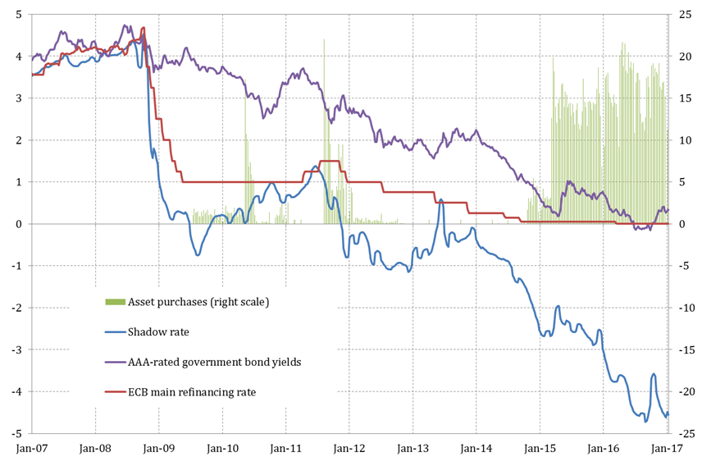
The DCC-MGARCH model: independent variables
VSTOXX_{t}: the EURO STOXX 50 volatility index, intended to capture the impact of shocks on international investors’ degree of risk aversion;
ECB’s APPs_{t}: a family of (exogenous) proxies to describe the ECB asset purchase programmes since July 2009, namely:
  the weekly average of 10-year yields on euro area AAA-rated government bonds (violet line);
  the weekly average of the shadow rate developed by Wu and Xia (2016) for the euro area (blue line);
  a quantity, rather than a price, indicator represented by the increase in the ECB’s holdings of securities for monetary purposes (green bars).
Notes:
Capital flows_{t} refers to the net portfolio inflows to EU-6 economies for registered funds from Emerging Portfolio Fund Research (EPFR), which are calculated as z-scores of equity flows, bond flows and total portfolio flows used, respectively, in the mean equations of the stock market returns, bond yield changes and foreign exchange variations (this is essentially done to assure cross-country comparability of the net portfolio inflow series).
Attention is focused on a series of proxies to gauge the impact of such non-standard measures on volatility developments in EU-6 economies.

Slide 11
The DCC-MGARCH model: independent variables (cont.)
  The expected signs for the volatility equation are hosted in the following table:
Notes:
The volatility of asset returns is supposed to be:
positively related to the VSTOXX index (+), reflecting the natural transmission of shocks from global to local markets.
As regards the expected association with the ECB’s APPs, the hypothesis we would like to test here is the existence of a mitigating impact on volatility developments in EU-6 countries’ financial markets stemming from the implementation of such non-standard measures, reflecting the functioning of the “risk taking” channel of transmission as well as the working of the “funding (cash)” and “market” liquidity mechanisms. Given that we are using three different proxies, this hypothesis would translate into different expected signs for each of these measures: on the one hand, we would expect to see an inverse (i.e. negative) relationship with the flow of financial assets actually purchased by the ECB (i.e. the larger the flows, the lower the volatility); on the other hand, we would expect a direct (i.e. positive) relationship with the average level of 10-year yields on euro area AAA-rated government bonds and the shadow rate (i.e. the lower the rates, the lower the volatility).

Slide 12
The DCC-MGARCH model: estimation outcomes (base representation)
Notes:
The prevalence of green suggest that our three proxies appear to have a clear effect on the volatility of asset returns in EU-6 financial markets: the signs of the estimated coefficients often come out as expected, and these coefficients are statistically significant for the majority of EU-6 countries across the different financial markets and model specifications.
These conclusions apply strongly for the stock and the foreign exchange markets: in the former case, all the coefficients of the three proxies turn out with the expected positive sign and statistically significant in the majority of the cases (100% for the continuous proxies; 67% for the flow of asset purchases); for the latter, the sign is again correct in all the countries throughout all the different specifications, but significant in three over five cases for each of them (the 60% of the cases).
On the contrary, volatility developments in bond markets seem to remain largely unaffected by our three proxies: with the exception of the flow of asset purchases – for which there appears to be a sufficiently robust evidence of a dampening impact on bond market volatility (right sign in 4 over 6 cases and significant in 3 over 6 cases) – both the tow continuous proxies do not seem to play an economically and statistically relevant role in affecting volatility developments in EU-6 bond markets (AAA: right sign in 3 over 6 cases and significant in just 1 case; shadow: right sign in 3 over 6 cases and significant in 2 over 6 cases) at least when estimations are run throughout the whole available time span and/or without any transformation of those independent variables.
This battery of estimation results seems to give a first support to our research question related to the existence of a favourable influence played by the implementation of the APPs in containing volatility in EU-6 financial markets: the flows of financial asset purchases, along with the resulting dynamics of the euro area AAA-rated 10-year government bond yields or the shadow rate, seem to have been able to counter adverse developments in global volatility indicators, thereby shielding EU-6 financial markets from negative external shocks to international investors’ risk aversion. In our view, the economic and statistical significance of the estimated coefficients would support the existence of both a “risk-taking” and a “liquidity” channel of transmission stemming from the ECB’s non-standard monetary measures, which may operate both directly (on the volatilities of EU-6 financial markets) as well as indirectly (via their impact on the VSTOXX index).

Slide 13
The DCC-MGARCH model: estimation outcomes (refinements)
  Shadow rates and AAA-rated bond yields are available for the whole time span under study and may depend on several factors in addition to outright financial asset purchases by the ECB.
  To address this concern two refinements:
  10-year yields on euro area AAA-rated government bonds. Two-step procedure originally proposed by Ahmed and Zlate (2014), aimed to isolate the changes in such yields that can be considered as directly attributable to the implementation of the ECB’s non-standard monetary measures;
  Shadow rate. Augmenting the basic specification with a couple of additive and interaction dummies to look for the existence of a structural break in the relationship between this proxy and asset price volatility developments in EU-6 economies.
  The two dummies are located around the week ending on the 9th of December 2011 (see figure), when the shadow rate finally delved into negative territories to remain there until recently.
Notes:
In the first stage, a simple OLS regression over the period from July 2009 to December 2016 is run, where the ECB’s one-week ahead actual gross asset purchases are used as an explicit determinant of the weekly average of euro area AAA-rated government long-term yields; in the second stage, the fitted values of this regression (less the respective estimated constants) are used in the volatility equation as a proxy of the effects of the ECB’s APPs, with the expected sign being positive to indicate a direct relationship with the volatility measures (i.e. a reduction in euro area AAA-rated government long-term yields determined by the actual implementation of asset purchases is associated with a lower volatility in EU-6 countries financial markets).
The additive dummy is intended to modify the average level of volatility in EU-6 financial markets after the ‘treatment’ represented by the launch of different waves of APPs; the interaction dummy is intended to assess the existence of a differential – by sign, magnitude and significance level – impact of the chosen proxy on volatility developments in EU-6 financial markets, respectively, before and after the chosen cut-off date.
As regards the choice of the cut-off date, we decided to experiment with the week ending the 9th of December 2011: i) as the euro area sovereign debt crisis reached its peak, the ECB stepped in by reactivating, in August 2011, the Securities Market Programme, with interventions much larger than before; ii) on the 8th of December 2011 the Governing Council decided to conduct two longer-term refinancing operations (LTROs) with a maturity of 36 months which, though not representing a true asset purchase programme, undoubtedly sent an important signal to reassure market participants about the willingness to support bank lending and money market activity in the euro area. Reflecting these choices, the shadow rate entered into negative territory – traditionally considered as a reflection of the implementation of unconventional monetary policies – where it has remained almost continuously until the present.
All in all, we are taking an approach quite similar in spirit to the one used by the Federal Reserve as regards the shadow rate calculated for the US.

Slide 14
The DCC-MGARCH model: estimation outcomes (refinements)
  Results for the first refinement (AZ procedure):
Notes:
The compression in euro area AAA-rated long-term government bond yields that can be ascribed to the implementation of the various ECB’s APPs has been accompanied by a more contained volatility in EU-6 financial markets. The new proxy has the expected sign for all the countries in the sample in both the stock and the foreign exchange markets, and is statistically significant in four out of six cases in the former and in three out of five cases in the latter. These results are the same as before for the foreign exchange market and marginally worsen for the equity markets, though not as much to radically change the overall conclusions More importantly, the new proxy seems to be better suited to capture the effect on volatility in bond markets: contrary to what observed with the original measures, the coefficients now have the correct sign in four out of six cases, while turning out statistically significant in half of the sample countries.
Stock market. Hungary and Romania clearly show the occurrence of a structural break around the December event: on the one hand, the interaction term takes on the expected positive sign and is significant in contrast with the insignificant coefficient of the non-interacted term, therefore demonstrating that our proxy started to exert a relevant trimming effect after the cut-off date; on the other hand, the coefficient of the additive dummy comes out with a negative sign, suggesting that the period from December 2011 onwards has been characterised by a lower average volatility than the preceding period. These conclusions are confirmed by the results of the F-test on the joint significance of the coefficients of both the indicator dummy and the interaction term. For the other countries the conclusion about the favourable role played by the shadow rate in containing volatility spikes in EU-6 stock markets appears to be confirmed: independently of the occurrence of the December 2011 event, the coefficients of the term Shadow rate_{t} always come out with the expected significant positive sign and larger than the (always insignificant) coefficients of the interaction terms.
Bond market. For the cases of Croatia, the Czech Republic, Hungary and, marginally, Bulgaria estimation results clearly point to the existence of a structural break in the relationship between the shadow rate and volatility developments. For these three countries, in fact, the coefficients of the interaction term turn out having the correct positive sign and being statistically significant, clearly pointing to the occurrence of a change in the relationship among the variables at stake especially when compared with the insignificant, or non-correctly signed, coefficients of the non-interacted term. Although the wrongly signed coefficients of the additive dummies would tend to signal an average higher volatility in the aftermath of the December event, their magnitude is relatively contained and not as large as to drastically change the conclusions about the dampening effect exerted by the shadow rate on volatility developments in this market. For the cases of Poland and Romania, on the contrary, there appears to be as well a structural change, although in the opposite direction with respect to the expected one; nevertheless, the magnitude of the coefficients of the non-interacted term is always larger than that of the interacted term, therefore making the overall impact after the cut-off date still coherent with the general conclusion according to which the shadow rate has been helping contain EU-6 bond market volatility.
FX markets. In only two occasions (i.e. the Czech Republic and Hungary) there appears to be a clear structural break in the estimated relationship; nevertheless, adding the case of Romania – where again, independently from the occurrence of the December 2011 event, the coefficient of the non-interacted term always comes out with the expected significant positive sign while being larger than the (always insignificant) negative coefficient of the interaction terms – provides further support to the general conclusion about the role played by the shadow rate in containing volatility spikes in this market.
ALLA FINE, IN TERMINI DI PAESI OK, CON QUESTO METODO OTTENIAMO LO STESSO DI PRIMA NEL CASO DI STOCK E FX; FACCIAMO MEGLIO PER IL MERCATO DEI BOND CHE ERA QUELLO CHE VOLEVAMO.

Slide 15
The DCC-MGARCH model: estimation outcomes (refinements)
  Results for the second refinement (dummies and structural breaks): the case of Hungary
Notes:
Stock market. Hungary and Romania clearly show the occurrence of a structural break around the December event: on the one hand, the interaction term takes on the expected positive sign and is significant in contrast with the insignificant coefficient of the non-interacted term, therefore demonstrating that our proxy started to exert a relevant trimming effect after the cut-off date; on the other hand, the coefficient of the additive dummy comes out with a negative sign, suggesting that the period from December 2011 onwards has been characterised by a lower average volatility than the preceding period. These conclusions are confirmed by the results of the F-test on the joint significance of the coefficients of both the indicator dummy and the interaction term. For the other countries the conclusion about the favourable role played by the shadow rate in containing volatility spikes in EU-6 stock markets appears to be confirmed: independently of the occurrence of the December 2011 event, the coefficients of the term Shadow rate_{t} always come out with the expected significant positive sign and larger than the (always insignificant) coefficients of the interaction terms.
Bond market. For the cases of Croatia, the Czech Republic, Hungary and, marginally, Bulgaria estimation results clearly point to the existence of a structural break in the relationship between the shadow rate and volatility developments. For these three countries, in fact, the coefficients of the interaction term turn out having the correct positive sign and being statistically significant, clearly pointing to the occurrence of a change in the relationship among the variables at stake especially when compared with the insignificant, or non-correctly signed, coefficients of the non-interacted term. Although the wrongly signed coefficients of the additive dummies would tend to signal an average higher volatility in the aftermath of the December event, their magnitude is relatively contained and not as large as to drastically change the conclusions about the dampening effect exerted by the shadow rate on volatility developments in this market. For the cases of Poland and Romania, on the contrary, there appears to be as well a structural change, although in the opposite direction with respect to the expected one; nevertheless, the magnitude of the coefficients of the non-interacted term is always larger than that of the interacted term, therefore making the overall impact after the cut-off date still coherent with the general conclusion according to which the shadow rate has been helping contain EU-6 bond market volatility.
FX markets. In only two occasions (i.e. the Czech Republic and Hungary) there appears to be a clear structural break in the estimated relationship; nevertheless, adding the case of Romania – where again, independently from the occurrence of the December 2011 event, the coefficient of the non-interacted term always comes out with the expected significant positive sign while being larger than the (always insignificant) negative coefficient of the interaction terms – provides further support to the general conclusion about the role played by the shadow rate in containing volatility spikes in this market.
ALLA FINE, IN TERMINI DI PAESI OK, CON QUESTO METODO OTTENIAMO LO STESSO DI PRIMA NEL CASO DI STOCK E FX; FACCIAMO MEGLIO PER IL MERCATO DEI BOND CHE ERA QUELLO CHE VOLEVAMO.

Slide 16
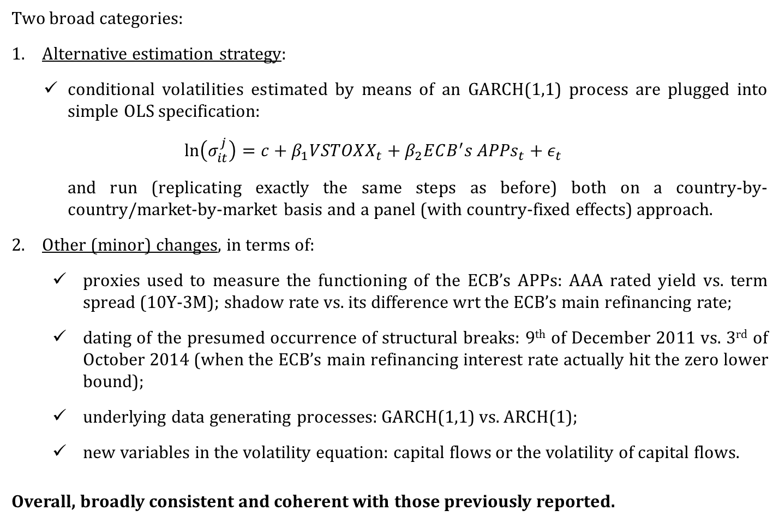
The DCC-MGARCH model: robustness tests
  Two broad categories:
  Alternative estimation strategy:
  conditional volatilities estimated by means of an GARCH(1,1) process are plugged into simple OLS specification:
  $$\ln\left(σ_{it}^{j}\right)=c+β_{1}{VSTOXX}_{t}+{β_{2}ECB^{′}s APPs}_{t}+ε_{t}$$
  and run (replicating exactly the same steps as before) both on a country-by-country/market-by-market basis and a panel (with country-fixed effects) approach.
  Other (minor) changes, in terms of:
    proxies used to measure the functioning of the ECB’s APPs: AAA rated yield vs. term spread (10Y-3M); shadow rate vs. its difference wrt the ECB’s main refinancing rate;
    dating of the presumed occurrence of structural breaks: 9th of December 2011 vs. 3rd of October 2014 (when the ECB’s main refinancing interest rate actually hit the zero lower bound);
    underlying data generating processes: GARCH(1,1) vs. ARCH(1);
    new variables in the volatility equation: capital flows or the volatility of capital flows.
    Overall, broadly consistent and coherent with those previously reported.

Slide 17
Conclusions and policy implications
  We shed light on the question of whether, and to what extent, the different waves of asset purchase programmes the ECB has been implementing since July 2009 may have contributed to protecting EU-6 financial markets from the adverse shocks that have been hitting international investors’ degree of risk aversion in recent years.
  Irrespective of the measurement method and model specification, estimation outcomes show that such non-standard monetary initiatives contributed to taming volatility developments in EU-6 stock, long-term government bond and foreign exchange markets, evidence which may be thought of as reflecting the working of a “risk taking” and a (“market” or “funding cash”) liquidity channel of transmission.
  These results, which are robust to an extensive series of checks, may have important implications: looking forward, in fact, it could not be ruled out that the process of gradual re-calibration of the monetary stance by the ECB could be accompanied by an increase in volatility in EU-6 financial markets.
  Measures to limit adverse volatility spillovers may include, but are not limited to, altering monetary and fiscal policies where policy space is available, as well as exchange rate and foreign exchange reserves management.

Slide 18
  Thank you

Slide 19
Back

Slide 20
The DCC-MGARCH model: independent variables
capital flows_{t}: net portfolio inflows (equity, bond, total) to EU-6 economies for registered funds from Emerging Portfolio Fund Research (EPFR), which are calculated as z-scores;
VSTOXX_{t}: the EURO STOXX 50 volatility index, intended to capture the impact of shocks on international investors’ degree of risk aversion;
ECB’s APPs_{t}: a family of (exogenous) proxies to describe the ECB asset purchase programmes since July 2009, namely:
  the weekly average of 10-year yields on euro area AAA-rated government bonds (violet line);
  the weekly average of the shadow rate developed by Wu and Xia (2016) for the euro area (blue line);
  a quantity, rather than a price, indicator represented by the increase in the ECB’s holdings of securities for monetary purposes (green bars).

Slide 21
The DCC-MGARCH model: independent variables (cont.)
  The expected signs are hosted in the following table:
  Against the background of our research question, and due to the rather complex structure of the tables (2 equations times 3 markets times 6 countries times 3 proxies), in what follows attention will be focused only to the estimation results related to the sign and significance of the three proxies in the volatility equations of each financial market at stake.
  Of course, the interested reader is referred to the paper for the broader picture.
Notes:
Beyond depending on their own lagged values, the level of financial asset returns in the mean equation is supposed to show:
a direct relationship with the size of the portfolio inflows destined to any given EU-6 country: higher inflows would be typically associated with an increase in stock market indices (+), a compression of government bond yields (–) and an appreciation of local currencies vis-à-vis the euro (+);
an inverse relationship with external shocks to global volatility – traced by the VSTOXX index – since they would generate a plunge in stock prices (–), an increase in long-term yields (+) and downward pressures on the exchange rate (–);
a direct relationship with the gradual implementation of asset purchase programmes by the ECB: under the hypothesis that a portfolio rebalancing channel of transmission of such non-standard monetary measures is actually at play, the increase in the ECB’s holdings of securities, along with the related compression of euro area AAA-rated government bond yields or the shadow rate, would typically generate a positive push on financial market valuations in EU-6 countries.
The volatility of asset returns is supposed to be:
positively related to the VSTOXX index (+), reflecting the natural transmission of shocks from global to local markets.
As regards the expected association with the ECB’s APPs, the hypothesis we would like to test here is the existence of a mitigating impact on volatility developments in EU-6 countries’ financial markets stemming from the implementation of such non-standard measures, reflecting the functioning of the “risk taking” channel of transmission as well as the working of the “funding (cash)” and “market” liquidity mechanisms. Given that we are using three different proxies, this hypothesis would translate into different expected signs for each of these measures: on the one hand, we would expect to see an inverse (i.e. negative) relationship with the flow of financial assets actually purchased by the ECB (i.e. the larger the flows, the lower the volatility); on the other hand, we would expect a direct (i.e. positive) relationship with the average level of 10-year yields on euro area AAA-rated government bonds and the shadow rate (i.e. the lower the rates, the lower the volatility).

Slide 22
The DCC-MGARCH model: estimation outcomes (base representation)

Slide 23
The DCC-MGARCH model: estimation outcomes (refinements)
  Results for the first refinement (AZ procedure):
  Results for the second refinement (dummies and structural breaks):

