Slide 1

Labour market conditions and wage inflation in CEE economies
Simone Auer
(Bank of Italy)
Disclaimer: the opinions expressed and conclusions drawn do not necessarily reflect the views of the Bank of Italy.

Slide 2
Motivation of the paper
Increasing interest in the weak relation between wage inflation and unemployment rate over the recent years as a relevant policy issue
e.g. IMF WEO (2017), ECB (2017), BOE (2017).
This missing link was considered as part of the explanation of the so-called “growth-inflation disconnect”:
missing deflation after the global financial crisis;
missing inflation during the recent recovery;
(Wage and price) Phillips curve has “broken down” (Summers, 2017):
Unemployment rate underestimates true degree of labour market slack
(Stock and Watson, 2018)
Wage/price-unemployment relation plagued by non-linearities
(Nalewaik, 2016)
2

Slide 3
Aim of the paper and main results
Less attention devoted to the relation between wage inflation and unemployment rate in EMEs, especially CEEs.
In this paper:
1st: check the existence of a negative relation in the main CEE economies (Poland, Czech Republic, Hungary)
  → Weaker (or even null) relation in the period post-2008
2nd: evaluate (qualitatively) possible explanations behind this evidence
  → Composition effects in the labour supply
3

Slide 4
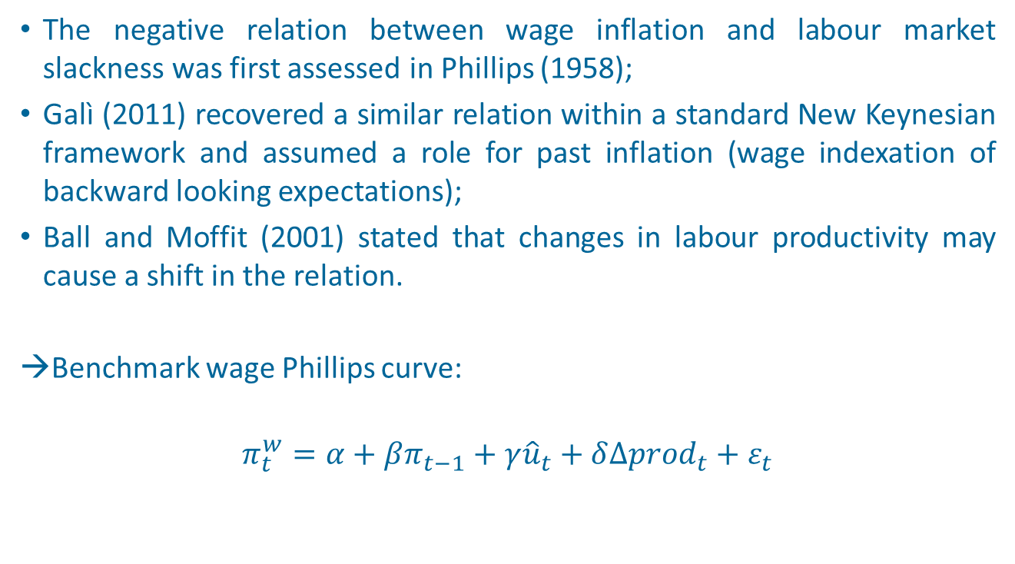
Wage Phillips curve
The negative relation between wage inflation and labour market slackness was first assessed in Phillips (1958);
Galì (2011) recovered a similar relation within a standard New Keynesian framework and assumed a role for past inflation (wage indexation of backward looking expectations);
Ball and Moffit (2001) stated that changes in labour productivity may cause a shift in the relation.
→Benchmark wage Phillips curve:
$$π_{t}^{w}=α+βπ_{t−1}+γ{\hat{u}}_{t}+δ{∆prod}_{t}+ε_{t}$$
4

Slide 5
Recent evolution of hourly earnings in the CEE…
Relatively weak nominal wage dynamic in the period of rapid economic recovery (after 2013);
Sharp acceleration only in early 2017, especially in Hungary and the Czech Republic.
Source: OECD
5

Slide 6
… in a context of rapidly declining unemployment rate
The unemployment rate started to decline after mid-2013;
Unemployment rate at minimum historical level since early 2016;
Values in 2017 largely below the NAWRU estimated by the EC.
Source: Eurostat
6

Slide 7
Weak labour productivity growth with respect to pre-2008
Large boost to labour productivity in 2003-2007: GVC and FDI
Slowdown after the crisis, with the exception of PO;
Moderate recovery over the last few years, mainly in HN.
Source: Eurostat
7

Slide 8
Inflation was relatively low especially between 2013-2016
Inflation below the minimum historical level for a long period, especially in Poland.
Potential role in reducing the pressure toward the demand for higher nominal wages by workers.
Source: National sources
8

Slide 9
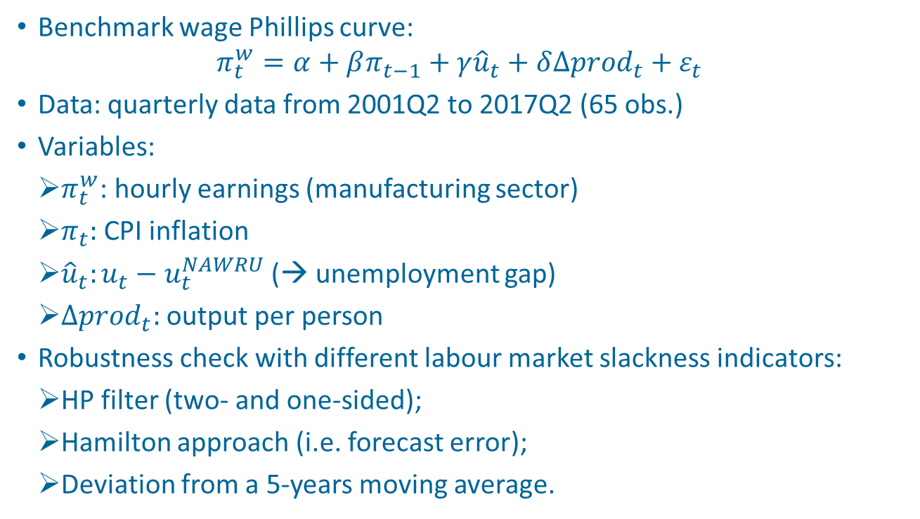
Wage Phillips curve - estimation
Benchmark wage Phillips curve:
$$π_{t}^{w}=α+βπ_{t−1}+γ{\hat{u}}_{t}+δ∆{prod}_{t}+ε_{t}$$
Data: quarterly data from 2001Q2 to 2017Q2 (65 obs.)
Variables:
    $π_{t}^{w}$: hourly earnings (manufacturing sector)
    $π_{t}:$ CPI inflation
    ${\hat{u}}_{t}:u_{t}−u_{t}^{NAWRU}$ (→ unemployment gap)
    $∆{prod}_{t}:$ output per person
Robustness check with different labour market slackness indicators:
    HP filter (two- and one-sided);
    Hamilton approach (i.e. forecast error);
    Deviation from a 5-years moving average.
9

Slide 10
Wage Phillips curve - OLS
Coefficients with the expected signs and significant (with Hamilton approach for Poland)
Adj-R² relatively low, in particular in the case of Poland
10

Slide 11
Wage Phillips curve – IV (2SLS)
IV regression to tackle potential issue of reverse causality through lagged inflation;
Instruments: additional lagged values;
The OLS results are only slightly affected
NB: Robustness check also on potential endogeneity issues related with the other regressors.
11

Slide 12

Wage Phillips curve decomposition
2009-2013:
${\hat{u}}_{t}$contributed negatively to wage inflation, but only in PO was the main driver (labour productivity in HN and CZ) 2014-2016:
Lagged inflation and labour productivity offsetting the effect of lower ${\hat{u}}_{t}$.
NB: large negative residuals in PO & CZ
12

Slide 13
Rolling window estimates of γ
Poland
Hungary
Rolling OLS regressions with a fixed window of 30 observations (i.e. first estimation with data up to 2008Q3)
Clear indication of a decrease in the coefficient attached to the unemployment gap, especially in PO and the CZ
In the case of the CZ the coefficient becomes not significant from end-2014
Czech Republic
13

Slide 14
Potential explanation of weak wage inflation in the CEE
Main explanation in advanced economies related to inappropriate measure of slackness in the labour market:
Underutilization rate of labour force (Yellen, 2014; ECB, 2017)
Wider use of temporary and part-time contracts (IMF, 2017)
The role of long-term unemployment (Llaudes, 2015; Kiley et al., 2015)
→These explanations do not seem suitable for CEE economies
14

Slide 15
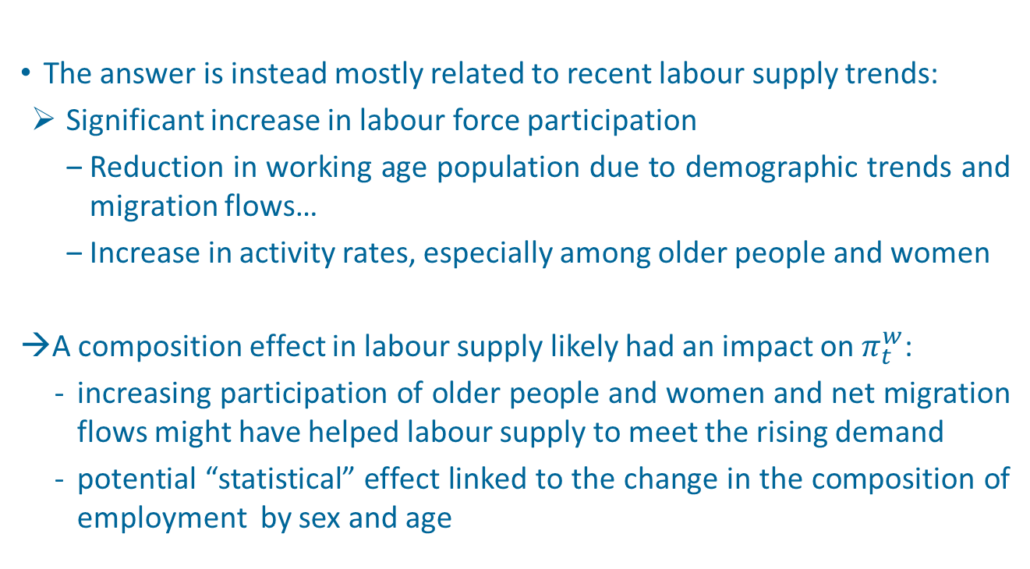
Potential explanation of weak wage inflation in the CEE
The answer is instead mostly related to recent labour supply trends:
Significant increase in labour force participation
Reduction in working age population due to demographic trends and migration flows…
Increase in activity rates, especially among older people and women
→A composition effect in labour supply likely had an impact on $π_{t}^{w}$:
increasing participation of older people and women and net migration flows might have helped labour supply to meet the rising demand
potential “statistical” effect linked to the change in the composition of employment by sex and age
15

Slide 16
Thanks!

Slide 17
Underutilization rate of labour force
    Underutilization rate of labour force:
    Underemployed (involuntary part-time) + marginally attached workers (available not seeking and seeking not available)
17

Slide 18
Temporary and part-time workers (% of total employment)
18

Slide 19
Long-term unemployment rate
19

Slide 20
Labour force participation rate, %
20

Slide 21
Working age population, % variation
21

Slide 22
Labour force participation rate, %
22

