Slide 1
What the does the strange crisis in Russia indicate about labor supply?
Risto Herrala (presenter) & Timo Kuosmanen
22.11.2018

Slide 2
Meanwhile in Russia: Weak labor market reaction to a large shock..

Slide 3
The literature has seen movement from the flat towards the inward shift view
Hall (2007): long standing concencus that cyclical shifts in employment are demand determined
Chetty et al (2011): survey of empirical literature indicates a relatively vertical labor supply curve
Recent work, however, points to cyclical shifts in labor supply
  Eggertsson & Krugman (2012) theorize: tigtening borrowing constraints during recession force households to work more. Rossi & Trucchi (2016) find empirical support for this.
  Foroni et al (2018); Mulligan (2010) empirical evidence that labor supply plays a non-negligible role in business cycle fluctuations.

Slide 4
This paper
Uncover the labor supply reaction during the cyclical downturn in Russia
In this first version: focus on how credit limits impact labor supply
  Does Eggertsson and Krugman’s (2012) hypothesis hold?
  Still big issues, a rework is forthcoming

Slide 5
Novelties, apart from the data
New theory of labor supply when the loan market is characterized by moral hazard
  Labor supply, consumption, credit limits, interest rates endogenously detemined
  The model allows an in depth study the channel from financial frictions to labor supply
Improved identifiction of model from micro data
  Identify credit limits & its components from debt distribution based on a zero-inefficiency stochastic frontier model.
  Use the components & two calibrated parameters to quantify labor supply.

Slide 6
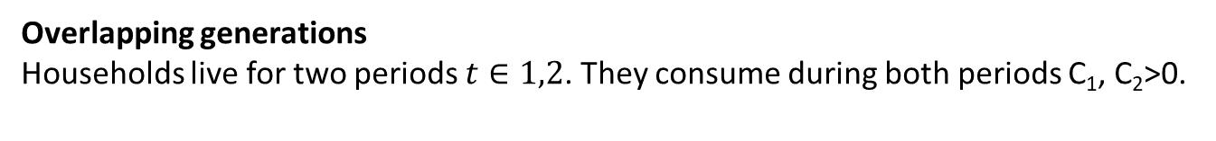

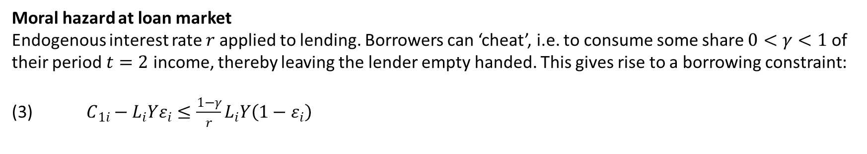
The theory
Overlapping generations
Households live for two periods $t∈1,2$. They consume during both periods C₁, C₂>0.
Slow accrual of income from labor
They supply labor $L>0$ only at t=1 to generate income $LY$, where unit income Y is exogenous. Income is spread out over the two periods: income at $t=1$ is $LYε$ and income at $t=2$ is $LY(1−ε)$.
Moral hazard at loan market
Endogenous interest rate $r$applied to lending. Borrowers can ‘cheat’, i.e. to consume some share $0<γ<1$ of
their period $t=2$ income, thereby leaving the lender empty handed. This gives rise to a borrowing constraint:
(3) $C_{1i}−L_{i}Yε_{i}≤\frac{1−γ}{r}L_{i}Y\left(1−ε_{i}\right)$
Quadratic utility
$$U_{i}=−1/2{L_{i}}^{2}+C_{1i}+C_{2i}+β/2\left({C_{1i}}^{2}+{C_{2i}}^{2}\right)$$

Slide 7
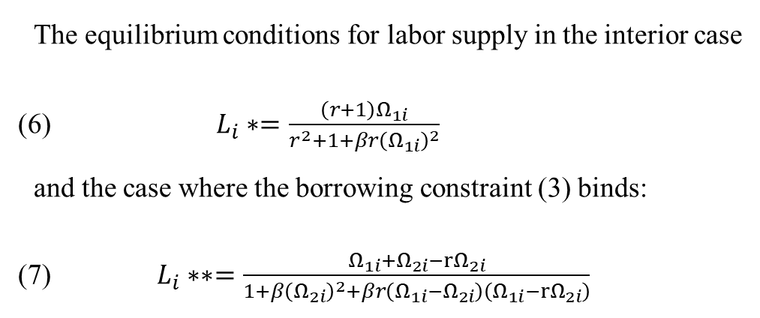
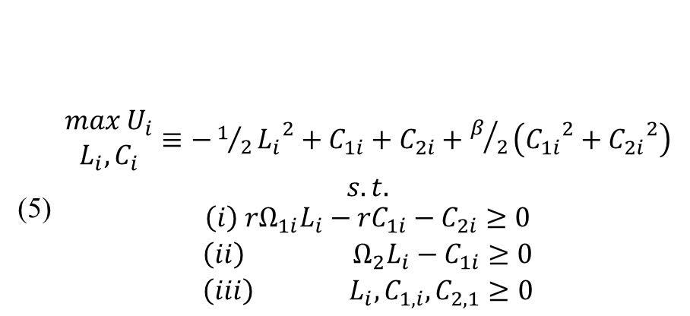
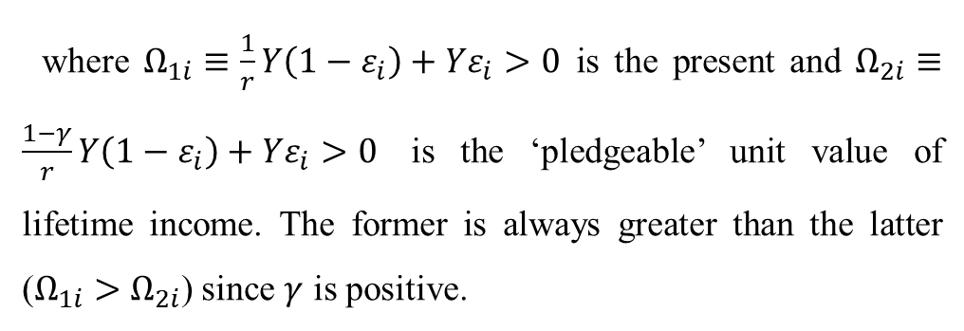
Deriving the equilibrium
The equilibrium conditions for labor supply in the interior case
(6) $L_{i}∗=\frac{\left(r+1\right)Ω_{1i}}{r^{2}+1+βr{\left(Ω_{1i}\right)}^{2}}$
and the case where the borrowing constraint (3) binds:
(7) $L_{i}∗∗=\frac{Ω_{1i}+Ω_{2i}−rΩ_{2i}}{1+β{\left(Ω_{2i}\right)}^{2}+βr\left(Ω_{1i}−Ω_{2i}\right)\left(Ω_{1i}−{rΩ}_{2i}\right)}$
(5) $\begin{matrix}\begin{matrix}\begin{matrix}max U_{i} \\ L_{i},C_{i}\end{matrix}≡−1/2{L_{i}}^{2}+C_{1i}+C_{2i}+β/2\left({C_{1i}}^{2}+{C_{2i}}^{2}\right) \\ s.t.\end{matrix} \\ \left(i\right) rΩ_{1i}L_{i}−{rC}_{1i}−C_{2i}≥0 \\ \begin{matrix}\left(ii\right) Ω_{2}L_{i}−C_{1i}≥0 \\ {\left(iii\right) L}_{i},C_{1,i},C_{2,1}≥0\end{matrix}\end{matrix}$
where $Ω_{1i}≡\frac{1}{r}Y\left(1−ε_{i}\right)+Yε_{i}>0$ is the present and $Ω_{2i}≡\frac{1−γ}{r}Y\left(1−ε_{i}\right)+Yε_{i}>0$ is the ‘pledgeable’ unit value of lifetime income. The former is always greater than the latter ($Ω_{1i}>Ω_{2i}$) since $γ$ is positive.

Slide 8
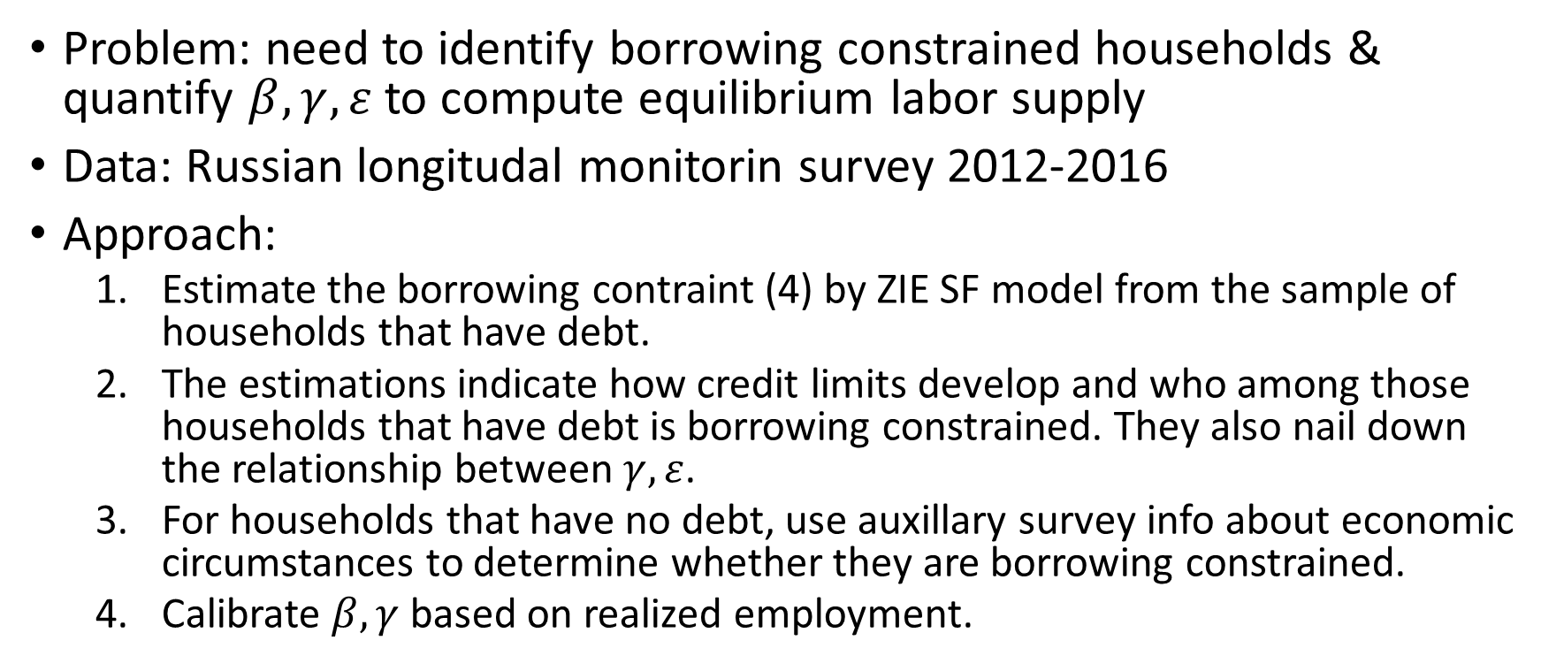
Bringing the model to data
Problem: need to identify borrowing constrained households & quantify $β,γ,ε$ to compute equilibrium labor supply
Data: Russian longitudal monitorin survey 2012-2016
Approach:
  Estimate the borrowing contraint (4) by ZIE SF model from the sample of households that have debt.
  The estimations indicate how credit limits develop and who among those households that have debt is borrowing constrained. They also nail down the relationship between $γ,ε$.
  For households that have no debt, use auxillary survey info about economic circumstances to determine whether they are borrowing constrained.
  Calibrate $β,γ$based on realized employment.

Slide 9
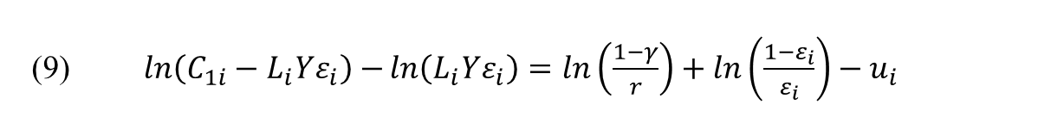
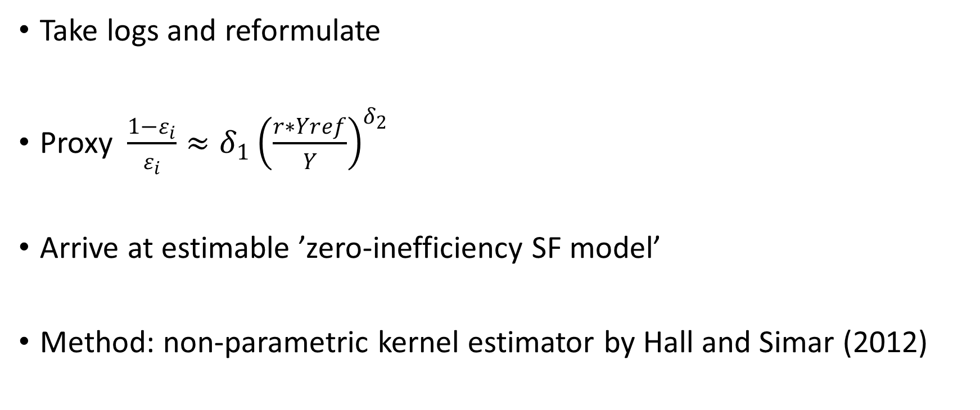
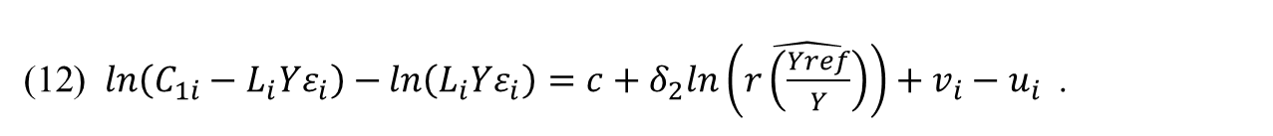
Step 1 Estimating the borrowing constraint
Take logs and reformulate
Proxy$\frac{1−ε_{i}}{ε_{i}}≈{δ_{1}\left(\frac{r∗Yref}{Y}\right)}^{δ_{2}}$
Arrive at estimable ’zero-inefficiency SF model’
Method: non-parametric kernel estimator by Hall and Simar (2012)
(9) $\ln\left(C_{1i}−L_{i}Yε_{i}\right)−ln\left(L_{i}Yε_{i}\right)=ln\left(\frac{1−γ}{r}\right)+ln\left(\frac{1−ε_{i}}{ε_{i}}\right)−u_{i}$
(12) $\ln\left(C_{1i}−L_{i}Yε_{i}\right)−ln\left(L_{i}Yε_{i}\right)=c+δ_{2}ln\left(\hat{r\left(\frac{Yref}{Y}\right)}\right)+v_{i}−u_{i}$.

Slide 10
Visual of the estimation method

Slide 11
Use of auxillary info to classify households that have no debt
Not borrowing constrained:
  Very satisfied with economic situation, or significant wealth
Borrowing constrained:
  Very concerned about economic essentials, or very bad health
Only 2-3 percent of households remain declassified. These are assigned 50 percent chance of being constrained.

Slide 12
Estimation results

Slide 13
Calibrating β and γ
Select β so that L corresponds with its realized average value 2012-16
Select path for γ so that the path of L corresponds closely with realized path

Slide 14
Completed baseline model

Slide 15
Simulation results:
Labor supply deceases when borrowing constraints tighten
Contrary to
Eggertsson & Krugman (2012)

Slide 16
Concluding remarks
The analysis is still very preliminary
Work is ongoing with alternative utility functions, improved simulation techniques, expanded coverage to other supply factors

Slide 17
scrap

Slide 18
The estimation period

