Slide 1

XVIth ESCB Emerging Markets Workshop
Has private sector credit in CESEE approached levels justified by fundamentals?
A post-crisis assessment
By Mariarosaria Comunale, Markus Eller and Mathias Lahnsteiner
Comments by Alessio Ciarlone
Bank of Italy
International Relations and Economics Directorate

Slide 2
Overview
Research question
Have credit-to-GDP ratios in 11 CESEE EU member states eventually approached levels justified by macroeconomic and financial fundamentals?
Econometric procedure
Static and dynamic panel techniques accounting for cross-sectional dependence, heterogeneous coefficients, non-stationarity and co-integration.
Main takeaway
Few countries in line with fundamentals (Slovenia for total credit and Estonia + Latvia for domestic credit); many countries not in line with fundamentals (overshooting in Bulgaria and Croatia, undershooting in all the remaining ones).

Slide 3
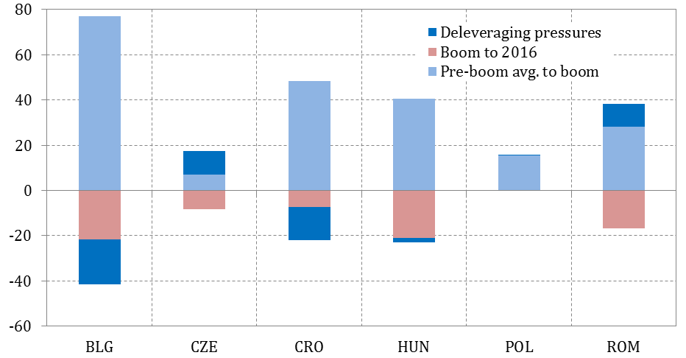
Overview
Non-financial corporates
Households
De-leveraging pressures calculated as the simple average of the distance w.r.t. four different thresholds: i) the average prevailing in the pre-boom years (’00-’03); ii) the long-term average (calculated by recurring to the whole 1995-2016 time span, where available); iii) the most recent realisation of the long-term trend of the series at stake; iv) the median of the EU-28 distribution over the whole 1995-2016 time span.

Slide 4
The dependent variable
Authors compare estimation results related to two credit variables, “domestic” vs. “total” (i.e. domestic + cross border). Not clear to me the rationale behind, and the actual advantages stemming from, this choice.
Apparently, authors use the same set of estimation results (those obtained for “total” credit) to derive information about the fundamental-based level of “domestic” credit: in my view, this should have been subject to a different set of estimates.
Notes:
I mean, if authors think that this external credit is relevant, they should look just at this variable and stress more in the text the actual reasons behind this choice. In fact, while authors maintain that accounting for cross-border credit matters for credit gap assessment (“The inclusion of cross-border credit matters considerably for credit gap assessments as it results in larger gaps in most cases”), this cannot be regarded as the only justification. In fact, the larger deviations stemming from the use of a “total” definition may be simply the reflection of larger residuals, i.e. a smaller ability of the model to account for what is actually going on and not necessarily of a heavier weight related to domestic private sector indebtedness.
After all, why should I expect a role for foreign variables in case of “domestic” credit? Even admitting any role, why should it be equal to the one obtained in the case of “total” credit?

Slide 5
The independent variables
I would have expected a bit more of discussion about the rationale behind the choice of the independent variables, as well as about the related “expected” signs.
As regards one of the global variables, why not using a “credit-weighted average of credit partners’” total private sector credit-to-GDP (as in Backè et al., 2013; Feldkircher and Huber, 2016; Fadejeva et al., 2017) instead of the “trade-weighted average of trading partners’” version you actually used?
More generally, no control for the cyclical position of the economy or the level of financial sector development or the level of house prices or the dynamics of the exchange rate or the difference between domestic vs. external level of interest rates?
Notes:
Especially from the perspective of a couple of differently-signed coefficients you obtain at the end.
It would be more in line with the story behind the “de-leveraging process” of euro area banking groups from the area.
There is a list of relevant variables which are supposed to influence both the demand and the supply of credit which is not taken into account in the paper.

Slide 6
Cross-sectional dependence
The issue of cross-sectional dependence is (at least partially) tackled once external/global variables are plugged into the estimation procedure.
Against this backdrop, why not resorting to time-demeaned variables (which might as well serve at removing the common global trends from each variable)?
Not tried with the Common Correleted Effects Mean Group estimator (Pesaran, 2006)?

Slide 7
The procedure
Once the issue of cross-sectional dependence is (at least partially) solved, need to find the most appropriate econometric technique to address the research question.
Against this backdrop, authors distinguish between a static from a dynamic model. But is there an actual need to distinguish between the two models?
Isn’t it the case that the equation used for the static model
is nothing else that the long-run equilibrium relationship between the credit-to-GDP ratio and its determinants which acts as a forcing equilibrium condition in the panel error correction representation of the dynamic model
Therefore, why not looking only at the latter representation which could be used to face contemporaneously both the issues regarding the long-run equilibrium level of the credit-to-GDP ratio and its short-run variations (as in IMF, 2015) ?
Notes:
The distinction between a static from a dynamic model is an artificial one, in my view. Did you try to build the same charts with the results related to the long-term relationship deriving from a dynamic model?
Moreover, even admitting that this is the right choice, it is not clear to me what is the motivation behind the choice of the Group Mean-Fully Modified OLS (GM-FMOLS) w.r.t. the FE or the Pesaran’s MG estimator as the preferred model. Any model selection criteria?

Slide 8
The dynamic model
In the dynamic model (still work in progress), authors maintain to have used a series of Hausman tests to select the most suitable estimator among the MG, the PMG and the DFE: apparently, the latter turns out to be the preferred one.
Nevertheless, no trace of these Hausman tests in any of the documents provided.
Moreover, this conclusion appears to be in stark contrast with the results of the (presumed) static model, where all the coefficients are left being heterogeneous (in the tables, the average is reported).
In general, advantages related to more degrees of freedom should be weighed against disadvantages related to a loss of efficiency in case the imposed restrictions turn out to be false.
Notes:
One may wonder what happens between the static and the dynamic model to make heterogeneity OK for the former and homogeneity OK for the latter.

Slide 9
Robustness and further extensions
Since conclusions are drawn about country-specific disequilibria, is a panel approach actually the best procedure to follow? Any attempt to run country-specific ECMs and see whether the conclusions about the existence of under- or over-shooting still hold?
No distinction is done, within the private sector, between non-financial corporates and households, though this distinction might be relevant to discover: i) sector-specific vulnerabilities and ii) what is actually driving the under- or over-shooting of current debt w.r.t. fundamental based levels. Any plan to extend the methodology to account for this classification?
Notes:
For instance, the second chart I reported clearly show that household debt is still a problem in Poland and the Czech Republic.

