Slide 1
Examining macroprudential policy and its macroeconomic effects – some new evidence
Soyoung Kim (Seoul National University) and Aaron Mehrotra (BIS)
XVIth ESCB Emerging Markets Workshop
Rome, 22-23 November 2018
Disclaimer: the views expressed are those of the presenter and not necessarily those of the BIS

Slide 3
Motivation
Previous empirical research focuses on the effects of macroprudential policy on credit and house prices (eg Cerutti et al (2017a); Kuttner and Shim (2016))
But less evidence on:
  Broader macroeconomic effects (eg Aikman et al (2016); Monnet (2014); Richter et al (2018); Kim and Mehrotra (2018))
  Macroprudential reaction function (eg Angelini et al (2014); Bailliu et al (2015); Boar et al (2017))

Slide 4
This paper
Examines the broader macroeconomic effects of macroprudential policy
Investigates how macroprudential policy responds to financial imbalances
Panel VAR framework, similarly to Kim and Mehrotra (2017, 2018), estimated for 32 economies

Slide 5
Our main results
Contractionary macroprudential policy shocks have similar effects to monetary policy shocks: output, the price level and credit decline
  But there are differences in the transmission of the two policies
Macroprudential policy tightens as a response to a credit shock
  However, the effect is very modest and varies between different economies

Slide 6
Data – macroprudential instruments and target variable
Prudential instruments from Cerutti et al (2017b)
  General capital requirements, three type of sector-specific capital buffers, LTV ratio, concentration limits, interbank exposure limits, changes in local and foreign currency reserve requirements
Included in the estimation as an index variable, with changes in policies accumulated over time (eg Akinci and Olmstead-Ramsey (2018); Bruno et al (2017))
Real credit considered the target variable of macroprudential policy

Slide 8
VAR framework
Structural panel VAR model with fixed effect, identified using recursive zero restrictions
Estimated for 32 AEs and EMEs, using quarterly data for 2000-14
Five endogenous variables
  RGDP: real GDP
  CPI: consumer price index
  CRD: total credit extended to the private sector
  PP: macroprudential instrument (index)
  R: policy interest rate
Exogenous variables: Fed funds rate, US real GDP

Slide 9
VAR – identification of policy shocks
RGDP, CPI, CRD ordered before the two policy instruments; extension of Christiano et al (1999)
Interest rates set considering output, prices and credit, given a potential financial stability objective (eg Bailliu et al (2015))
Macroprudential policy set considering credit, but potentially also output and prices (Angelini et al (2014); Gelain and Ilbas (2017))

Slide 10
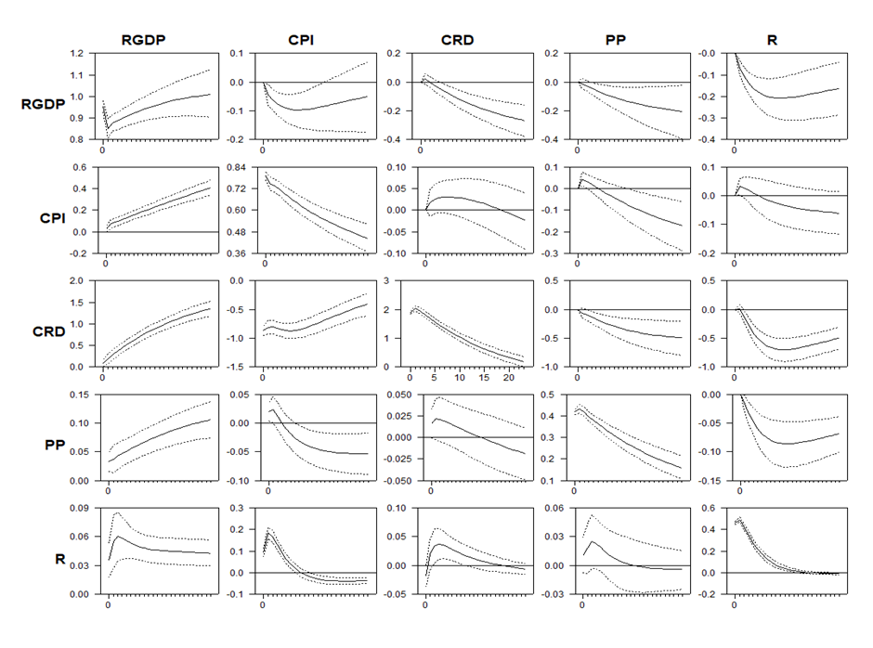

Slide 11

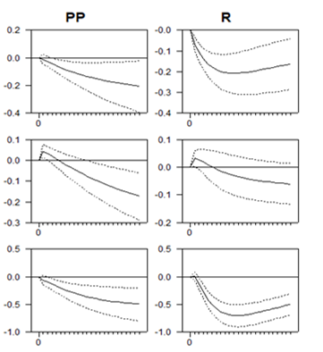
Real effects of macropru and monetary policy shocks

Slide 13
Why do the macroeconomic effects arise?
Lower LTV ratios may reduce house prices, residential investment and consumption (Alpanda and Zubairy (2017))
Tighter debt-service-to-income ratios can lower the demand for housing or consumption (Kuttner and Shim (2016))
Increase in reserve requirements may raise lending rates, reducing the stock of credit (Reinhart and Reinhart (1999))

Slide 14
Consumption vs. investment

Slide 15
Household vs. corporate credit

Slide 16
Extensions
Type of macroprudential instrument
  We differentiate between asset, liability and capital-based measures
Country characteristics
  Degree of financial development; financial openness; level of debt

Slide 17
Policy responses to credit shocks

Slide 19
Using a novel central bank survey by the BIS
Covers the prudential policy arrangements in different economies
We consider how the macroprudential policy response to credit shocks is affected by the central bank’s role in
  Financial stability analysis and research
  Collecting financial system related data
  Macroprudential policy decision making
  Conducting monetary policy with macroprudential orientation

Slide 22
Conclusions
We have analysed the use and effects of macroprudential policy along two dimensions:
  Broader macroeconomic effects
  Macroprudential policy reaction function
We find that macroprudential policy shocks have broadly similar effects on output, prices and credit as monetary policy shocks
Macroprudential policy tightens as a response to credit shocks
  The magnitude of tightening tends to be modest; governance arrangements play a role

