Slide 1
Rumours and Runs in Opaque Markets: Evidence from the Panic of 1907
Caroline Fohlin (Emory University)
Thomas Gehrig (University of Vienna)
Marlene Haas (Cornerstone Research)

Slide 2
Plan of the Talk
Creating the NYSE historical database
Rumors and runs of 1907
Opaque
  Opaqueness/illiquidity in funding markets leads stock market liquidity
  Asymmetric information exacerbates market illiquidity
But the market priced illiquidity risk
  In particular, asymmetric information risk
Conclusion
  opaqueness hurts liquidity; markets price AS risk

Slide 3
The New Database:
Main source is New York Times
Three primary tables
  “Complete transactions in Stocks”
  “Bid and Ask Quotations” for inactive stocks
  “Consolidated Exchange Sales”

Slide 4
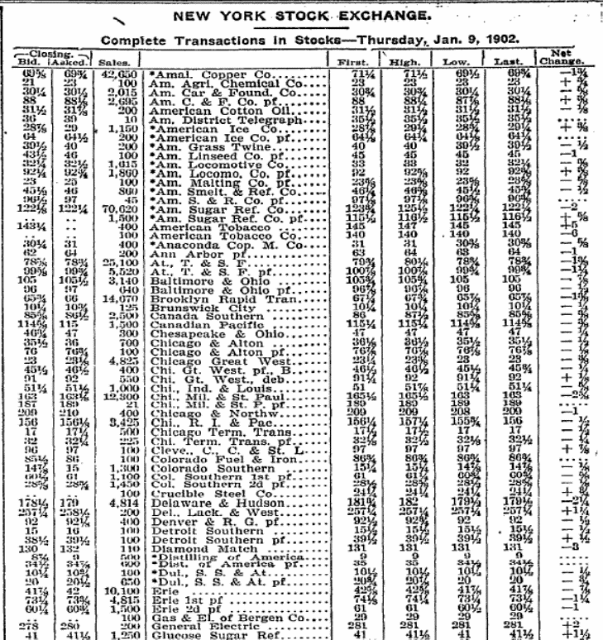
The New Database: TAQ Info
“Complete transactions in stocks”
  Contains all equity securities traded the previous day
    Common and preferred stocks
    Rights offerings
    Certificates and trust receipts
  Includes “unlisted” stocks, denoted with asterisk
  Gives figures for
    closing bid and ask quotations
    Number of shares sold
    High and low transaction prices
    First and last transaction prices
    “net change” from previous day
  Indicates “ex dividend” days
  Occasional “odd lots”

Slide 5
The New Database: Data Entry Process
Step 1: gathering source material to be entered (undergrad RA’s)
Downloaded images for each ‘article’ (stock tables) for each day
  1900-1910: Every trading day (Mon-Sat)
  1911 – 1925: Weekly (Fridays)
Step 2: manual data entry (outsourced)
Double entered and cross checked
Step 3: cleaning and coding (me and *many* RA’s)
Standardized each stock name
Applied numerical identifier for each company and each unique issue
  Many companies issued multiple classes of stock
Created indicator variables for Stock type, Ex div. days, odd lots
Step 4: Error checking
Wrote Stata routine to check for inconsistencies
  EG: ask>bid?
  Are prices in 1/8th increments?

Slide 6
Data for this study
Daily data for 1905-1910 from New York Stock Exchange (NYSE)
~ 200 companies
Included are:
  Transaction prices micro structure
  Bid & ask quotes
  Trading volume
  Industry type corporate finance
  Listing status
  Book value of common equity
  Number of shares outstanding
  Call money rates opportunity costs
  Monthly gold flow rates
  (T-bill not invented yet)

Slide 7
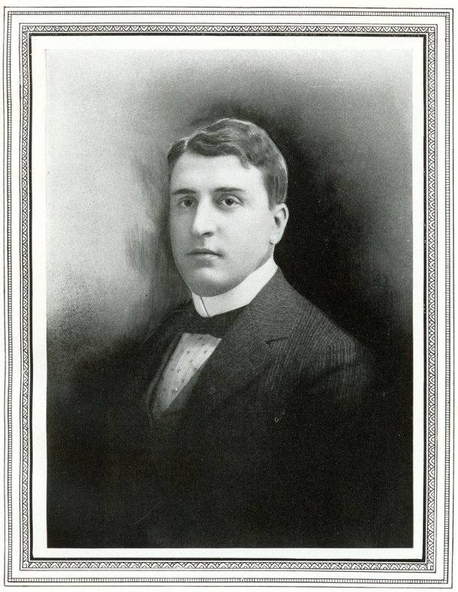
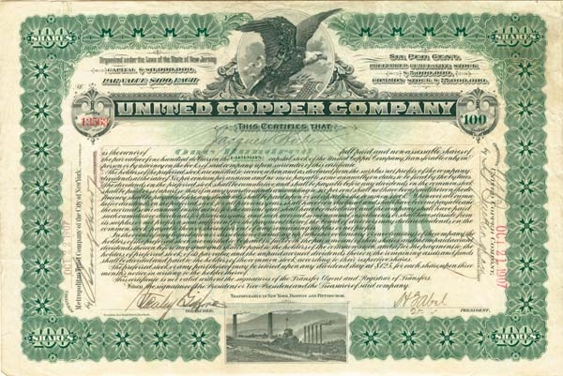
Rumors and runs in 1907
How does a rogue trader in a minor ‘curb’ stock cause
  Failure of two NYSE member brokerages
  A run on major NYC financial institutions
  Freeze in the money market
  Massive sell-off in the NYSE
  Spike in illiquity, with effects lasting for many months after

Slide 8
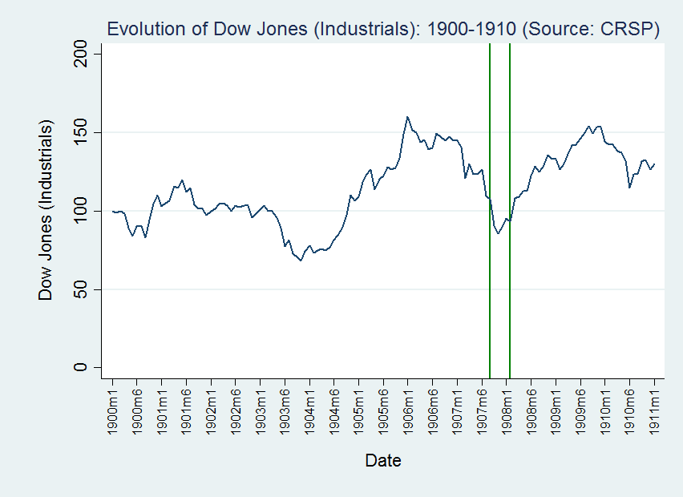
Fundamentals
Starts with a bear market in all sectors
Concerns over valuations began many months earlier
SF earthquake in April of 1906 caused financial stress
Falling copper prices

Slide 9
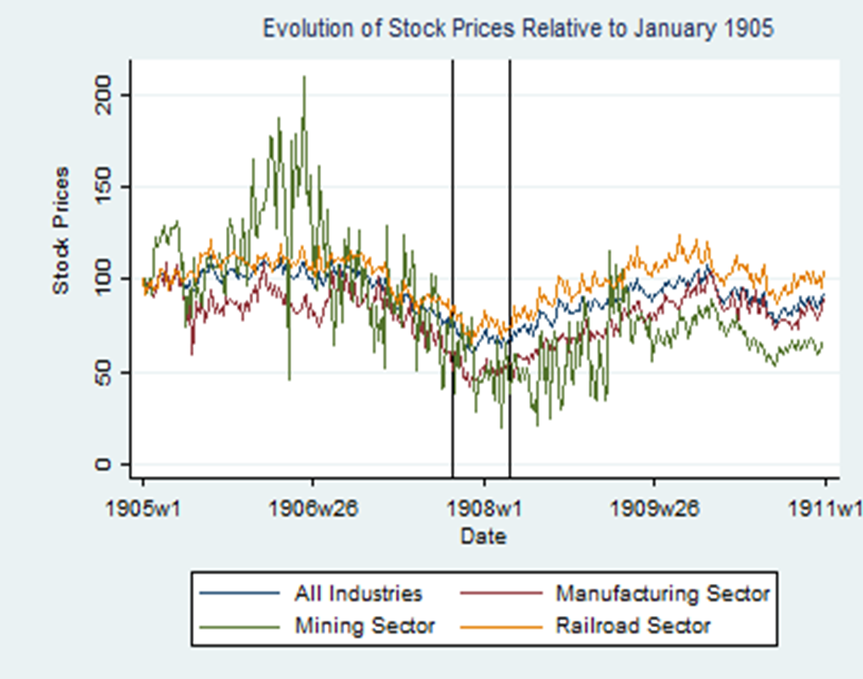
Boom and bust cycle in mining (copper)

Slide 10
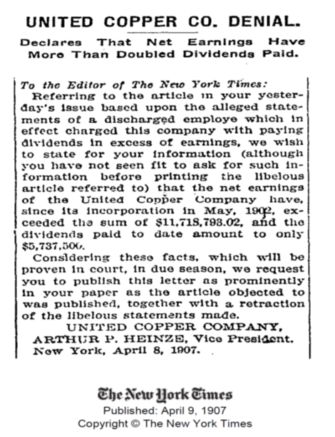
The Information Environment Circa 1907
Add opaque information environment:
Minimal corporate governance law
  Little public information disclosure, particularly in certain sectors and market segments
Variable accounting practices
Inconsistent legal remedies
Self-regulated stock markets
Large, unregulated (non-bank) financial institutions acting like banks
No official liquidity backstop

Slide 11
Rumors and runs in 1907
October 14-18, 1907: Stock corner by Otto Heinze fails
October 21st, 1907: Panic starts – Charles Barney forced to step down from Knickerbocker Trust
October 24th, 1907: JP Morgan organizes emergency funding
October 31st, 1907: issuance of loan certificates

Slide 12
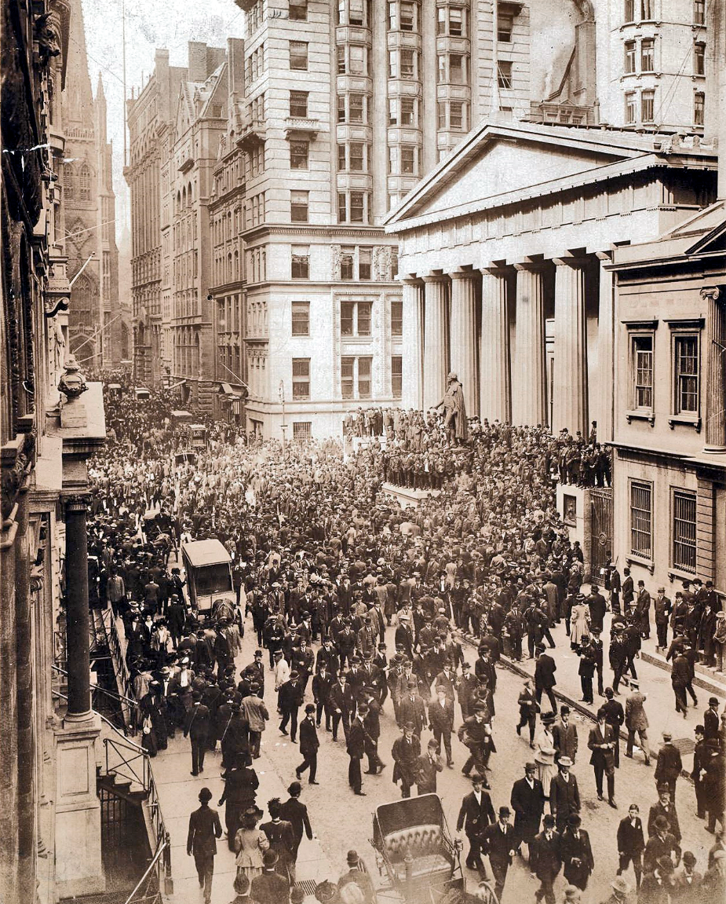
Rumors and runs in 1907
Noisy price discovery
  Opaqueness allowed rumours to seem like fundamental news
  Threat of informational contagion and counterparty risk
  Runs on financial institutions
Panic on Wall Street, Harper’s Magazine, October 1907

Slide 13
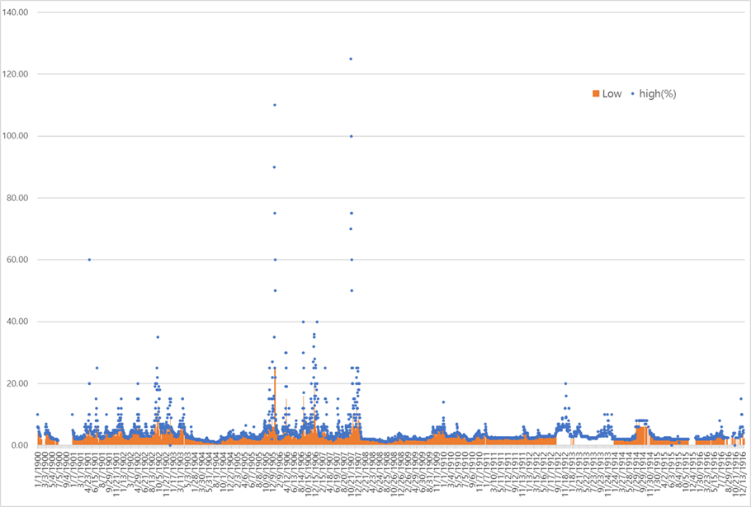
Freezing funding markets
Call Money Rates 1900-1916 (Daily)
Panic of 1907
Great Northern Panic (May 9, 1901)
Start of WWI (July 30, 1914)

Slide 14
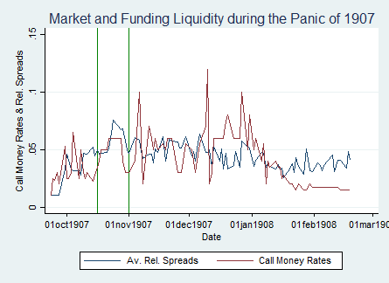
Freezing funding markets
funding illiquidity driving market illiquidity at height of crisis
decoupling between funding and market illiquidity after Nov. 1907

Slide 15
Freezing funding markets

Slide 16
Freeze in funding markets leads illiquidity in stock market

Slide 17
Freeze in funding markets leads illiquidity in stock market

Slide 18
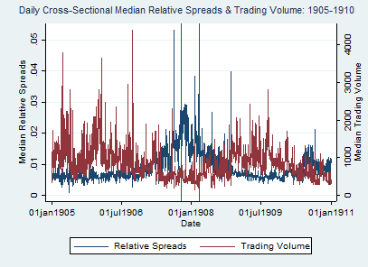
Illiquidity in stock market

Slide 19
Illiquidity in stock market

Slide 20
Asymmetric information exacerbates market illiquidity
Approach:
1. Decompose quoted bid-ask spread into three cost components (based on Huang & Stoll,1997)
  Informational costs (cost of trading with informed insider)
  Inventory costs
  Order processing costs
2. Compare information cost over time
3. Analyze cross-section of spreads and information cost by a priori opaqueness class
Notes:
order processing costs are identied by the variance of the bid-ask bounce,
while inventory holding costs are identied by serial correlation of transactions prices and
adverse selection costs are identied by changing means of relative bid-ask spreads.

Slide 21
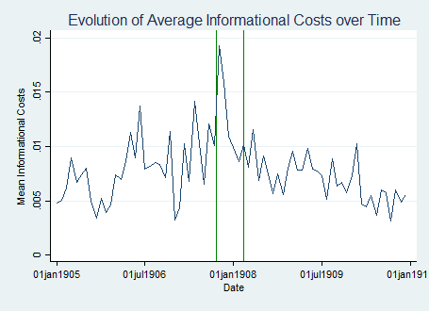
Asymmetric information exacerbates market illiquidity
Adverse selection risk is a significant driver of illiquidity during the Panic of 1907.
Observation 1

Slide 22
Asymmetric information exacerbates market illiquidity
Observation 2
Illiquidity is particularly strong in sectors with more opaque accounting (mining and manufacturing).

Slide 23
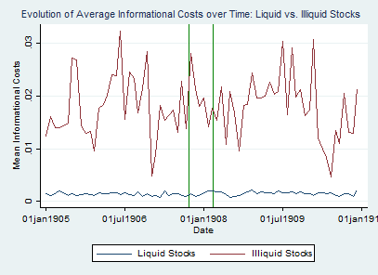
Asymmetric information exacerbates market illiquidity
Observation 3
Adverse selection risk affects illiquid stocks more than liquid stocks.

Slide 24
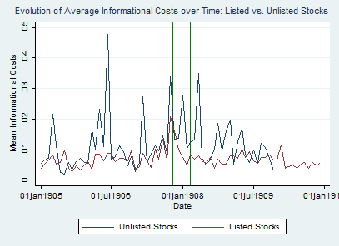
Asymmetric information exacerbates market illiquidity
Observation 4
Adverse selection risk affects unlisted stocks more than listed stocks.

Slide 25
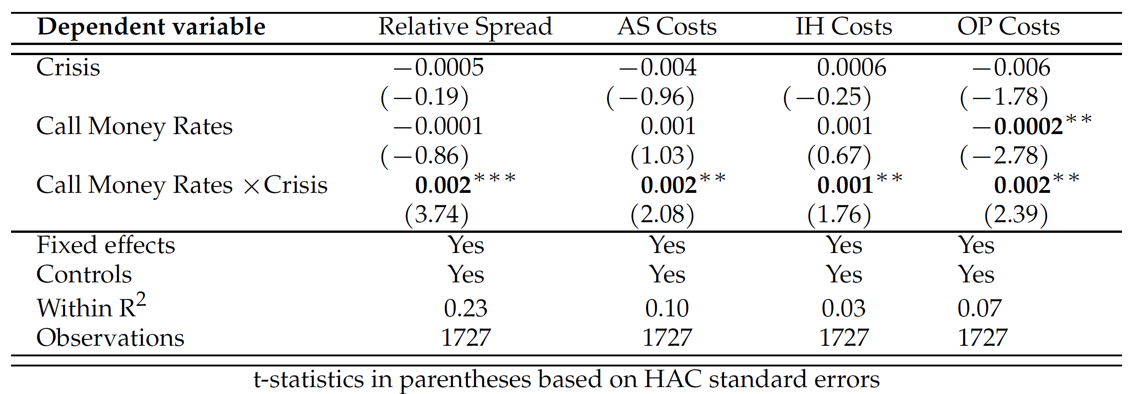

Spike in call money rates drives up transaction costs
$\left.{Spreads_{i,t} \atop \begin{aligned}AS Costs_{i,t} \\ IH Costs_{i,t} \\ OP Cost_{i,t}\end{aligned}}\right\}=β_{0}+β_{1}Crisis_{t}+β_{2}CallMoney_{t}+β_{3}CallMoney_{t}∗Crisis_{t}+{β_{5}X}_{i,j,t}+FE_{i}+ε_{i,t}$
Controls: liquidity, volatility

Slide 26

Illiquidity risk is priced

Slide 27
Asymmetric information risk, in particular, is priced

Slide 28
Conclusions
Opaqueness amplifies liquidity problems in funding markets (panic)
Funding illiquidity leads stock market liquidity—especially in a crisis
Asymmetric information about asset values exacerbates asset market illiquidity
But! Investors priced in illiquidity risk, in particular, asymmetric information risk
Still, panics cause lingering illiquidity—so best to improve transparency and try to avoid them

