Slide 1
Gold and Trade
An empirical simulation approach
Rui Esteves and Florian Ploeckl

Slide 2
Question
What were the links between a country’s monetary standard and its trade relationships during the First Globalization?
Did countries trade and sign trade agreements with other nations because of their monetary standards? (selection effect)
Did trade and trade agreements influence the likelihood that a country adopts the standard of its partners? (influence or contagion effect)

Slide 3
Endogeneity
Two sources of endogeneity:
Reverse causality between country characteristics (i.e. exchange rate regime) and spatial structures (trade and treaties)
In terms of a network structure there is endogeneity between
  network ties (Trade networks)
  actor behaviour (Monetary standard)
Violation of i.i.d. for country dyads
  The probability of country A establishing a tie (e.g. signing a treaty) with country B depends on the pre-existing treaties of A and B as well as of all other nations in the network
  A form of spatial autocorrelation
  Identification through conventional methods problematic

Slide 4
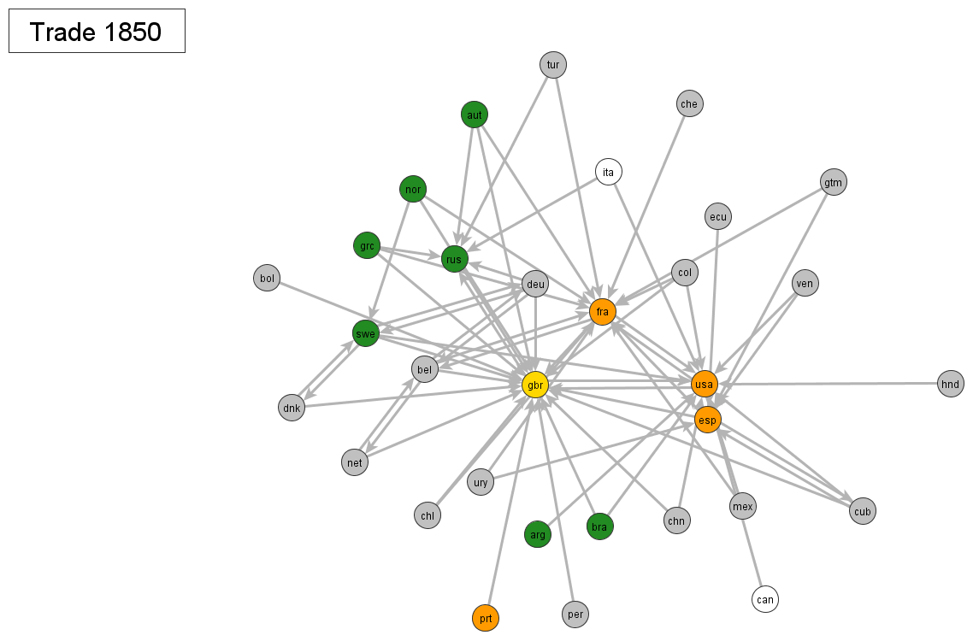
Network graphs (major exporters ≥10%)

Slide 5
Preview
Do countries trade with each other because they share a monetary standard? (selection effect)
  Yes (only intensive margin)
Does trade influence the likelihood that a country chooses the monetary standard of its partners? (influence or degree)
  Yes
Do treaties create trade or does trade lead to treaties?
  Treaties ⇒Trade

Slide 6
Structure
Historical Setting of the First Globalization
Setup and Method
Data
Results
Conclusions

Slide 7
Gold and the First Globalisation
Network externalities in the adoption of the gold standard, through trade gains (López-Córdova and Meissner 2003, Flandreau and Maurel 2005, Mitchener and Voth 2011; Rose and Glick 2016)
But also that more open economies adopted the gold standard earlier (Meissner 2005)
Other drivers:
  Financial maturity (Bordo and Flandreau 2003)
  Economic development and industrialisation (Galarotti 1995)
  Political economy conflicts (Broz 1997, Mitchener and Voth 2011, Reti 1998)
  Shocks to silver production in the 1860s and gold production in the 1880-90s (Flandreau 2004)
  Franco-Prussian war (Flandreau 1996) and US demonetisation of silver in 1873 (Friedman 1990), which destabilised the bimetallic core of nations (Meissner 2015, Morys 2015)

Slide 8
Gold and the First Globalisation
Network externalities in the adoption of the gold standard, through trade gains (López-Córdova and Meissner 2003, Flandreau and Maurel 2005, Mitchener and Voth 2011; Rose and Glick 2016)
But also that more open economies adopted the gold standard earlier (Meissner 2005)
Other drivers:
  Financial maturity (Bordo and Flandreau 2003)
  Economic development and industrialisation (Galarotti 1995)
  Political economy conflicts (Broz 1997, Mitchener and Voth 2011, Reti 1998)
  Shocks to silver production in the 1860s and gold production in the 1880-90s (Flandreau 2004)
  Franco-Prussian war (Flandreau 1996) and US demonetisation of silver in 1873 (Friedman 1990), which destabilised the bimetallic core of nations (Meissner 2015, Morys 2015)

Slide 9
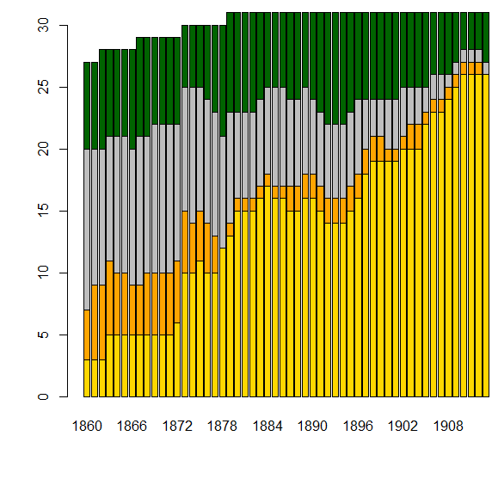
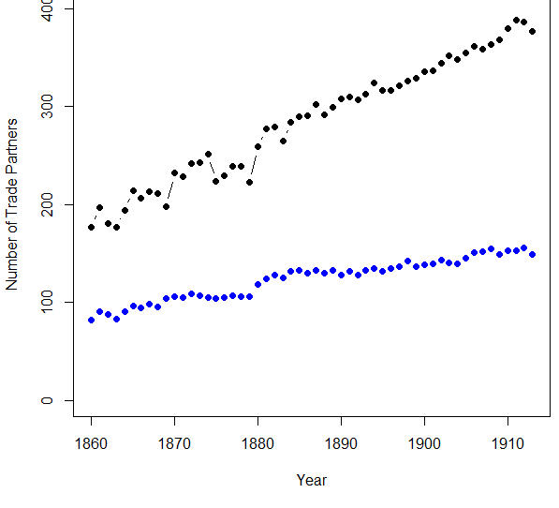
Trade Partners Monetary Standards
∙ Trade Partner
∙ Major Trade Partner
∙ Gold ∙ Silver
∙ Bimetallic ∙ Paper

Slide 10
Approaches in the literature
Other methods to deal with non-i.i.d. observations:
Conley's (1999) standard errors
  But without spatial lags
Spatial lags models
  But without dealing with endogeneity of weighting matrix
Gravity models with `third-country' effects
  But estimated indirectly as a black box via multilateral resistance terms (Anderson and van Wincoop 2003, Head and Mayer 2014)
Dearth of natural experiments
  Mitchener and Voth (2011) on colonies
  Don't usually address i.i.d. violations

Slide 11
SIENA
Our approach: Empirical (dynamic) stochastic actor-oriented network analysis (SIENA)
  Snijders, Steglich and Schweinberger (2007); Steglich, Snijders and Pearson (2010) Ripley et al. ( 2015)
Modelling of reciprocal influence
  Focus on joint evolution of network and behaviour (here: trade and exchange rate regime)
Modelling of dependence between network ties
  Addresses violation of iid assumptions for country-pair observations
Change determined stochastically based on objective functions and current network/behaviour (Markov chain Monte Carlo)

Slide 12
Three main assumptions
Continuous time process: opportunities for actors to modify their network / behaviour can arise at any time
  Even though only observable in discrete windowsonditional
Conditional Independence: decisions about network and behaviour separated, i.e. actor decides to modify one given the state of the other
Decision to modify modelled like a multinomial logistic regression
  Countries' changes to their monetary systems and trade agreements evaluated with respect to an evaluation function
  Each opportunity allows exactly one change:
    Move up/down or stay at level at monetary system (Paper ⇒ Silver ⇒ Bimetallic ⇒ Gold)
    Add/ remove/ keep one network tie (bilateral trade/ agreements)

Slide 13
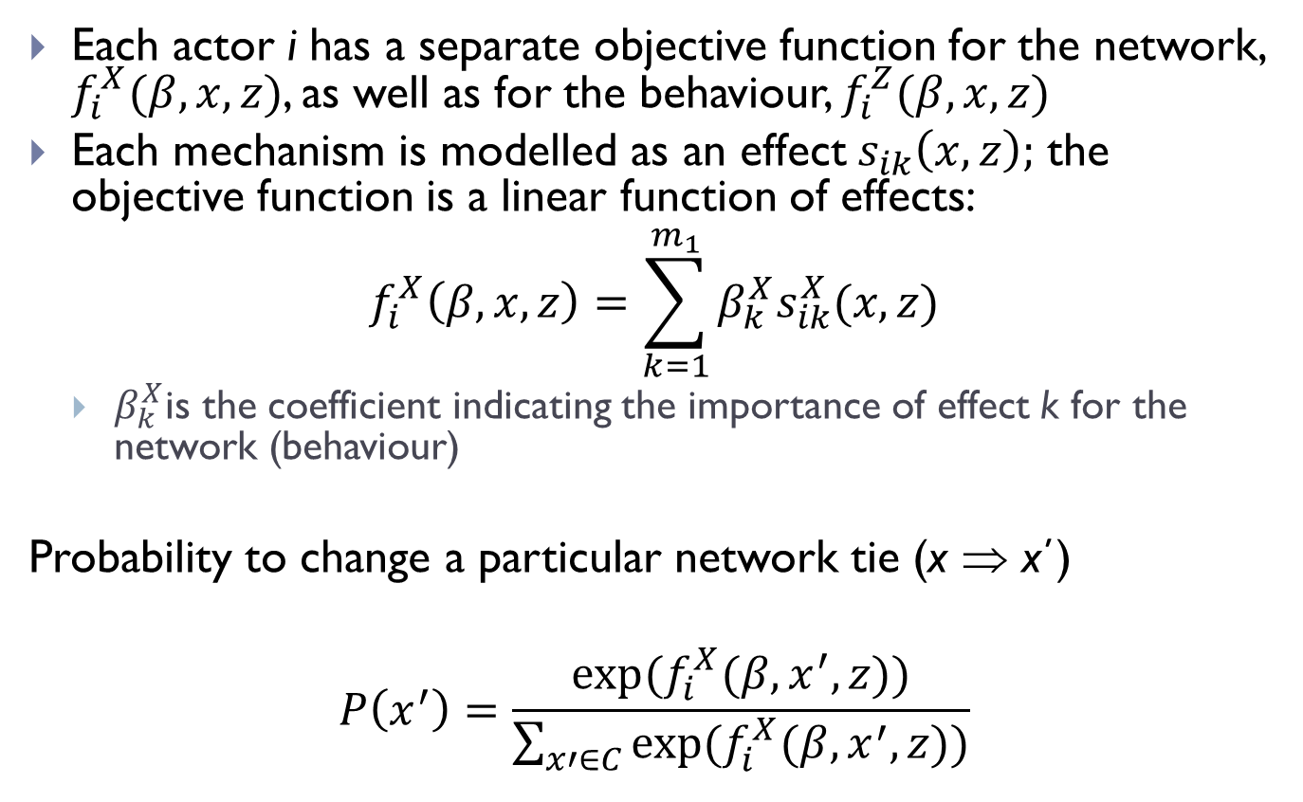
Evaluation Function
Each actor i has a separate objective function for the network, $f_{i}^{X}(β,x,z)$, as well as for the behaviour, $f_{i}^{Z}(β,x,z)$
Each mechanism is modelled as an effect $s_{ik}\left(x,z\right);$ the objective function is a linear function of effects:
$$f_{i}^{X}\left(β,x,z\right)=\sum_{k=1}^{m_{1}}{β_{k}^{X}s_{ik}^{X}(x,z)}$$
  $β_{k}^{X}$is the coefficient indicating the importance of effect k for the network (behaviour)
Probability to change a particular network tie (x ⇒ x΄)
$$P\left(x^{′}\right)=\frac{exp⁡(f_{i}^{X}(β,x^{′},z))}{\sum_{x′∈C}{exp⁡(f_{i}^{X}(β,x^{′},z))}}$$

Slide 14
Types of effects
Monadic effects: GDP, urbanisation, foreign debt
Dyadic: contiguity, distance, alliances
Network structure:
  Within the network: degree (out or in), reciprocity, transitive triads
  Mediated by the behaviour: exchange rate regime (own or partner's)

Slide 15
Implementation
Countries as actors in a network setup optimizing stochastically multiple outcomes
‘Behaviour’ ⇒ Monetary Standard
ordered with 4 levels
- Paper/Silver/Bimetallic/Gold
‘Network’ ⇒ Trade Networks
three binary networks
- Trade partner (extensive margin)
- Major partner (intensive margin)
- Trade agreement

Slide 16
Major (5%) and minor (0.5%)

Slide 17
Included effects
Network (trade links)
Behaviour (monetary regime)
Density (#links)
Transitive triads (closure)
Indirect partners (#partners)
Monetary standard (own and trade partner interactions)
Trade agreements (effects between networks)
Partner GDP
Contiguity, distance, language, war, alliances
Trade-weighted partner regime
Minimum standard major partner
GDP (per capita)
Disputes
Foreign Debt
Gold production

Slide 18
Data
Time periods
1860-1911
Triennial observations
Countries
31 independent countries
  Unbalanced panel
Sources
Monetary – historical reconstructions
Trade data – RICardo and TRADHIST
Trade agreements – Pahre (2007)
Covariates – COW, other regular sources

Slide 19
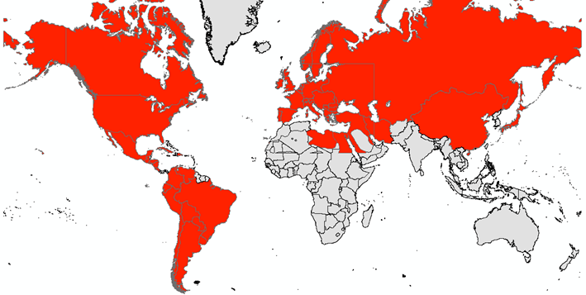
Sample coverage

Slide 20
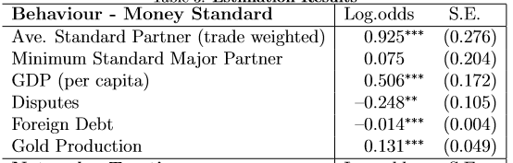
Monetary Regimes (Behaviour)
Effects on Monetary standards
Significant, positive effect of monetary regimes of trade partners
No separate effect of minimum of major partners
Positive effect of GDP pc
  1 SD ⇒ 210% more likely
Negative impact of political/military disputes
  Per dispute 22% less likely
Negative impact of foreign debt
  1 SD ⇒ 62% less likely
Positive impact of global gold production



Slide 21
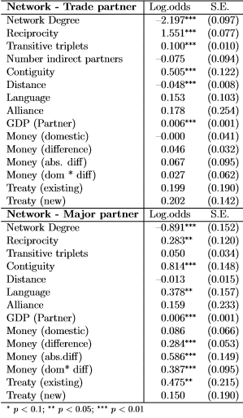
Trade network
Effects on Trade relationships
Effect of reciprocity ( 471% / 33%)
Triad effect for extensive margin (11%)
Monetary standards have an impact on the intensive margin but not on the extensive margin
GDP effect (+1sd ⇒ 51%)
Contiguity + distance effects
Language positive for intensive margin
No effect of Alliances
Treaties have an effect on the intensive margin, but not on the extensive one
Trade does not lead to treaties






 
Intensive Margin Extensive Margin









Slide 22
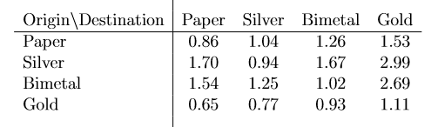
Effect Size
The effect is asymmetric
  Assume trade partner with 10% export share
  If partner shifts from silver to gold ⇒ 9.7% more likely to increase
  If partner shifts from gold to paper ⇒ 24.2% more likely to decrease
Impact of monetary regimes on major trade partner status
If origin country is on gold
a destination country is 40% more likely to become a ‘major partner’ if on gold rather than silver
(or less likely to loose status)

Slide 23
The other way around: counterfactuals
Three major historical regime changes
  Literature treats them as ‘exogenous’
  French demonetisation of silver after 1871
  Germany (same)
  US return to gold after greenback inflation
Can use the model to simulate how the world would evolve in the absence of these changes
  Simulate both choice of regimes and the trade networks
  Caveat: we update the exogenous variables to their historical values each period (ignore part of the GE effects)

Slide 24
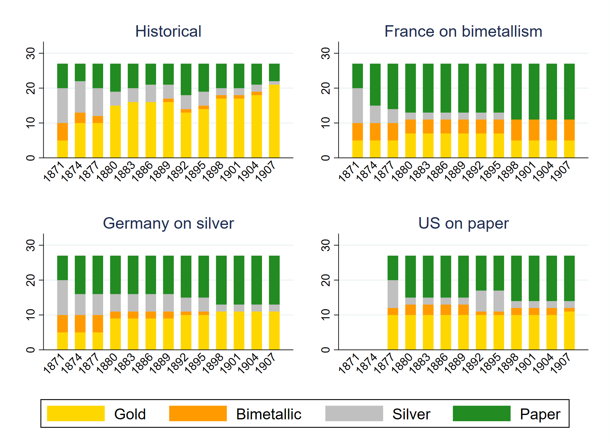
Distributions of monetary regimes

Slide 25
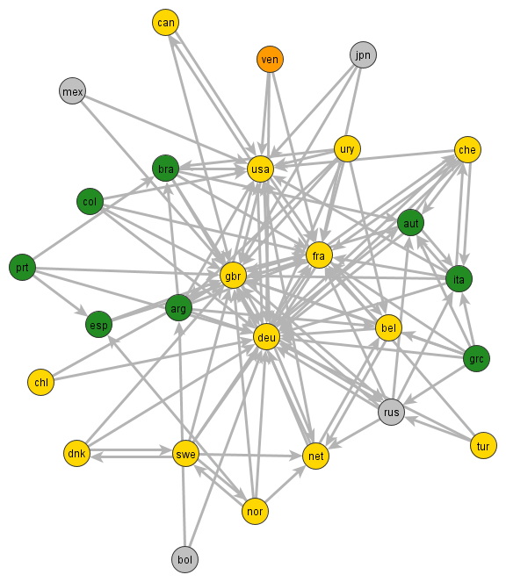
Trade networks (both)

Slide 26
Conclusions
Application of methodological approach designed to better understand situations with potential endogeneity between network ties and actor characteristics
  Portable method to other settings involving dynamic co-evolution of ties and behaviour
Reciprocal influence of monetary standards and trade agreements during the First Globalization
  Money standard influencing intensive rather than extensive margin
  Contagion of monetary standard through trade partners

Slide 27
Appendix slides

Slide 28
Moran’s I

Slide 29
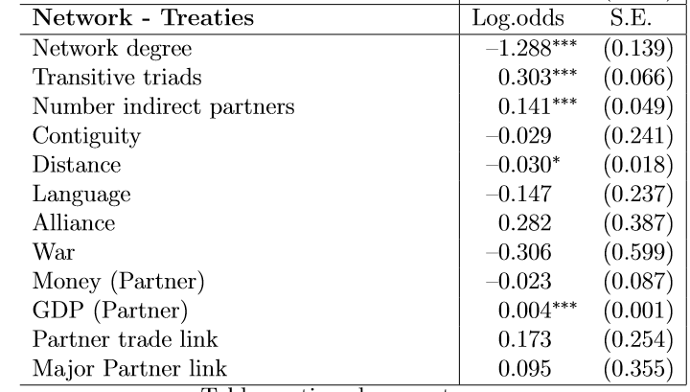
Trade Treaties

Slide 31
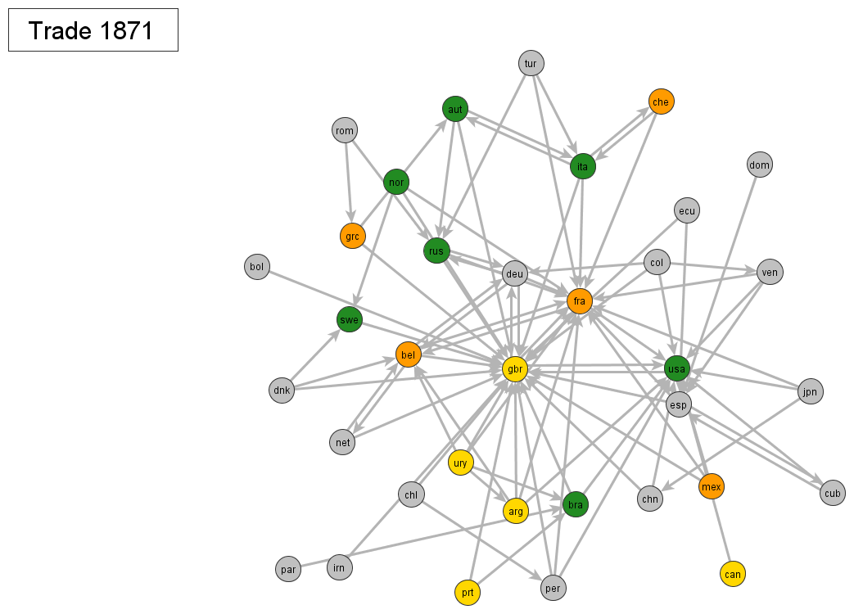

Slide 32
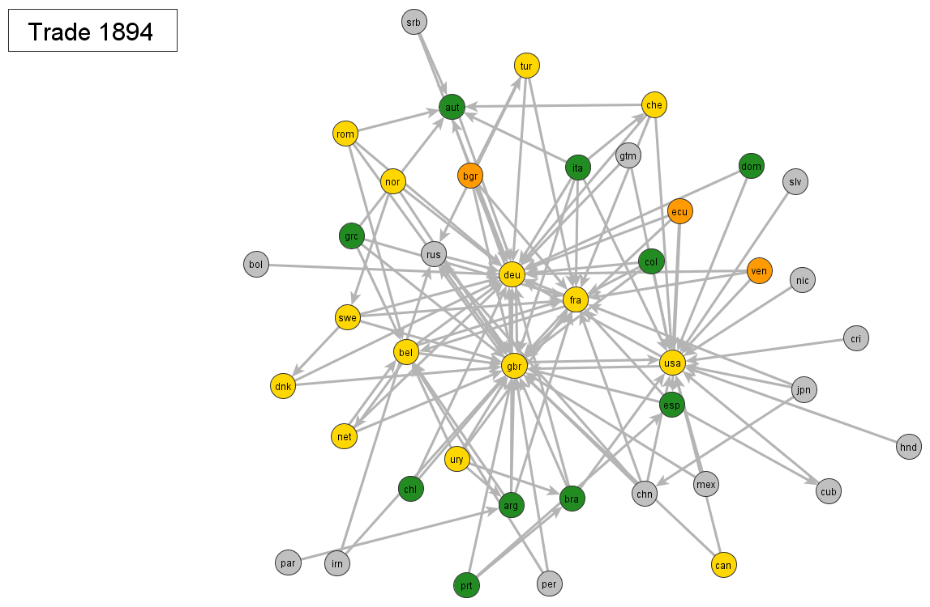

Slide 33
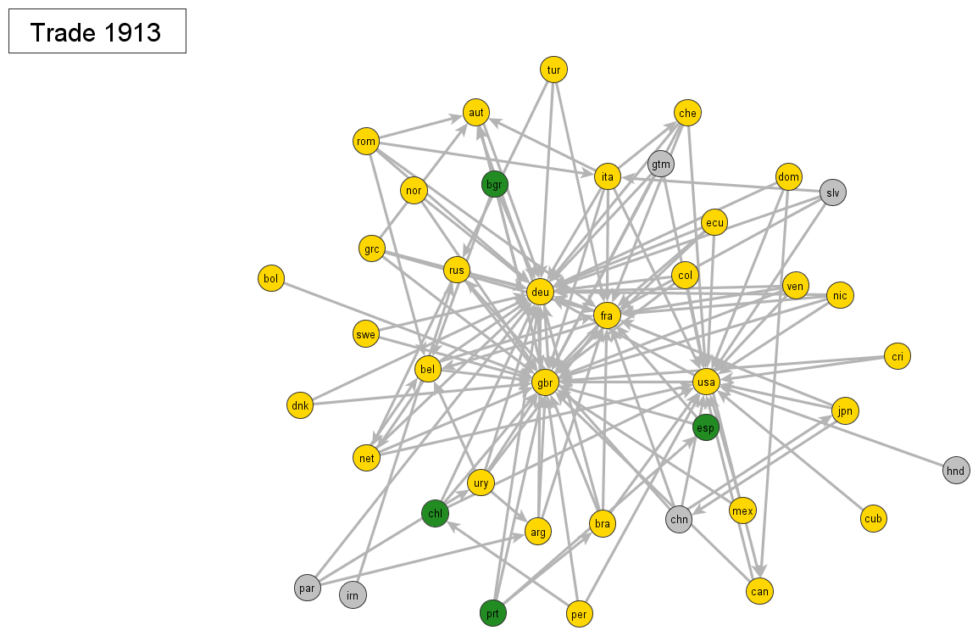

Slide 34
Historical (1895)

Slide 35
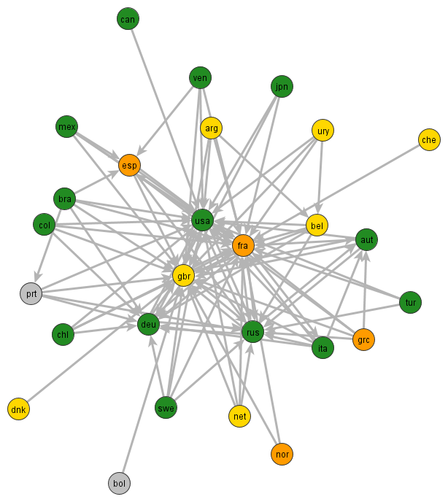
France (1895)

Slide 36
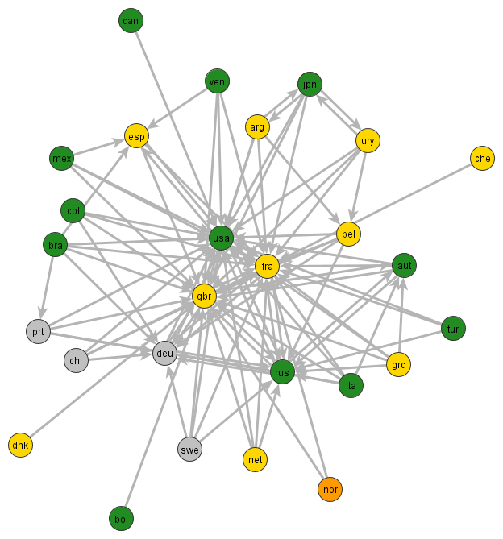
Germany (1895)

Slide 37
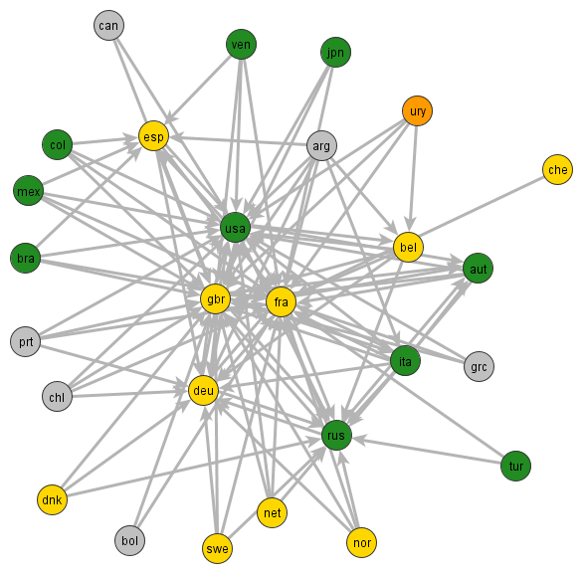
USA (1895)

