Slide 1

Taking stock of 50 years of the SHIW
The Bank of Italy’s Analysis of Household Finances
Fifty Years of The Survey on Household Income and Wealth and the Financial Accounts
Rome, 3-4 December, 2015

Slide 2

The SHIW
1951 - a survey in disguise
1961-1962 - 6 pilot surveys
1965-1987 - yearly
1989-today - biannual
2013-today - (shorter) survey in bewteen years
Since the late ‘80s, freely available micro data 1977-onwards
BoI and the SHIW play a leading role in several international projects:
- Luxembourg Income Study,
- Luxembourg Wealth Study,
- ESCB Household Finance and Consumption Survey

Slide 3
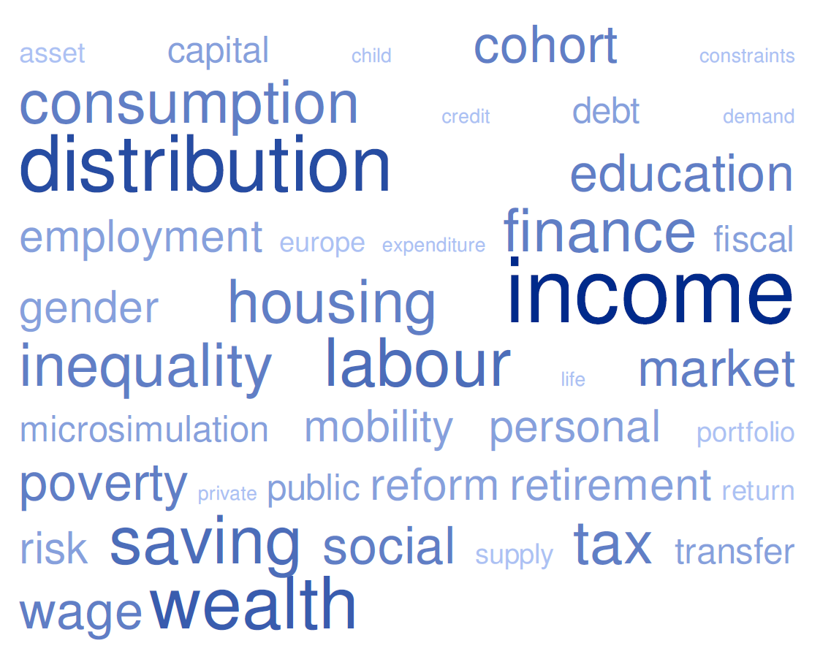
Research on the SHIW

Slide 4
The SHIW
Continuous effort to further improve «fitness for use» :
dissemination policies; facilitate timely access of heterogeneous users (citizens, journalists, policy makers, historians, researchers,…) to information relevant to their needs and goals taking into account their potentially different skills.
data accuracy, content and coverage of the survey; experimentation with complementary survey methods and data sources, continuous reflexion on additional topics to be covered and on improvements of data collection strategies, interaction with scientific community.

Slide 5
Data dissemination
Tools and materials to meet diverse needs.
Until today…
one-click download of the historical archive, of the yearly archives of the complete survey results, of the replication weights;
full documentation of methods and processes to ensure transparency, replicability and continuous dialogue with the research community;
results and data delivered by beginning of year after fieldwork year

Slide 6
Data dissemination
Tools and materials to meet diverse needs.
From today…
a revamped SHIW section on the BoI website
upgraded single historical archive (new weights, new variables, fixes to older data…)
Italian HFCS & 2010 gross household income
time series of the main objects of investigation of the SHIW through the BoI website in zipped archives and datawarehouse (BDS)
new historical material from 1961-76 surveys, partly unexplored
final results and data delivered by the end of fieldwork year; preliminary evidence on specific topics in Annual report.

Slide 7
Data dissemination
Tools and materials to meet diverse needs.
… in the (near and less near) future
growing coverage of the BDS datawarehouse
gross household income since 2002
web tabulator, tools for direct interrogation of microdata
keep on strengthening interaction with external users:
  social media and user satisfaction surveys
  user conferences to increase use and awareness of IBF and HFCN in the scientific, policy and non-academic communities

Slide 8
Data collection
Methods and variables for a changing world
How to collect…
standard and web surveys, administrative records, big data
What (else) to collect…
behavioural aspects & (still?) deep parameters
expectations, financial literacy, sentiment
Why and where to collect…
migration and mobility within and in/outside Italy and Europe
rare data (income, wealth, mobility)

Slide 9
Thanks for your attention

Slide 10
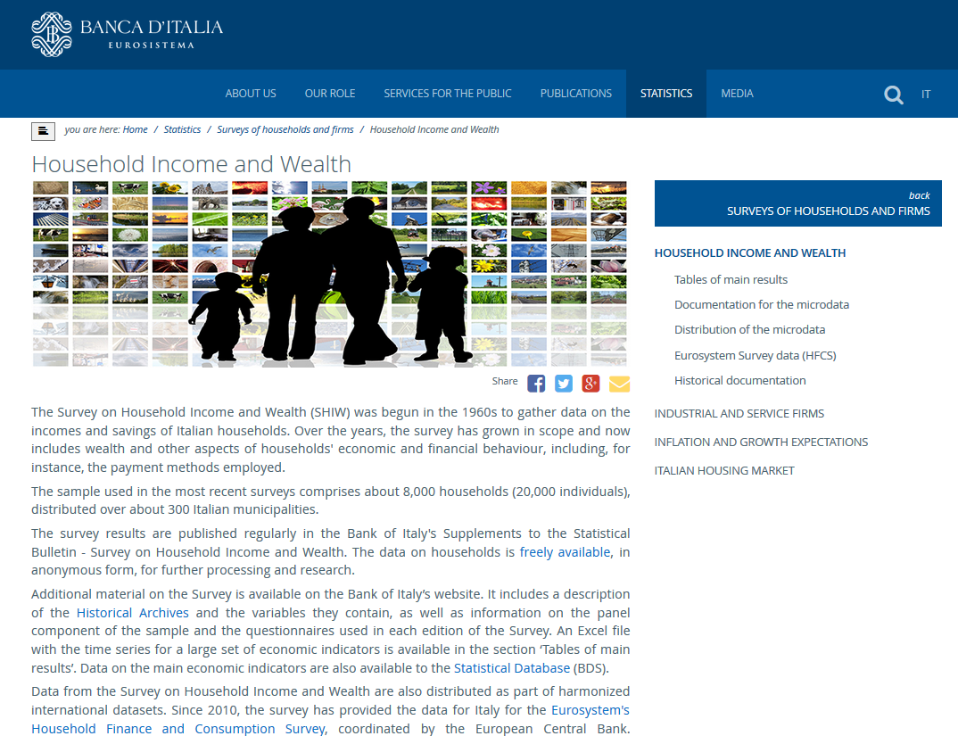
The new SHIW website
<<<

Slide 11
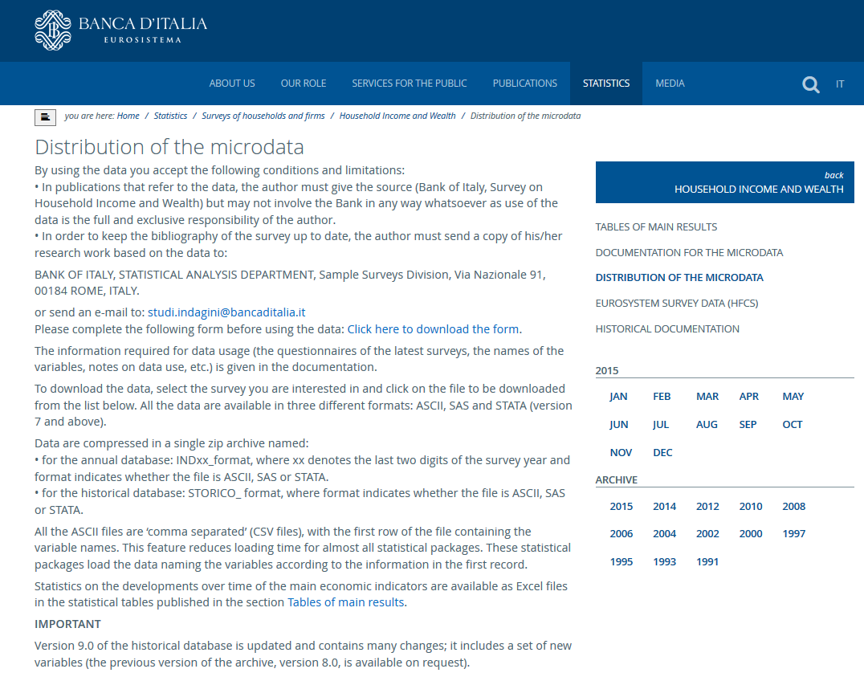
A new historical archive
<<<

Slide 12
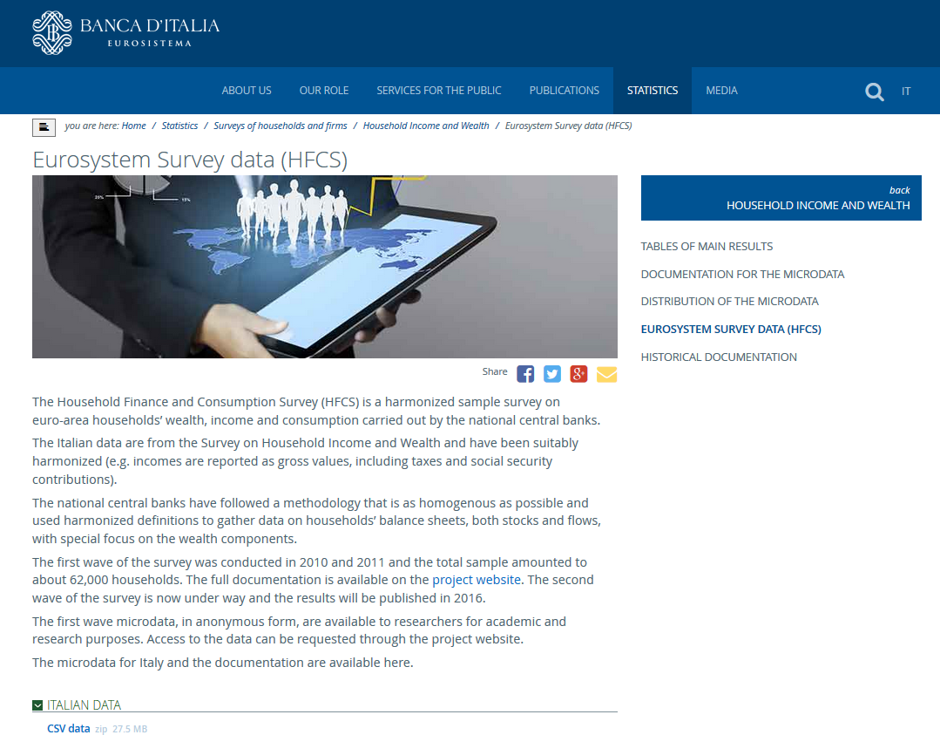
HCFS and gross incomes
<<<

Slide 13
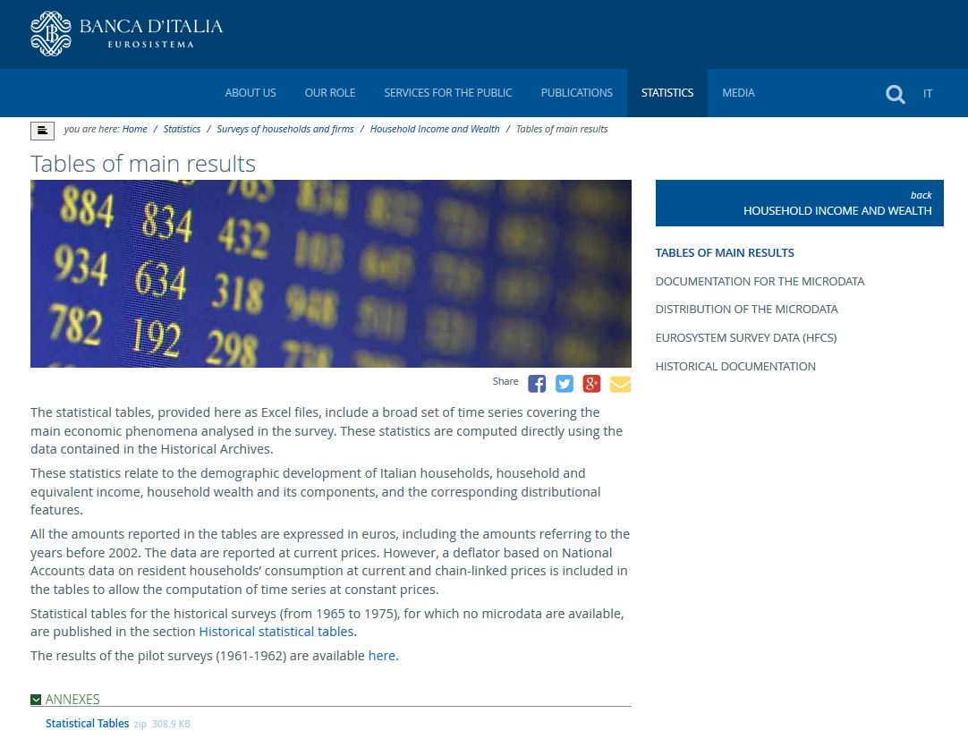
TS from the historical archive

Slide 14
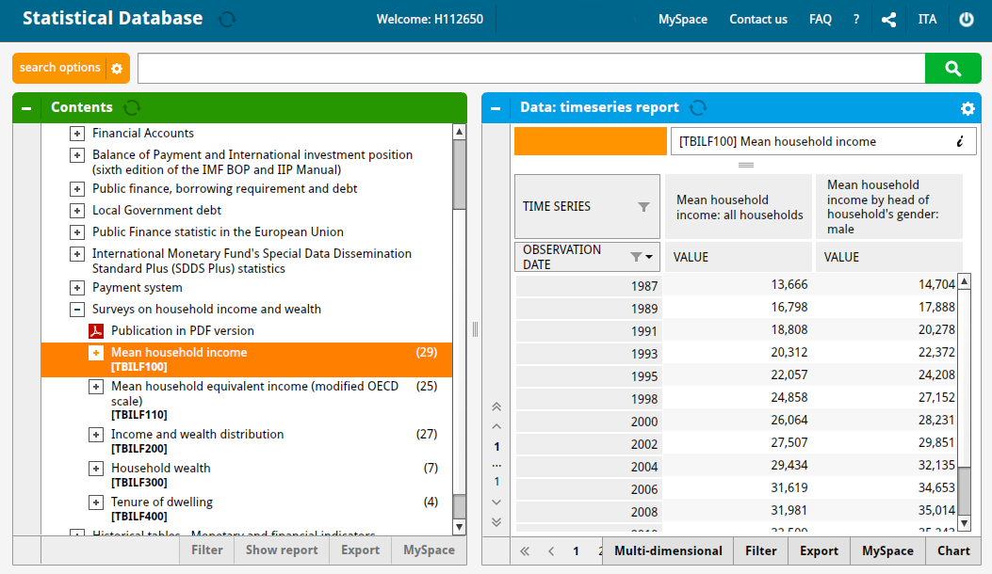
TS from the historical archive
https://infostat.bancaditalia.it/inquiry/#
<<<

Slide 15
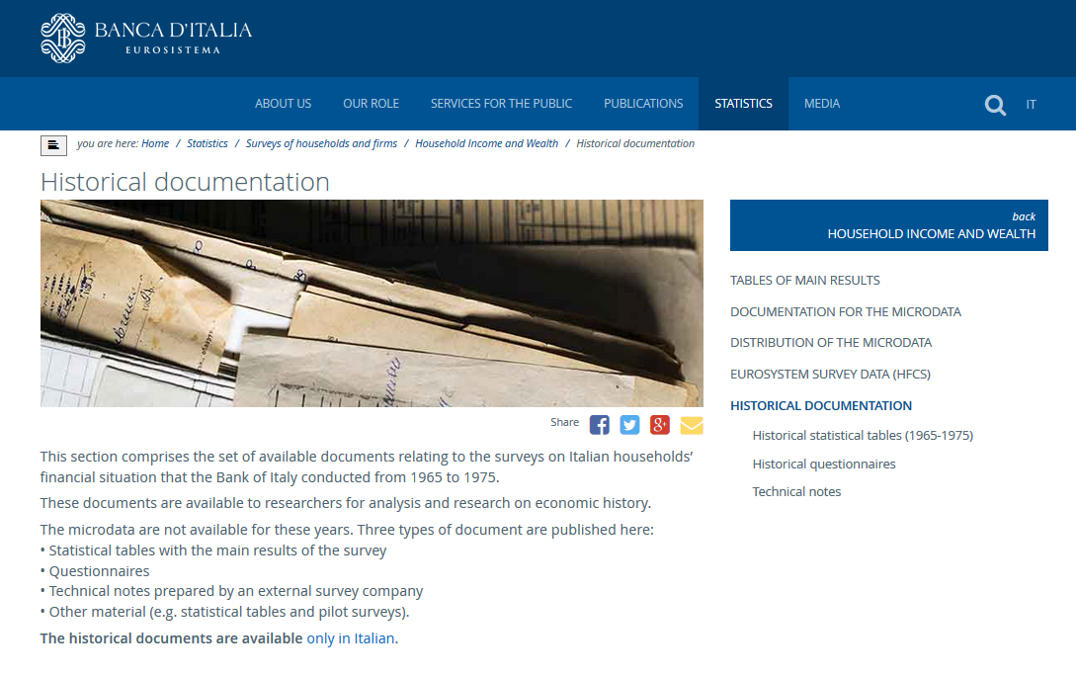
Historical documents

Slide 16
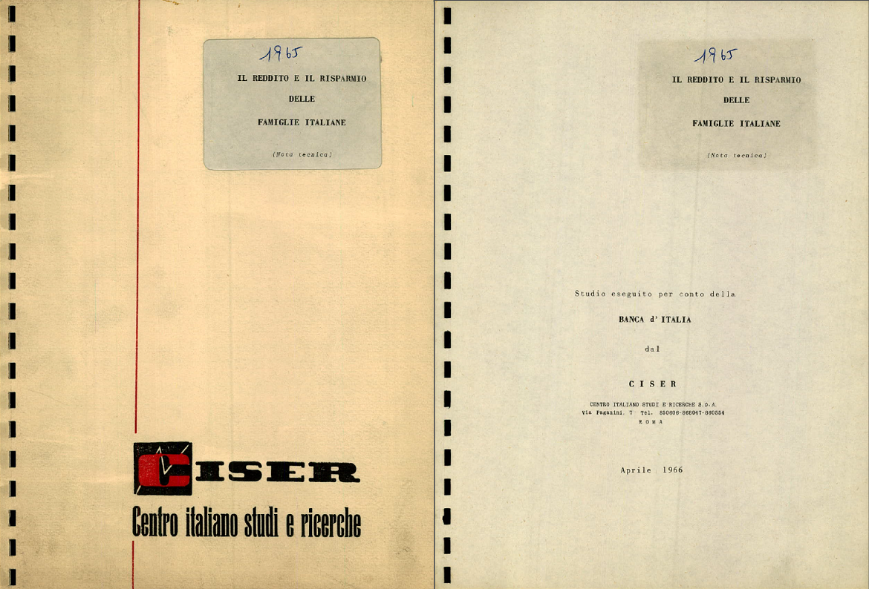
Historical documents
<<<

Slide 17
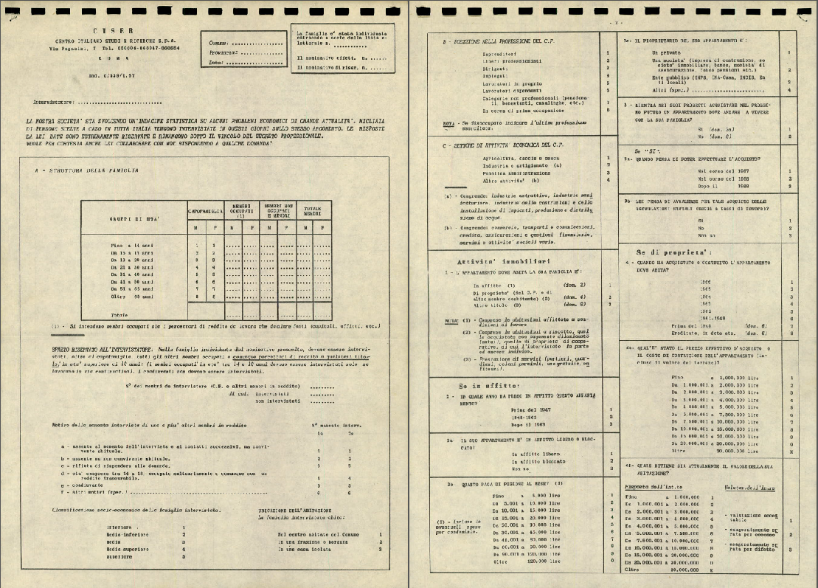
Historical documents
<<<

Slide 18
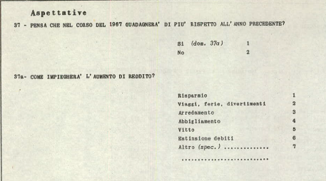
Historical documents
Income and expenditure expectations, 1966 survey
<<<

Slide 19
Historical documents
Income shocks and expenditure, 1961 survey
<<<

Slide 20
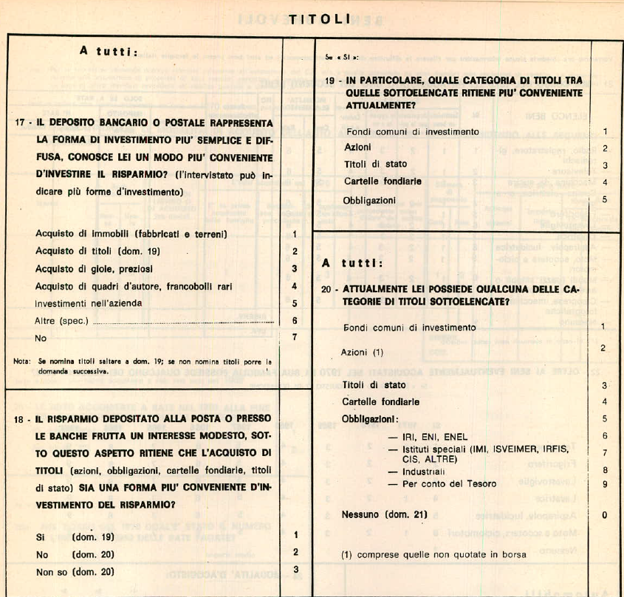
Historical documents
Financial literacy, 1970 survey
<<<

Slide 21
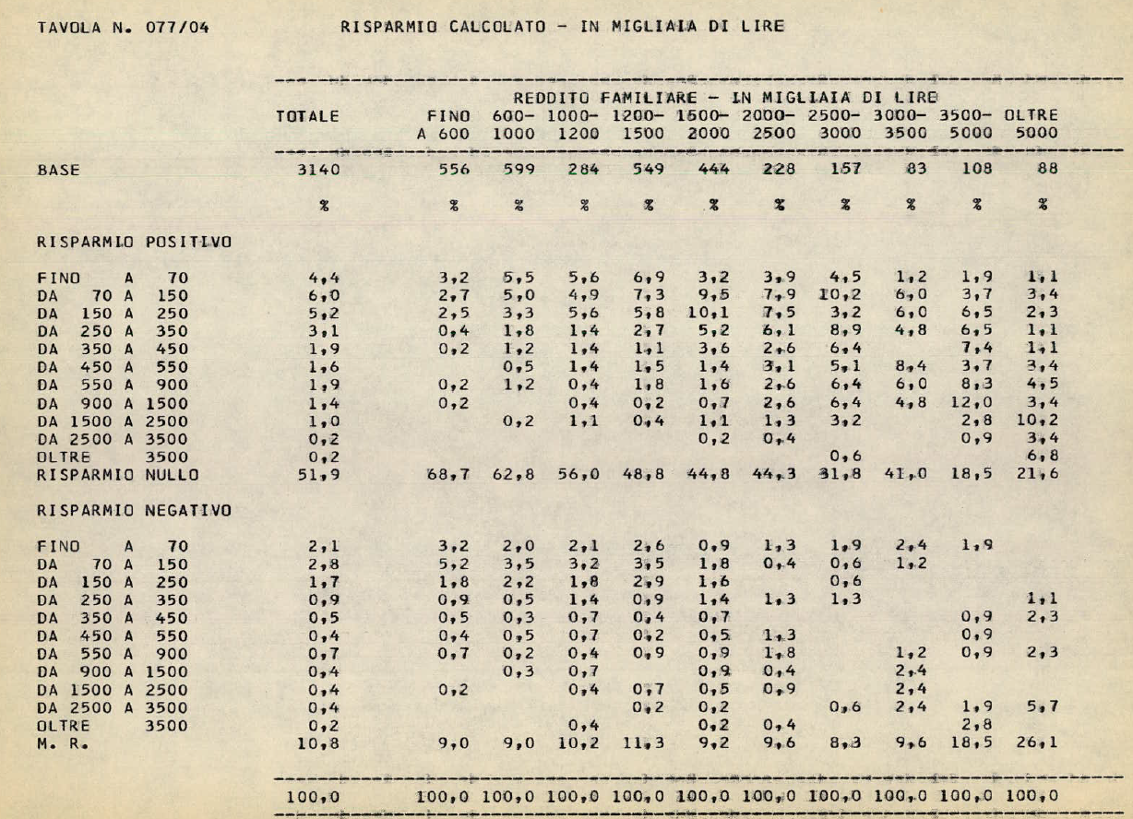
Historical documents
From 1967: savings and household income
From 1967: share of households with bank deposits by household income brackets
<<<

Slide 22
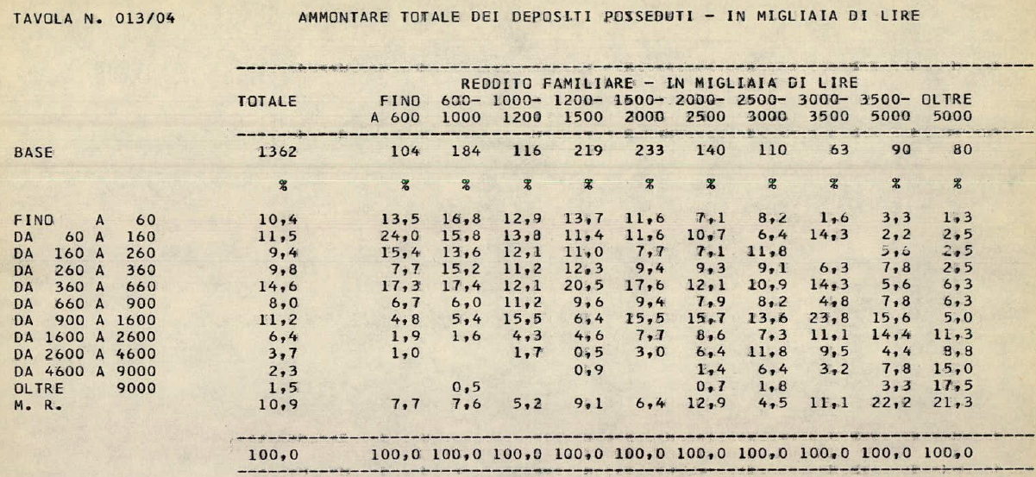
Historical documents
From 1967: value of bank deposits by household income brackets
<<<

