Slide 1
Income and Wealth Inequality
Discussion of the papers presented in
Giovanni Vecchi
University of Rome “Tor Vergata”
The Bank of Italy’s Analysis of Household Finances
Rome – 3-4 December 2015

Slide 2
Gambacorta and neri wealth and its returns, 1995-2014
PAPER 1

Slide 3
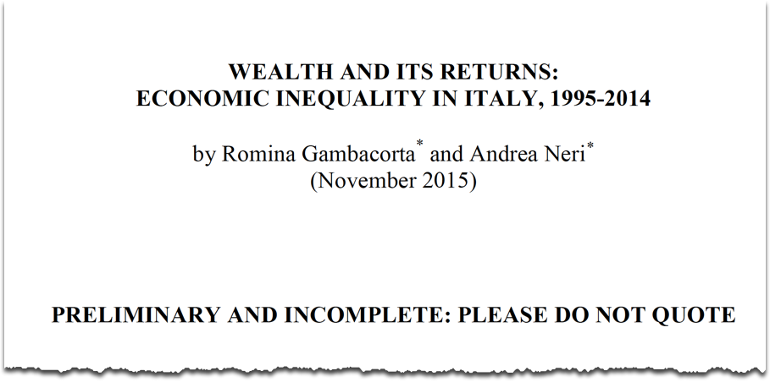
On the choice of the time span

Slide 4
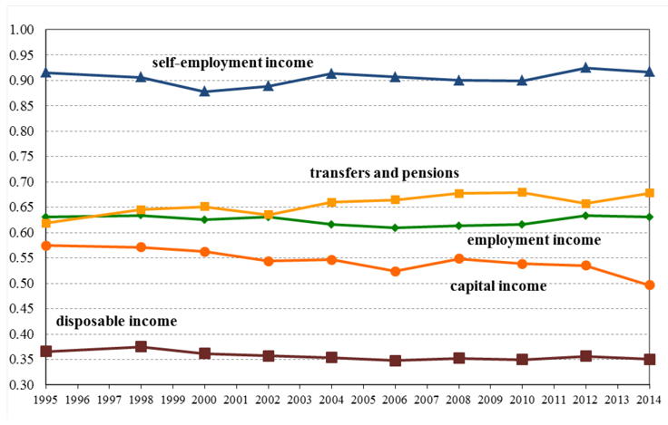
Gini index of net disposable income and its components, 1995-2014

Slide 5
Gini index, 1861-2012
Joint with N. Amendola (forthcoming)

Slide 6
Why the Gini index?
Why not quantile-based indicators?
(quintile ratios, quintile share ratios, …)?
Why not Lorenz curves?
I am interested in how the ratio of net worth to income varies with income (Lorenz dominance)?
Why not using cumulative distribution functions?
(compete with Brandolini et al. 2010)

Slide 7
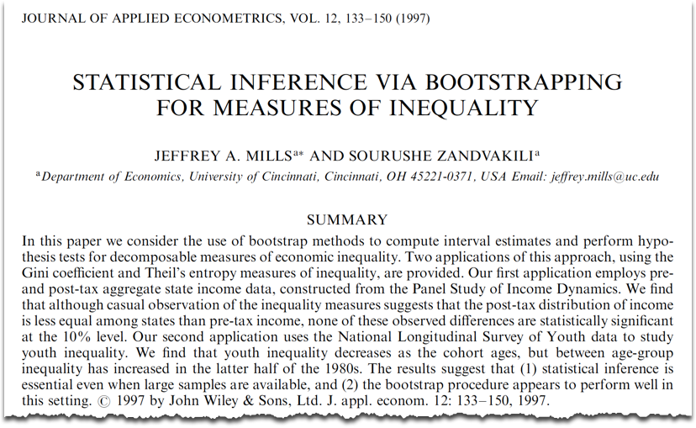
On the absence of standard errors

Slide 8
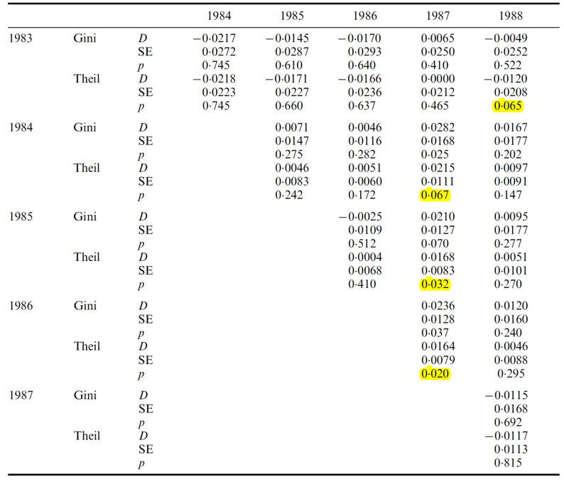
Yellow is ok, not yellow is not ok

Slide 9


Income net worth
Weisbrod and Hansen (1968, AER)
Discussion
Theoretical vices and virtues masterly discussed (p. 11)
Role of untestable assumptions (interest rate and individual life expectancy)?
Role of demographic changes could be assessed (e.g. shift-share analysis).

Slide 10
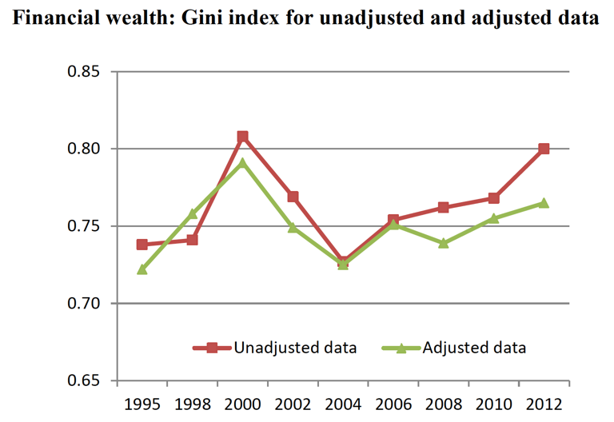
Imputations and various adjustments
Predicted values cannot be treated as if they were genuinely observed values
Standard errors?
Multiple imputation
Look at Fig. 5 (p. 18):
“The overall effect on financial wealth inequality is to reduce it.”

Slide 11

Conclusions
Current draft: clearly preliminary.
Cowell and Victoria-Feser (1996): possible synergies.
Most interesting finding (p. 25): “while survey data are likely to underestimate the inequality at a given year, they are able to capture the main trends over time.”

Slide 12
Beyond confidence intervals

Slide 13
Adermon, lindhal and waldensTröm intergenerational wealth mobility
PAPER 2

Slide 14
First reaction
Impressive paper
Impressive data
Impressive goals
  Estimate persistence of wealth inequality across multiple generations
  Quantify the importance of intergenerational transfers in the level of wealth mobility.

Slide 15
Einaudi’s view
“Dovrebbe in primo luogo l’imposta ereditaria falcidiare alla morte di ogni uomo tutta l’eccedenza della sostanza che egli in vita ha saputo cumulare al di là di quanto basti a garantire la vita del coniuge superstite, la educazione e la istruzione dei figli sino alla maggiore età economica, la sussistenza dei figli inetti, per deficienze fisiche o mentali, a procacciarsi il sostentamento, il possesso della casa, provveduta di adiacenze, di mobilio, di libri e di oggetti vari, reputata bastevole alla famiglia sopravvivente; sicché la sostanza riservata sia mantenuta entro limiti atti a impedire diseguaglianze apprezzabili nei punti di partenza”
(Luigi Einaudi – Lezioni di politica sociale, 1949).

Slide 16
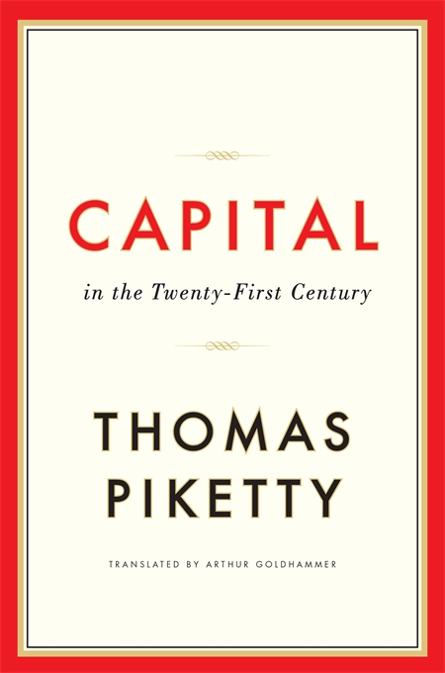
Conclusions & doubts
Current draft: clear pikettyan flavour.
(p. 30-31): “we find that inheritances are very important for explaining wealth transmission. (…) The extent to which economic success is inherited or self-made seems crucial (...) intergenerational persistence in the wealth distribution will grow even stronger in the years to come”
Incentives? Economic growth?

Slide 17
My question measurement
P. 9
we compute an alternative wealth measure, “capitalized wealth” (…) by an assumed real rate of return of three percent and then average across both years
P. 10
estate inventories are always filed individually, while we wish the joint parental wealth at death (...) suggested solution: “peak midparent wealth”
P. 10
“wealth in the first two years is censored from below at zero whereas this is not the case for te last year” (much more in footnote 12)
what is the combined potential impact of the many choices on the final estimates?

Slide 18
Robustness
Calculating a statistical level of confidence in the conventional forms is clearly impracticable
The Authors have devoted a lot of effort to explain, carry out sensitivity exercises, discuss pros and cons.
I really think I should be happy with that.
But I am not.
My suggestion is to cumulate the impacts of selected sensitivity exercises and let the reader know about the result.
In other words, I’d like to go back to the tunnel idea...

Slide 19
As I said, I am NOT asking for standard errors
(And this tunnel, or band, is NOT a confidence interval)

Slide 20

Minor issues
Inter vivos transfers ?
Malmö data
(see picture).

Slide 21
As a way of conclusion
Excited about:
  Nonlinearities in intergenerational associations
  Mechanism analysis: inheritance and human capital (section 6, p. 25): “If death is exogenous, or unanticipated, …”
Worried about:
  P. 30 (conclusions)
  “We find positive but statistically insignificant estimate of grandparents’ wealth in a three generation regression”

