Slide 1


The vulnerability of indebted households during the crisis:
evidence from the euro area
L.Bartiloro, V.Michelangeli and C.Rampazzi
“The Bank of Italy’s Analysis of Household Finances”
Rome, December 4th 2015

Slide 2
Outline
The financial crisis has shown that households’ financial vulnerability plays a pivotal role for financial stability.
We analyse the characteristics that are correlated with vulnerability for the euro area households.
We focus a standard indicator of financial vulnerability and we also compare our findings with those obtained using with the other indicators.
Policy implications of our results

Slide 3
What’s new
Related literature:
Household vulnerability in a country over time (IMF, 2011, 2012, 2013; ECB 2013b; Magri and Pico, 2012; Michelangeli and Pietrunti, 2014)
Household vulnerability in a country with different indicators of financial fragility or over-indebtedness (Bartiloro and Rampazzi, 2013; D’Alessio et al., 2013, among others).
Household indebtedness in the euro area (Bover et al., 2013)
Household mortgage choice in the euro area controlling for macro and financial variables (Ehrmann and Ziegelmeyer, 2013)
In this paper:
Focus on household vulnerability in the euro area countries (Financial stability)
We also evaluate how the main mortgage characteristics are related to household vulnerability (Policy implications)

Slide 4
Household vulnerability
Standard indicator of vulnerability:
DSR=Debt service payments/Income
Low income households may find it difficult to face other general expenses and to accumulate savings in order to offset unexpected negative economic shocks
A household is vulnerable if
its DSR ≥ 40 per cent and
its income is below the median of the population

Slide 5
Household Finance and Consumption Survey
Fist harmonized survey on households’ wealth, debt, income and consumption in the euro area
It is voluntary conducted by national central banks of the euro area member states and coordinated by the ECB
Data are so far available for just one wave and they mostly refer to year 2010.
The total sample of the first edition consists of about 62,000 households and covers 15 euro area countries
We excluded Finland from our sample because of lack of information on debt service and Slovenia because of the very limited sample size. Therefore, our euro area aggregate includes 13 countries.

Slide 6
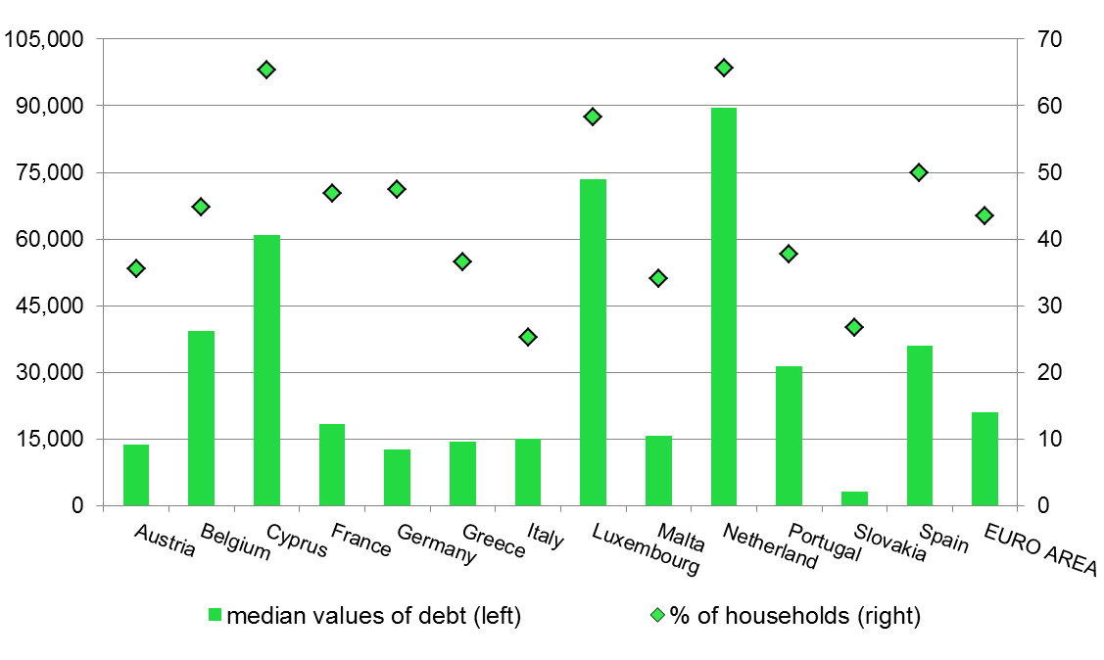
Indebted households: a comparison in the euro area

Slide 7
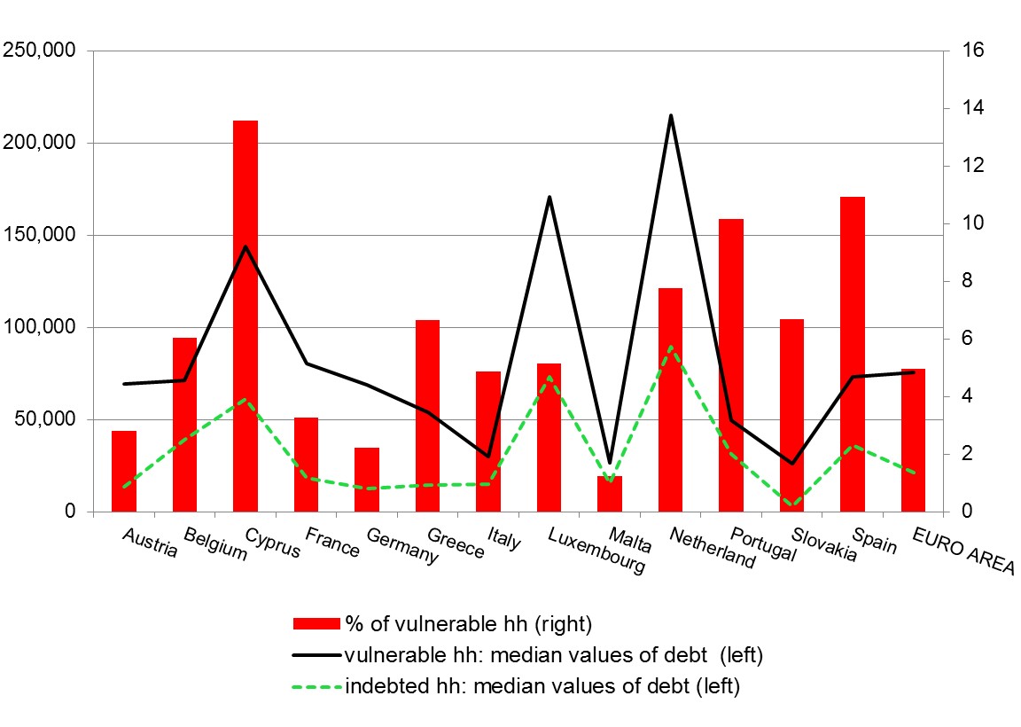
Vulnerable households: a comparison in the euro area

Slide 8
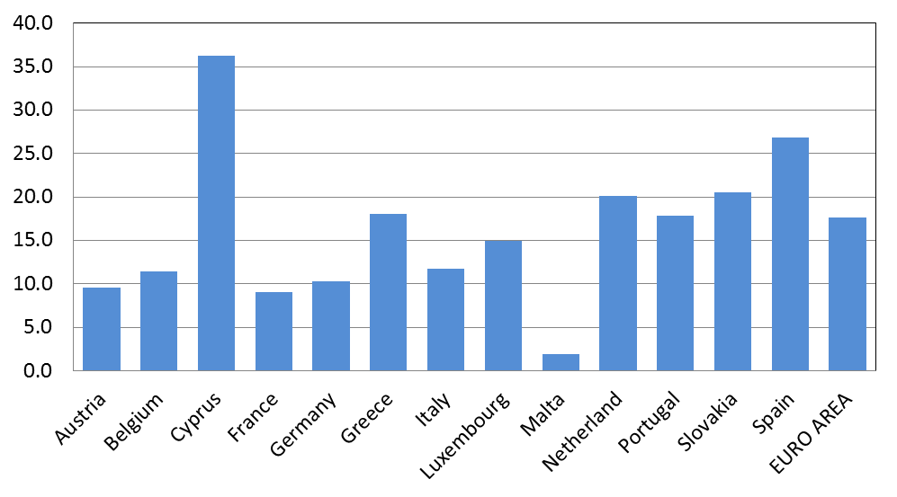
Share of debt held by vulnerable households

Slide 9
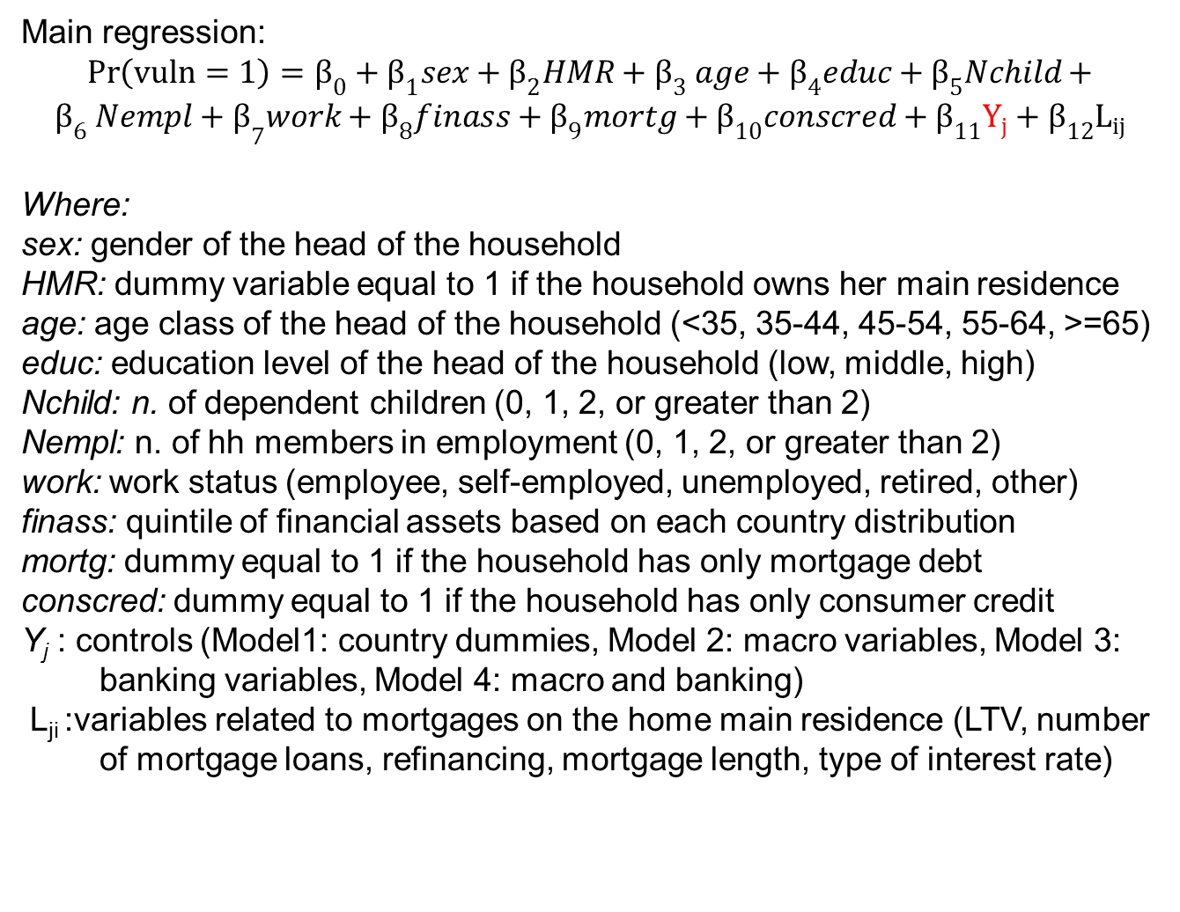
The model
Main regression:
$$\operatorname{Pr}\left(vuln=1\right)=β_{0}+β_{1}sex+β_{2}HMR+β_{3} age+β_{4}educ+β_{5}Nchild+$$
$${β_{6} Nempl+β}_{7}work+β_{8}finass+β_{9}mortg+β_{10}conscred+β_{11}Y_{j}+β_{12}L_{ij}$$
Where:
sex: gender of the head of the household
HMR: dummy variable equal to 1 if the household owns her main residence
age: age class of the head of the household (<35, 35-44, 45-54, 55-64, >=65)
educ: education level of the head of the household (low, middle, high)
Nchild: n. of dependent children (0, 1, 2, or greater than 2)
Nempl: n. of hh members in employment (0, 1, 2, or greater than 2)
work: work status (employee, self-employed, unemployed, retired, other)
finass: quintile of financial assets based on each country distribution
mortg: dummy equal to 1 if the household has only mortgage debt
conscred: dummy equal to 1 if the household has only consumer credit
Y_{j} : controls (Model1: country dummies, Model 2: macro variables, Model 3: banking variables, Model 4: macro and banking)
L_{ji} :variables related to mortgages on the home main residence (LTV, number of mortgage loans, refinancing, mortgage length, type of interest rate)

Slide 10
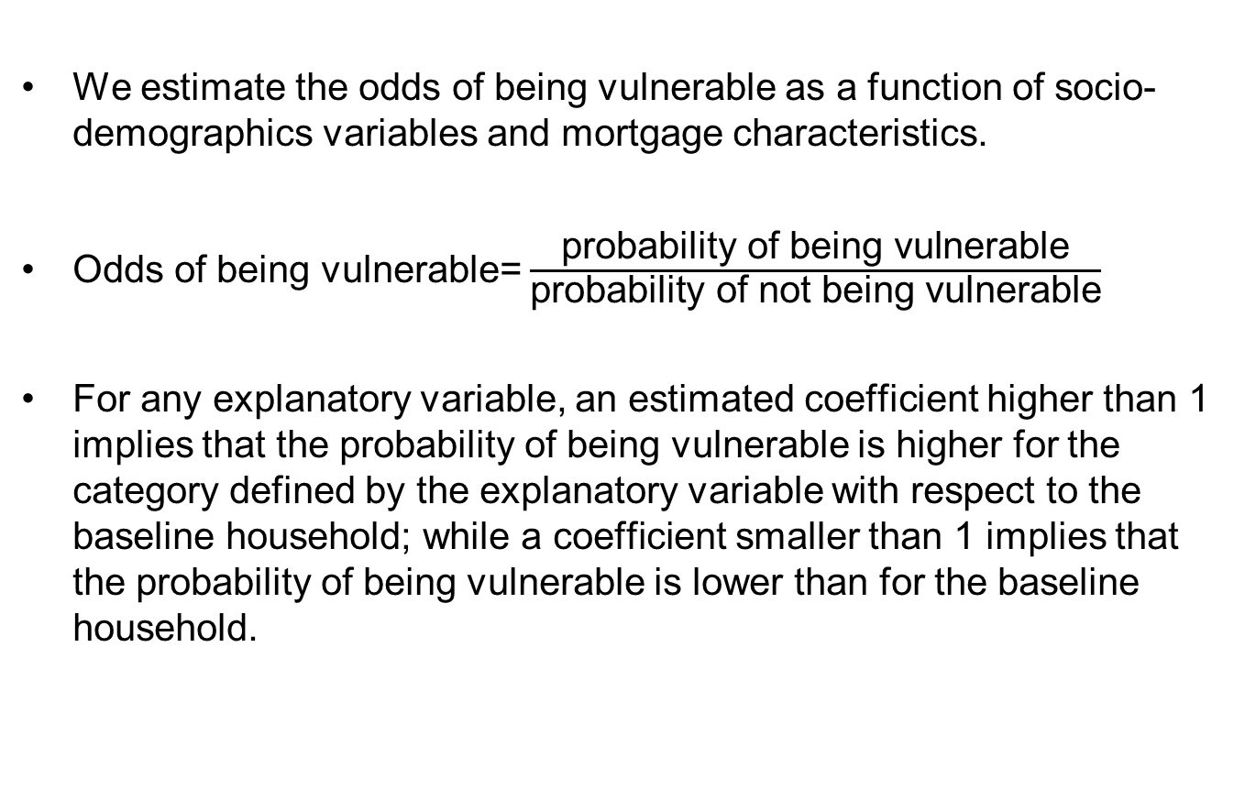
Odds ratios
We estimate the odds of being vulnerable as a function of socio-demographics variables and mortgage characteristics.
Odds of being vulnerable= $\frac{\text{probability} \text{of} \text{being} \text{vulnerable}}{\text{probability} \text{of} \text{not} \text{being} \text{vulnerable}}$
For any explanatory variable, an estimated coefficient higher than 1 implies that the probability of being vulnerable is higher for the category defined by the explanatory variable with respect to the baseline household; while a coefficient smaller than 1 implies that the probability of being vulnerable is lower than for the baseline household.

Slide 11
Baseline household
the head of the household is aged between 35 and 44
employee
medium level of education
two members in employment
no dependent children
first quintile of financial assets
both a mortgage and loans for consumption purposes.

Slide 12
Benchmark logistic regressions

Slide 13
Benchmark logistic regressions only hh with mortgage
All the results with respect to the demographics are confirmed

Slide 14
Other indicators of vulnerability
debt to income ≥3: long-run ability of repaying accumulated debt given the future stream of income
net wealth < 0: long-run ability of repaying accumulated debt given the accumulated savings
income - debt payments < food expenses: short-run ability to face expected expenses
financial assets < 2 months of income: short-run ability to face unexpected expenses

Slide 15
Other indicators of vulnerability (Cont.)
Heterogeneity across euro area countries ….
 | memo: hh with any debt | DSR>=40% & income<median | Debt/income>=3 | Net wealth<0 | Income-debt payments<food expenses | Liquid asset< 2 months of income | N° indicators >Euro area mean
Austria | 35.6 | 2.8 | 9.2 | 14.8 | 2.9 | 36.8 | 1
Belgium | 44.8 | 6.0 | 15.0 | 6.0 | 8.0 | 44.3 | 2
Cyprus | 65.4 | 13.6 | 31.5 | 4.4 | 13.6 | 56.8 | 4
France | 46.9 | 3.3 | 12.4 | 8.3 | 1.2 | 47.5 | 0
Germany | 47.4 | 2.2 | 11.3 | 15.7 | 2.3 | 49.0 | 1
Greece | 36.6 | 6.7 | 12.2 | 6.9 | 5.5 | 72.4 | 3
Italy | 25.2 | 4.9 | 11.0 | 5.7 | 5.1 | 50.5 | 2
Luxembourg | 58.3 | 5.1 | 20.6 | 6.5 | 3.2 | 44.1 | 2
Malta | 34.1 | 1.2 | 10.5 | 2.4 | 3.2 | 20.8 | 0
Netherland | 65.7 | 7.8 | 35.2 | 17.7 | 8.7 | 42.9 | 4
Portugal | 37.7 | 10.2 | 28.3 | 6.8 | 9.1 | 53.8 | 4
Slovakia | 26.8 | 6.7 | 11.4 | 4.4 | 6.0 | 70.7 | 3
Spain | 50.0 | 10.9 | 24.2 | 6.9 | 6.6 | 57.0 | 4
EURO AREA | 43.4 | 5.0 | 16.0 | 10.9 | 4.1 | 49.9
… but the main results are confirmed: being self-employed, a reduction in the n. of employed members, lower financial assets increase the odds of vulnerability in a significant way.

Slide 16
Building a unique indicator of vulnerability
Combine the different indicators of vulnerability
Weights obtained using the principal component analysis (First component)
We obtain a continuous variable (OLS regression)
Provide a synthetic representation of vulnerability

Slide 17
Vulnerability index (PCA weights):
OLS regression

Slide 18
Vulnerability index (PCA weights):
OLS regression - only hh with mortgage
All the results with respect to the demographics are confirmed

Slide 19
Conclusion
Large heterogeneity in the euro area with respect to the share of indebted households and of the debt at risk.
Some common aspects relevant for financial stability:
Strong correlation between self-employment and vulnerability, which may suggest the implementation of some policy initiatives to support the liquidity of self-employers (financial education, efficient mortgage insurance market)
Higher LTV is associated with higher vulnerability, while no effect has been detected for the number of mortgages or their duration.
Main policy implication: this analysis provides support for the introduction of limits to LTV ratios for macroprudential purposes.
Our benchmark indicator is a good measure of financial distress in the household sector. It is therefore crucial that macro-prudential authorities work on a unique, correct and exhaustive way of using the DSR in order to identify vulnerable households.

