Slide 1
Wealth and its returns: economic inequality in Italy, 1995-2014
by R. Gambacorta and A. Neri
Bank of Italy - Statistical Analysis Directorate

Slide 2
Aim of the paper
Describe trends in economic inequality in Italy in the last two decades (1995-2014).
Until recently research on economic inequality was mainly focused on the distribution on households’ income. More recently attention has shifted also to the role of wealth to explain households wellbeing.
Question: How can we combine these two components to describe the overall household economic situation? What is the role played by wealth and its returns in explaining economic inequality?
Survey data are affected by under-reporting and non-response that may affect this indicator.
Question: How do these errors affect the level and the dynamic of economic inequality and the role played by wealth and its returns?

Slide 3
The Survey of Household Income and wealth
Target variables: income, wealth and other socio-economic indicators.
Time span: since 1965 (yearly up to 1986; since 1987 every two years)
Sample: 8,000 households representative of the Italian population
In the period 1995-2014 definitions of income and wealth stable
Availability of external information that can be used to construct adjustments to correct for the presence of measurement errors.

Slide 4
Income net worth indicator: motivations
Measurement of economic well-being should include not only income but also wealth.
Wealth provides insurance against income risks and allows households to smooth consumption.
Particularly important in Italy where wealth has historically played a major role in shaping household’s fortune (the ratio W/Y grow from 5 to 8 between 1991 and 2012, falling back to 7.15 in 2014).
Role of precautionary saving enhanced in period of augmented instability of working conditions and by the worsening of expectations about pension endowments.
Need for a measure of household welfare that combines households disposable income with the share of wealth that can be potentially dissaved and transformed into consumption.

Slide 5
Income net worth indicator: definition
Income net worth indicator (Weisbrod and Hansen, 1968):
r is the discount rate and n is the lenght of life expectancy.
Wealth is converted into a stream of constant annuities and added to income.
This indicator is affected by age (older people will have shorter life expectancy and thus a larger annuity) and it is computed as if individuals would consume completely their assets.
In practice we use the life expectancy of major income earner within the family and a discount rate of 2 per cent. Income and wealth have been converted in equivalent terms to account for variations in the size and composition of households.

Slide 6
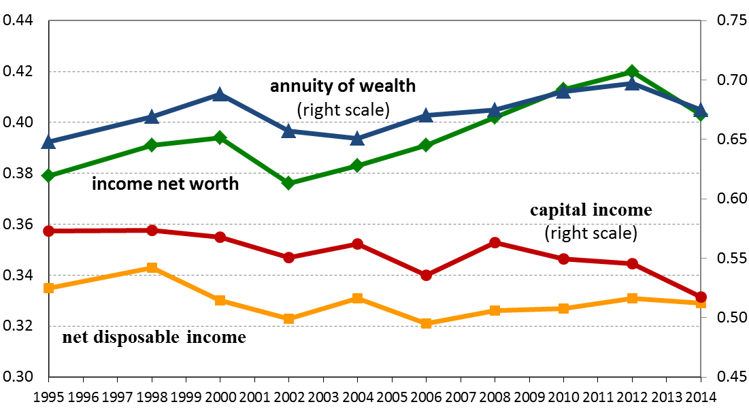
Income net worth inequality
We observe an increase in income net worth inequality by 2.4 percentage points.
Inequality in YW is higher than Y, mainly because of the influence of the annuity of wealth, which is more concentrated than income.
The annuity component shows a sharper increase in inequality from 2006 to 2012 and a more pronounced reduction in the last survey.
Wealth and its returns contribute to about 60 percent of overall YW inequality
Gini index of income net worth and its components
(1995-2014)

Slide 7
Wealth and its returns in the SHIW
Measurement errors and under-reporting inevitably affect survey data and in particular wealth and its returns.
Real wealth: households are asked to report all the properties they own (dwellings, land…) and for each one its value, and their return (effective or imputed rents).
Financial wealth: households are asked to report the ownership of a set of different instruments (deposits, government bonds, shares, mutual funds, ..) and their value (unfolding bracket approach). Financial incomes are estimated by applying average market rate returns to stocks.
The stock of wealth and its return are strictly related: any error in the estimation of the level of wealth will also affect its returns.
To account for these factors we use some methods trying to adjust for non-response and under-reporting.

Slide 8
Adjusted data
The time span is 1995-2012.
Methodology based on D’Alessio Neri (2015).
The first adjustment (ADJ) combines the main corrections (in particular weighting for non-response and correcting for under-reporting on secondary dwellings and on financial wealth).
Starting from the previous adjustment we also consider a second adjustment (ADJ_CAL) that calibrates data to make survey based estimates as close as possible to the macro statistics (National Accounts and Financial Accounts) after aligning the definitions (single components of income and wealth)
All adjustments for measurement errors are based on statistical matching techniques.

Slide 9
Real wealth adjustment
In the case of real wealth measurement errors mainly relate the under-reporting of the number of secondary properties.
The imputation model:
  Step 1: use unadjusted data to estimate the probability a household owns one or more dwellings as a function of socio-demographic characteristics.
  Step 2: calculate the missing dwellings as the difference between the number of houses in the SHIW and those resulting from the census.
  Step 3: Use the probabilities calculated in step 1 to distribute the missing dwellings.
  Step 4: Value the imputed houses taking into account the tendency of respondents to overestimate their belongings.
The correction method increases the share of households in the top tail of the distribution and reduces the share of those who don’t report any property. The average value of real wealth is increased by 12 percent.
Adjusted data show higher level of inequality.

Slide 10
Financial wealth adjustment
Financial wealth is the wealth component mostly affected by under-reporting.
The adjustment is based on a survey conduced among bank customers of a major Italian bank (D’Aurizio et al. 2006).
  Reticence is measured as the difference between customer declarations with real data on the stock they held.
  Probability of non-reporting and mis-reporting of the amounts are estimated as a function of the amounts declared and of socio-demographic characteristics.
  Assume that the estimated coefficients remain unchanged over time.
  Impute financial asset ownerships and adjust for misreporting on amounts.
The final imputed households financial average assets are almost 3 times higher than original.
The adjustment cause a reduction in financial wealth inequality

Slide 11
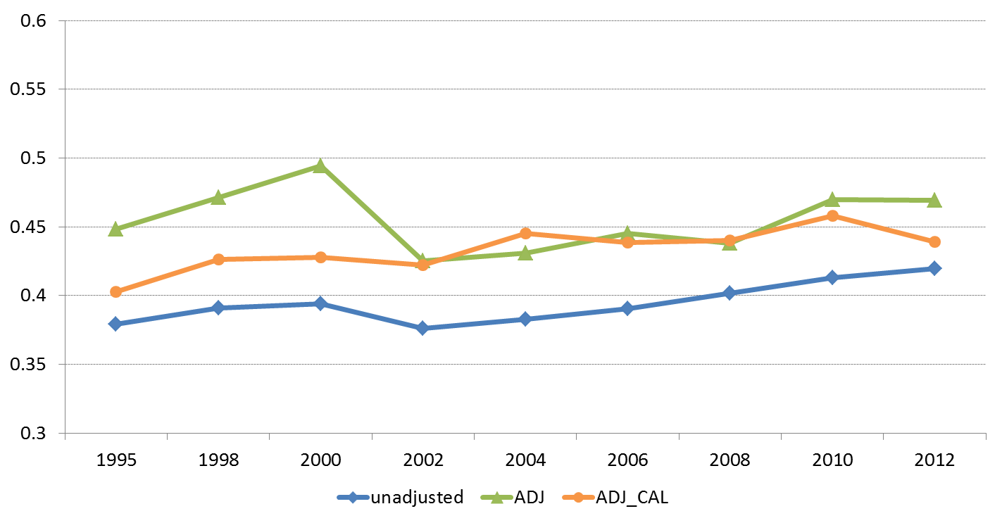
Results
Adjusted data are not a benchmark, but can be used as a robustness check.
Economic inequality is in general higher when using imputed data.
The use of imputed data increases the variability of the estimates. Calibration seems to improve this aspect.
Adjusted data confirms the increase in income net worth inequality between 1995 and 2012.
Gini index of income net worth
(1995-2014)

Slide 12
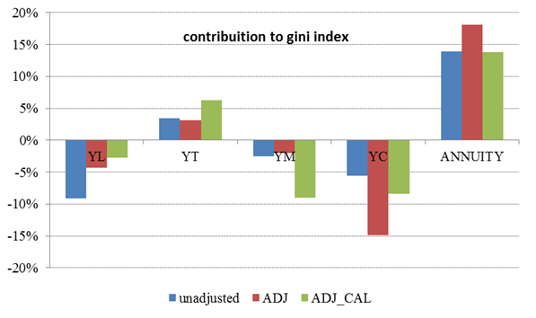
Results
The importance of wealth and its returns in explaining economic inequality is confirmed when using adjusted data (in general even larger).
Adjusted data confirms that the 1995-2012 increase in YW inequality has been mainly driven from the annuity component, while we observe a negative contribution of capital incomes (both the share on YW and the level of inequality decreased over time)
Percentage contribuition to the variation of Gini index of income net worth
(variation 1995-2014)

Slide 13
Conclusion
  All the estimates confirm the relevance of wealth and its returns in explaining economic inequality (60% - 75%) measured with YW.
Not accounting for measurement errors leads in general to an underestimation of economic inequality:
  Survey data under-represent households at the tails of the distribution;
  Rich households are more likely to under-report their secondary dwellings.
Main results about YW inequality dynamic are confirmed:
  Increase in inequality mainly driven from the increase of the annuity component.
  Decrease of inequality in capital income component

Slide 14
Further research
Use different specifications for life expectancy and discount rate in the computation of YW.
Inequality decomposition by socio-economic characteristics - use non parametric decomposition methods.
Update adjusted data (2014).

Slide 15
Wealth and its returns: economic inequality in Italy, 1995-2014
THANK YOU
FOR YOUR ATTENTION
by R. Gambacorta and A. Neri - Bank of Italy - Statistical Analysis Directorate

