Slide 1
Structural balance macro imbalances and fiscal surveillance
Comments on the papers by Gilbert and Hessel
and by Hernández de Cos and Jimeno
Lucio R. Pench
Director for Fiscal Policy
European Commission, DG Economic and Financial Affairs
15th Banca d'Italia Workshop on Public Finance
Notes:
I will discuss the two papers that were made available in draft. They have a common feature: how to conduct surveillance of fiscal policies around a major economic disruption ("a turn in financial cycle", "financial crisis"). The first paper looks at challenges in ex ante surveillance (a bit like "could we see it coming?"), the other paper discusses if and what fiscal policy can do to facilitate adjustment. My discussion will be form the angle of EU fiscal governance and its recent reform, where I have been directly involved.

Slide 2
N. Gilbert and J. Hessel:
The Financial Cycle and the European Budgetary Reversal During the Crisis: Consequences for Surveillance

Slide 3
Structural budget balance: nobody is perfect
Adjusting the nominal budget balance from the business cycle and the one-offs:
Uncertainty:
Assessment of potential output and cyclical conditions in real time
Sort-term fluctuations in the elasticity of taxes with respect to GDP
Uncertainty larger at the time of crisis, rapid structural change etc., but still
advantages relative pure nominal approach
'Learning to live with it': Public Finances in EMU (2008), Larch & Turrini
(2009), Lendvai et al. (2011).On tax elasticities: Barrio and Fargnoli (2010) and
Princen et al (2013).
Notes:
Structural budget balance:
SB – structural balance
BB – nominal balance
ε – budgetary sensitivity parameter (semi-elasticity)
In the early years, the EU fiscal surveillance was based exclusively on headline figures, but its shortcomings manifested themselves very quickly: untenable pro-cyclical prescriptions. The problems with a pure nominal approach led to the 2005 reform of the Stability and Growth Pact. The introduction of structural balance to surveillance can still be considered a major step forward, but it brings its own problems:
Assessment of potential output and cyclical conditions in real time
Fluctuations in the elasticity of taxes with respect to GDP (in turn, resulting from fluctuation of tax bases around their structural level differing from those of GDP and from fluctuation of in the elasticity of taxes vis-à-vis their tax base)
These uncertainties are larger at the time of major economic fluctuations – Larch and Turrini (2009) show it by reference to the burst of ICT bubble.
We are very well aware of these shortcomings, policy if always done under uncertainty and we keep learning to deal with that:
PFR (2008): Improving the estimation of the structural budget balance; Larch and Turrini (2009): The cyclically-adjusted budget balance in EU fiscal policy making: A love at first sight turned into a mature relationship; Lendvai et al: From CAB to CAAB? Correcting indicators of structural fiscal positions for current account imbalances. Tax elasticities – and particularly the impact of discretionary measures on apparent elasticities have been investigated in Barrios and Fargnoli (2010): Discretionary measures and tax revenues in the run –up to the financial crisis' and Princen et al. (2013 forthcoming): a conclusion is that both gross and net elasticities exhibit large short-term departure from their long-run values but average aroud one in the EU over the long-term.

Slide 4

Implications for surveillance
The 'preventive arm' of the SGP
Medium-Term Objective:
(i) a safety margin against breaching 3% of GDP;
(ii) sustainable public finances or rapid progress towards sustainability;
(iii) room for stabilisation over the cycle
Adjustment path towards MTO: 'two-pillar' approach (SB; EB)
  Structural balance
  Expenditure benchmark
  Overall assessment
Overall assessment: reconciling the differences
Notes:
In the preventive arm of the SGP the structural balance plays a role in defining the medium-term objective and the adjustment path towards it. When assessing progress towards the MTO, the recent reform of the SGP has introduced a complementary indicator, the expenditure benchmark (EB), which, focusing on expenditure evolving at a medium-term rate of growth and net of discretionary revenue measures (G), avoids some of the problems of the structural balance.

Slide 5
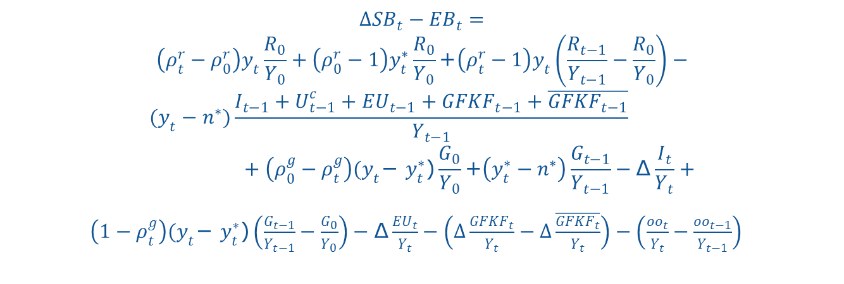
Comparing the change in the structural balance (ΔSB) with deviations from the expenditure benchmark (ΔEB)(I)
Trend increase in revenue ratio linked to potential growth
Deviation of actual weights (share of revenues in GDP and share of each tax in total revenues) from those used in CAB
Revenue windfall/shortfall
Trend increase in the medium-term revenue ratio due to the difference between the medium-term potential and the actual GDP growth rates
Deviation of actual elasticity of unempl. benefit expenditure from average
Change in interest payment exp.
Effect of a change in exp. matched by EU funds
Deviation of actual weights (share of exp. in GDP and share of unempl. benefit in total exp. ) from those used in CAB
Effect on the exp. side of the deduction of one-off measures from SB but not EB
Effect of a difference from annual GFKF spending
Effect on the exp. ratio of the difference between current and medium-term potential growth

Slide 6
Comparing the change in the structural balance with deviations from the expenditure benchmark (II)
Revenue side | Expenditure side
Windfalls/shortfalls due to divergences between observed and standard elasticities used for the cyclical adjustment (ΔSB)…
… of revenue | … of unemployment benefit expenditure
Changes from the fixed weights used for the cyclical adjustment (ΔSB)…
…in revenue/GDP ratio and in composition of revenue | …in the expenditure/GDP ratio and in composition of expenditure
One-offs or temporary measures (netted out in ΔSB but not in ΔEB)
Divergences due to a different base for revenue-to-GDP growth in both indicators… | Divergences due to corrections to the expenditure aggregate in EB
… linked to annual potential GDP growth, using a standard elasticity, in ΔSB. …linked to the difference between a reference rate of medium-term potential and actual GDP growth, in EB. | Annual change in interest payments
 | Deviation of gross fixed capital formation from 4-year average (peak smoothed by EB)

Slide 7
Implications for surveillance
The 'corrective arm' of the SGP
  Assessment of 'effective action' - ex-post assessment of action in response to Council recommendation
  Change in structural balance adjusted for:
    The impact of revisions in potential output
    The impact of revisions on the composition of economic growth or of other windfall/shortfall on revenue
    Possible impact of other unexpected events on the general government financial situation, not related to the above
  Hedging our bets: 'bottom-up' approach
Notes:
In the corrective arm of the SGP, the assessment of 'effective action' on the part of the Member state in EDP allows for correcting the bias that forecast errors in revenue elasticities and potential GDP introduce in the change in the structural balance as metrics of adjustment. Apart from this "top-down" approach we also implement the "bottom-up" approach, which is summing up all the measures introduced by the authorities.

Slide 8
Implications for surveillance – The 'corrective arm' of the SGP: The EDP 'decision tree'

Slide 9
Implications for surveillance
The limits of fiscal rules and indicators (I)
  "EMU countries would therefore only have been able to stay within the 3%-deficit ceiling if they had originally targeted – on average – a surplus of over 2% of GDP for 2009"
  Need to match the causes and the tools: macro-prudential policy, resolution framework, Macroeconomic Imbalances Procedure
  Introducing short-term indicator for fiscal stress risk (S0)
Fiscal Sustainability Report 2012 – results
Notes:
The authors write: "EMU countries would therefore only have been able to stay within the 3%-deficit ceiling if they had originally targeted – on average – a surplus of over 2% of GDP for 2009"
Would it have been appropriate, however? Is the role of fiscal policy to insure against financial risks and financial crises? There are other, more targeted tools to do that.
At the same time we have become increasingly aware that macro-financial conditions are a good predictor of fiscal stress. S0 is a recently introduced composite indicator of fiscal stress risks (based on 28 variables). Sub-indexes are elaborated based on the two sub-groups of variables (fiscal and macro-financial-competitiveness (the latter largely consistent with the MIP scoreboard)). Values of S0 beyond critical threshold (endogenously determined) signal fiscal risks one year ahead. In fact, the signalling power of the macro-financial-competitiveness sub-index is superior to that of the fiscal sub-index. It doesn't have a formal role in our surveillance, but we integrate it in our assessment.

Slide 10
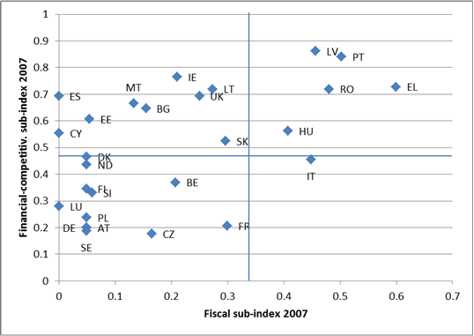
Implications for surveillance
The limits of fiscal rules and indicators (II)
Notes:
Would an early-warning indicator such as S0 helped to detect the crisis and its fiscal consequences? Looking at values of S0 indicator at the eve of the crisis (2007), one can say that the countries that would become programme countries tend to stand out. EL, PT, LV and RO are the furthest away from the safe area under both dimensions (fiscal and financial-competitiveness). On the other hand, IE stands out as the worst (furthest away from the threshold) among the countries displaying problems in 2007 only on the financial-competitiveness side. Both ES and CY already displayed problems in 2007 on the financial-competitiveness side, but no problems at all on the fiscal side.

Slide 11
P. Hernández de Cos and J.F. Jimeno:
Fiscal Policy and External Imbalances
Under a Debt Crisis: Squaring the Circle

Slide 12
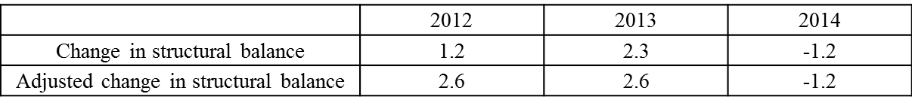
Aftermath of the crisis:
What can the EU do?
EU fiscal framework
  Focus on sustainability
  Introducing predictability in policy decisions
  Robust analytical framework
  Recent improvements ('Six Pack', 'Two Pack') strengthening surveillance reducing the risk of policy errors, both ex ante and ex post.
  .
  EU Economic policy framework
  Macroeconomic Imbalances Procedure
  European Semester
  EU Financial architecture
  ESRB
  European Supervisory Authoriti(es)
Spain – change in structural balance adjusted for forecast errors
Notes:
The EU fiscal policy framework has been improved to help policy-makers avoid 'gross errors' while allowing factoring in forecast errors in assessing the policy response of countries in EDP (the case of Spain is a good illustration).
But it also has to be seen in conjunction with the other elements of EU economic policy framework and the EU financial architecture.

Slide 13
Aftermath of the crisis:
What can the EU do?
EU fiscal framework
  Focus on sustainability
  Introducing predictability in policy decisions
  Robust analytical framework
  Recent improvements ('Six Pack', 'Two Pack') strengthening surveillance reducing the risk of policy errors, both ex ante and ex post.
  EU Economic policy framework
  Macroeconomic Imbalances Procedure
  European Semester
  EU Financial architecture
  ESRB
  European Supervisory Authoriti(es)
Spain – change in structural balance adjusted for forecast errors
Notes:
EU fiscal policy framework is well equipped to help policy makers follow the right path in the aftermath of the crisis (what is the right path – next slide). The methodology to assess effective action based on correcting forecast errors proved very useful at the current juncture – see example of ES.
But it also has to be seen in conjunction with the other elements of EU economic policy framework and the EU financial architecture.

Slide 14
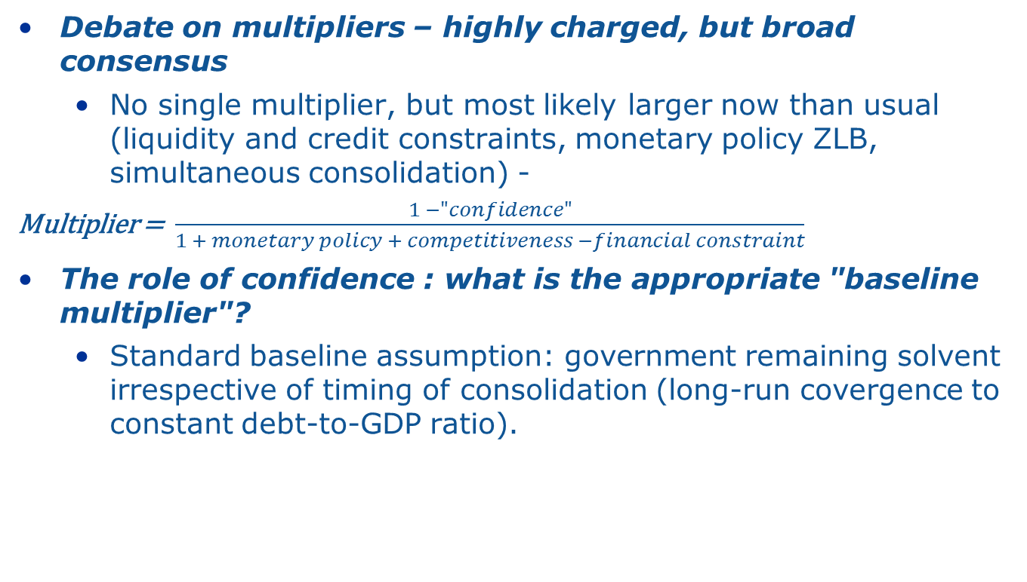
Aftermath of the crisis:
What can fiscal policy do?
Notes:
"Charlemagne consensus":
- no single fiscal multiplier across fiscal variables, countries or time;
- Multipliers likely to be larger after bursting of an asset bubbles and when monetary policy is constrained (at zero bound or problems with transmission); balance-sheet recessions
- Adjustment taking place simultaneously in most countries
Credibility of the consolidation (expressed in terms of its composition, combination with reforms, effectiveness of the national fiscal framework, perception of fairness of the consolidation) tends to reduce the multipliers through (i) non-keynesian wealth effects on consumption and investment and (ii) effects on risk premia;
What is appropriate multiplier for comparison?
Standard baseline assumption in multiplier analysis: Government remains solvent irrespective of consolidation timing (long run growth convergence to constant debt to GDP ratio).
However, in the current juncture with private sector deleveraging, bank rescue measures and rising NAWRUs, some countries are on a potentially explosive debt trajectory.
Therefore, an alternative "no consolidation" scenario with sovereign debt restructuring, or at least private sector expectation of debt restructuring, may be a more realistic baseline.

Slide 15
Fiscal multiplier with alternative baseline – A stylised experiment
GDP/Trend
Baseline, no default
Multiplier >0 (0.8)
Consolidation
Multiplier<0 (-1 to -3)
Baseline, partial sov. default
t0 t1
t
First year GDP effect of permanent fiscal consolidation: -0.8
First year GDP effect of expected debt restructuring: (-2 to -4)
Notes:
QUEST model with a banking sector
Th eexperiment allows us to explore how sovereign debt restructuring affects the economy via losses inflicted on the banking system.
Experiment:
Government reduces expenditure (by 1% of GDP) until debt is reduced by 10% of GDP.
Standard Baseline: Government remains solvent in the absence of a fiscal consolidation
Alternative baseline: Government is expected to default on 10% of its debt in year 2 (40% on banks, 60% on households)
We assume an "orderly" restructuring (no stock market panic, no expectation of EMU exit).
Banks hold government perpetuities: expected default leads to a capital loss on the banks' balance sheet in current period
Banks face capital requirement constraint and have to recapitalise.
Banks can raise equity in the domestic stock market, but not internationally.
The broader policy conclusion is that it is not irrational for policy-makers to pursue consolidation even when in the central scenario it will be more costly than normal when there is a plausible tail-risk scenario of debt unsustainability.

Slide 16
Aftermath of the crisis:
What fiscal policy cannot do now?
Agree with authors: no space at the current juncture to postpone consolidation to "make space" for private sector deleveraging
Deleveraging need to progress in both private and public sector
Shifting private debt to public debt - à la Eggertsson & Krugman (2012) - not a solution
  Public debt too high – sustainability risk
  Large foreign debt (Spain is not Japan)
  What about the role of inflation?

Slide 17
J. Cunha and C. Braz:
Presentation on Macroeconomic Imbalances and Fiscal Policy in Portugal

Slide 18
"The difficult case of Portugal"*
  Vulnerable situation before the crisis: low growth, low productivity, high unemployment, large fiscal and current account deficits – need for a comprehensive approach, fiscal policy only one aspect.
  Concerning fiscal policy:
  Portugal case vindicating reforms of EU fiscal framework:
      Expenditure benchmark
      National fiscal framework directive
      More intrusive surveillance and tighter coordination
  But currently only ex post avoidance of policy errors relevant (correction for forecast errors in EDP recommendantion).
* Quote from Blanchard O., (2006), "Adjustment within the euro. The difficult case of Portugal"

