Slide 1

The Economic Progress of Italy
Salvatore Rossi

Slide 2
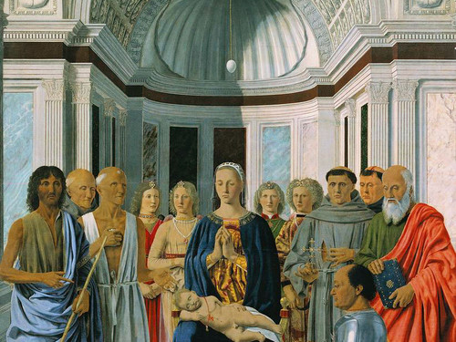
Piero della Francesca, Sacred Conversation, 1472

Slide 3
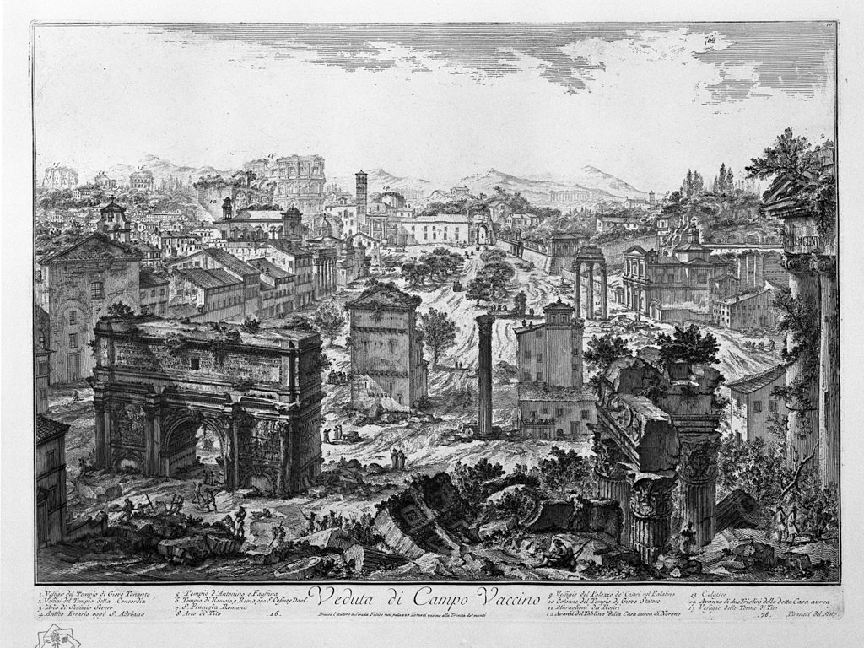
Giovanni Battista Piranesi, View of Rome, 1751

Slide 4
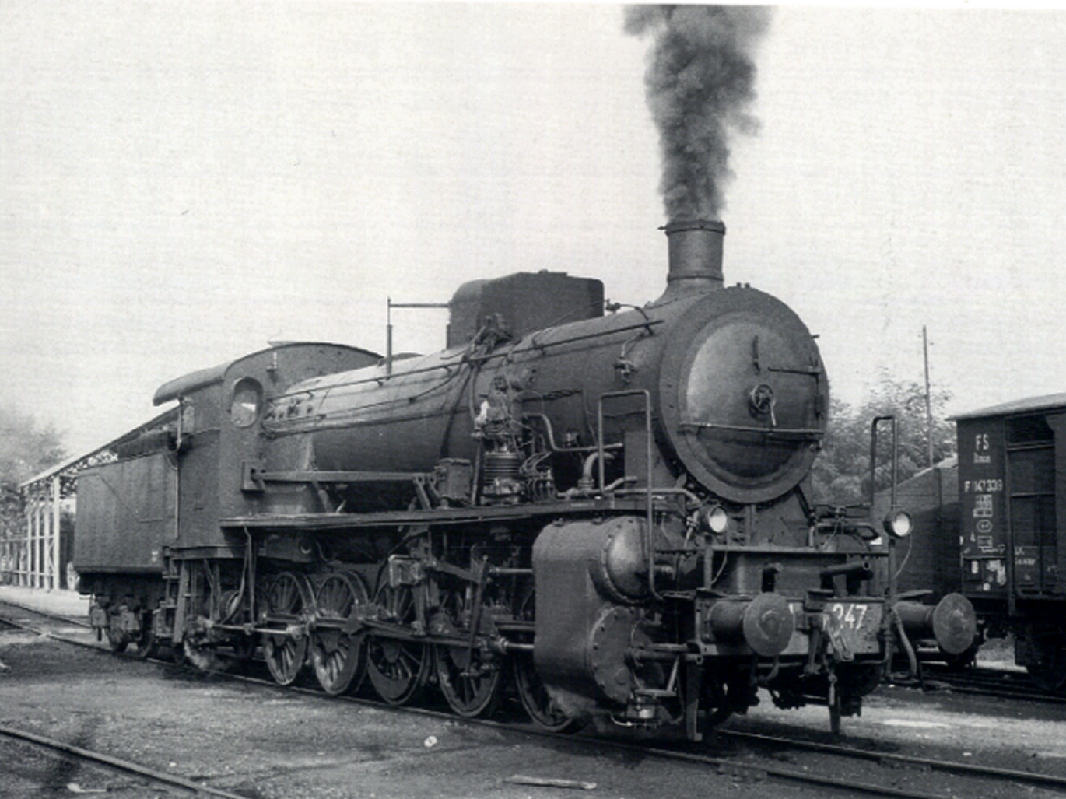
FS 470 Locomotive, produced by Officine Meccaniche di Milano, 1910

Slide 5
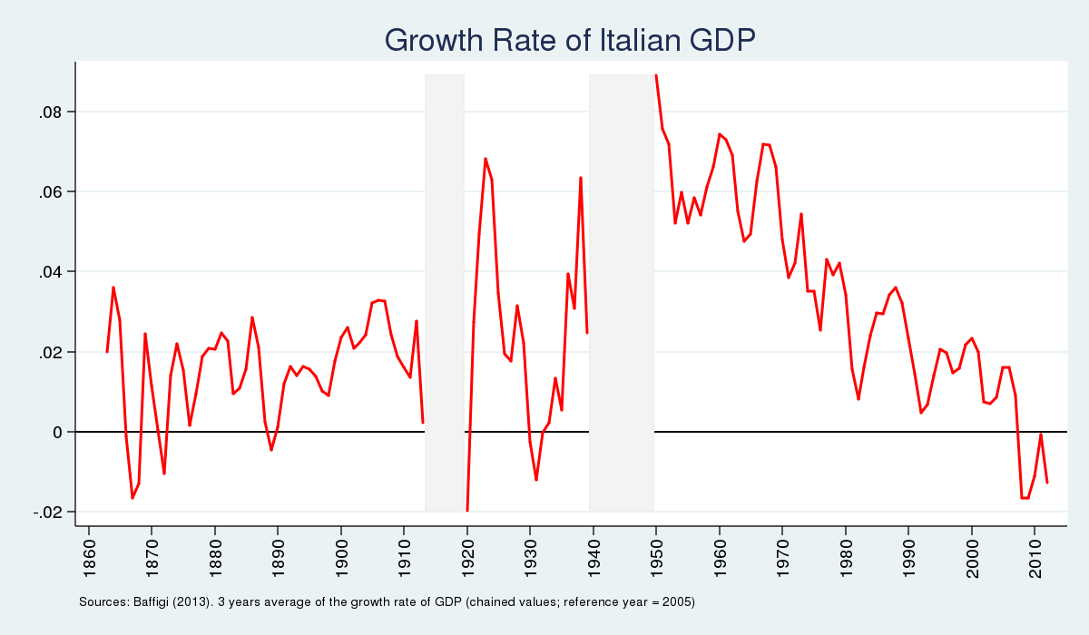

Slide 6
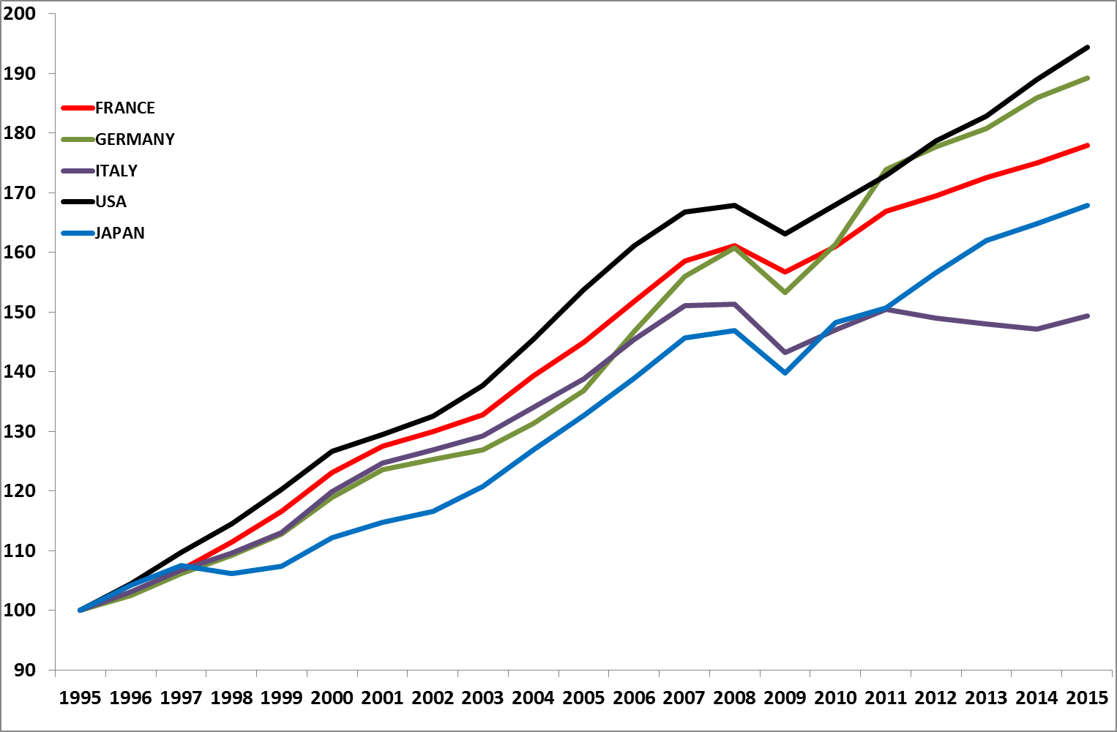
GDP Per Capita
PPP Dollars (1995 = 100)
Source: IMF World Economic Outlook

Slide 7
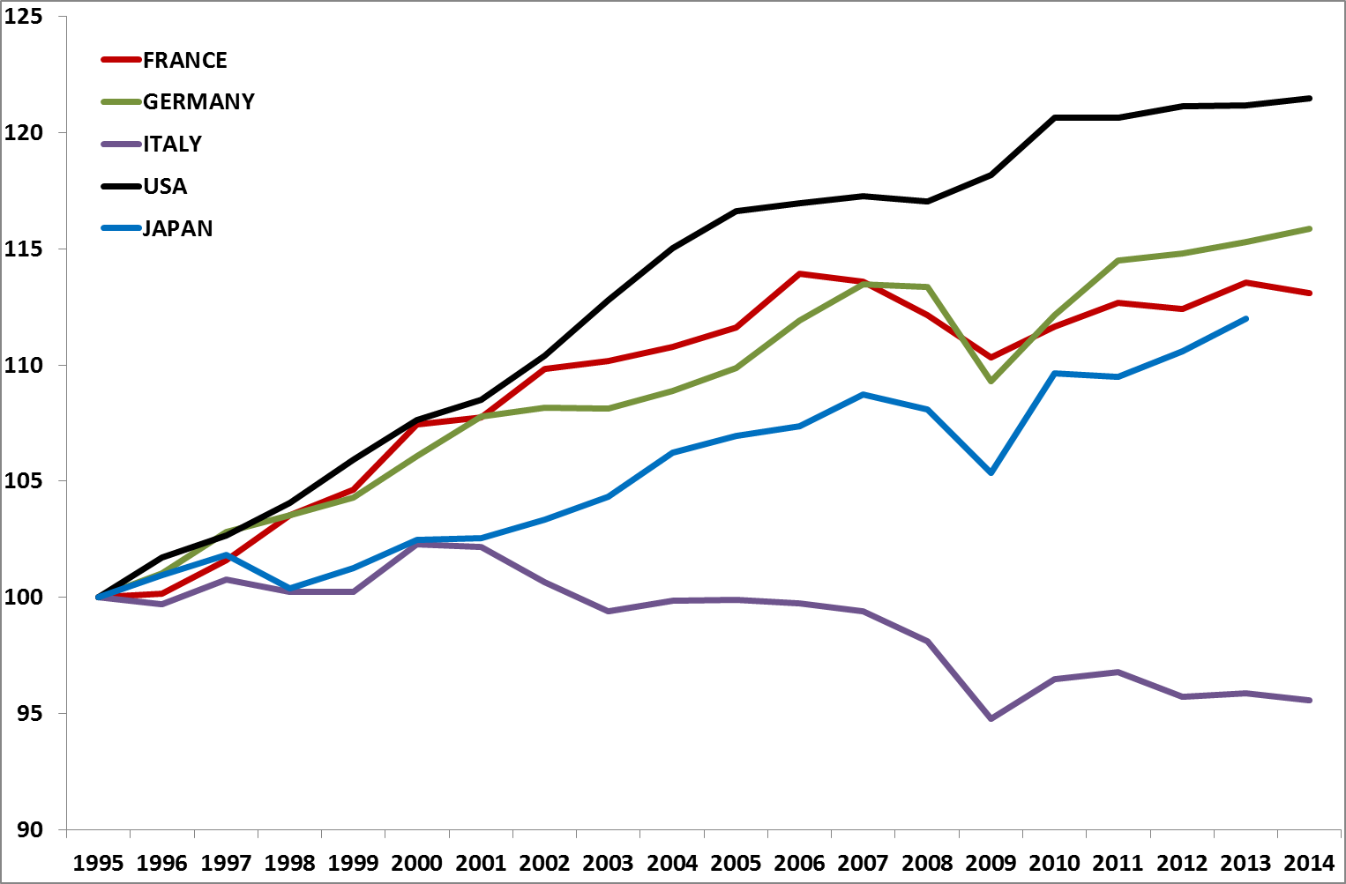
Total Factor Productivity
(1995=100)
Source: OECD Productivity compendium indicators

Slide 8
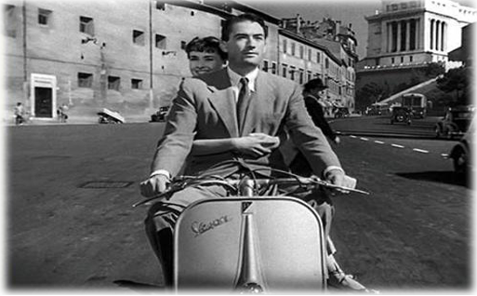

Slide 9
