Slide 1
Income shocks, consumption, and risk aversion
Discussion of papers presented in
Alfonso Rosolia
The Bank of Italy’s Analysis of Household Finances
Fifty Years of The Survey on Household Income and Wealth and the Financial Accounts
Rome, 3-4 December, 2015

Slide 2
Jappelli&Padula: The consumption and wealth effects of an unanticipated change in lifetime resources
1. TFR of public employees becomes a different financial product: it is riskier (compounded effect of inflation changes agains a fully indexed bond) → maybe effect is not due to lower anticipated value of severance payment but need to increase precautionary savings - can you tell tell them apart?
2. Are we sure that everything that happens in POST (except change in TFR rule) affects public and private employees in the same way?
→Riskiness of TFR returns INCREASES for public but DECREASES for private
→Relative wage developments are favourable to public employees
→Income and employment risks matter more for private employees and risks or macro volatility is lower in POST than PRE

Slide 3
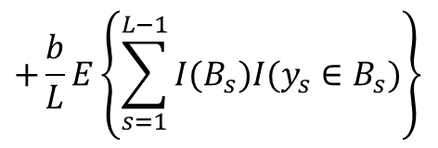
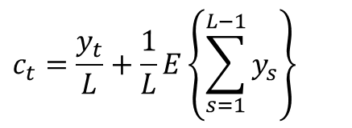
Neri&Rondinelli&Scoccianti: The marginal propensity to consume out of a tax rebate: the case of Italy
(Permanent/Temporary) policy vs income shock.
→ What do we measure? What can it be used for?
$$c_{t}=\frac{y_{t}}{L}+\frac{1}{L}E\left\{\sum_{s=1}^{L−1}{y_{s}}\right\}$$
$$+\frac{b}{L}E\left\{\sum_{s=1}^{L−1}{{I(B_{s})I(y}_{s}∈B_{s})}\right\}$$
$$+\frac{b}{L}{I(y}_{t}∈B_{t})$$
$${c_{t}}_{}^{T}−{c_{t}}_{}^{C}=\frac{b}{L}+\frac{y_{t|y∈B}−y_{t|y∉B}}{L}+\left(E_{y∈B}−E_{y∉B}\right)\frac{b}{L}$$
Most likely an upper bound to MPC out of tax rebate.
Most DD or RD would miss the EPDV of the bonus; whether this is relevant or not (i.e. different between treated and control) hinges on income process given y(t)
None of these empirical designs can be extrapolated to infer macro impact.

Slide 4
Guiso&Sapienza&Zingales: Time varying risk aversion
Correlation (QL,QN) not very meaningful: QL categorical, QN brackets
→ show joint distributions
Unclear what «change in RA» means for categorical variables
→use proportions «up» and «down» in empirical analysis.
Interval regressions? Used for dependent variables not for explanatory ones
→use dummies on the RHS and check they line up as expected
Tab VII has important rob checks (can’t make sense of sample sizes, though):
→ SE on «changes» and not only on diff between them;
→ Only control for employment in ’07, how about current one which shapes current risks? (portfolio efficiently combines all sources of risk)
Higher RA could be trend rather than response to shock→ Enter the lab
Control group? Shrek , Wizard of Oz or Zabriskie point?
approx 1/4 drops out from T. Only measure RA of endurers and C? Do we know anything about T-dropouts? Direction of bias unclear as liking horror movies orthogonal to RA. Less RA take more risks, thus enter the show and leave if don’t like? Experiment more like an option with bounded losses.

Slide 5
Thanks and, again, …congratulations for the good work.

